Slide 1
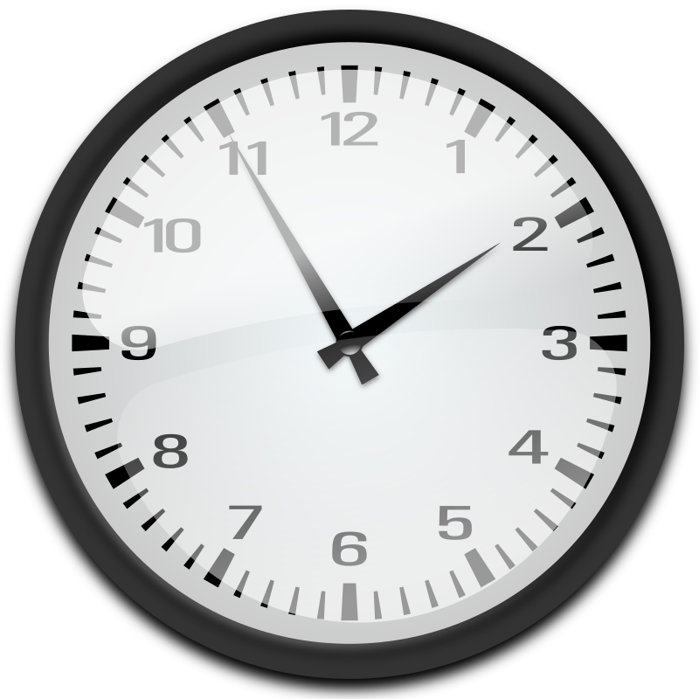
Unit 2 Week 6 Wonders- High Frequency Words
How do we measure time?

Slide 2
Chant the word as it appears
away
now
some
today
why
way

Slide 3
away now some today way why
Is this the ___ to school?
way

Slide 4
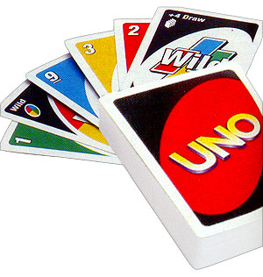
away now some today way why
Can we play the game ____?
now

Slide 5
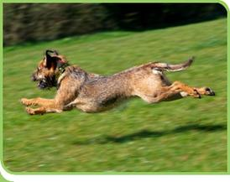
away now some today way why
My dog ran ____, but he came back.
away

Slide 6
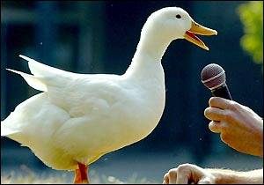
away now some today way why
____ are some ducks
quacking at me?
Why

Slide 7
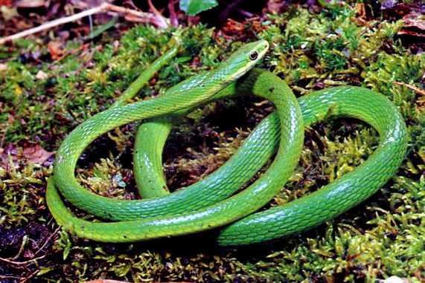
away now some today way why
I see ___ snakes in the grass.
some

Slide 8
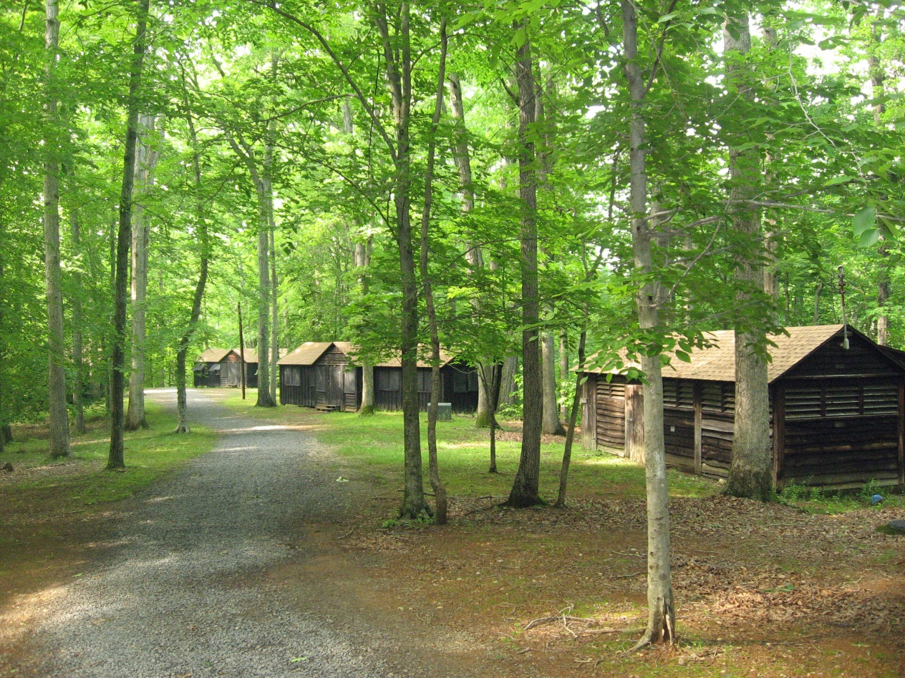
away now some today way why
I had fun at camp _____!
today

