Slide 1
Unit 5 Week 5 Wonders- High Frequency Words
How can we classify and categorize things?

Slide 2
Chant the word as it appears
four
large
none
only
put
round

Slide 3
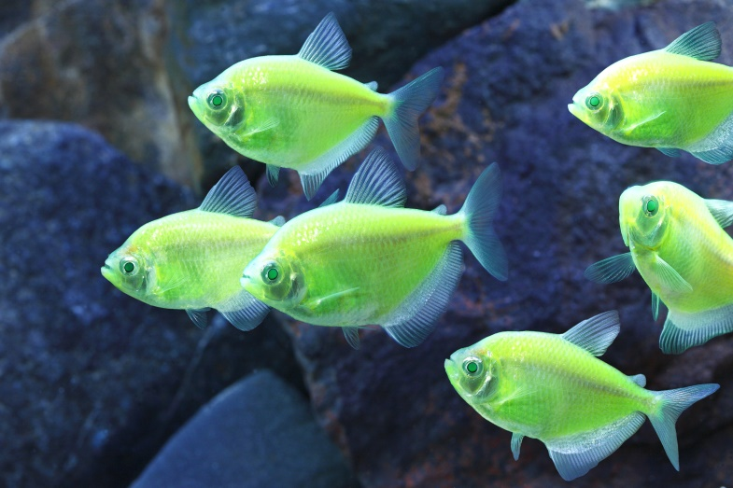
four large none only put around
I saw a ______ fish in the fish tank.
large

Slide 4
four large none only put around
Ted has one left, but Mark has _____.
none

Slide 5
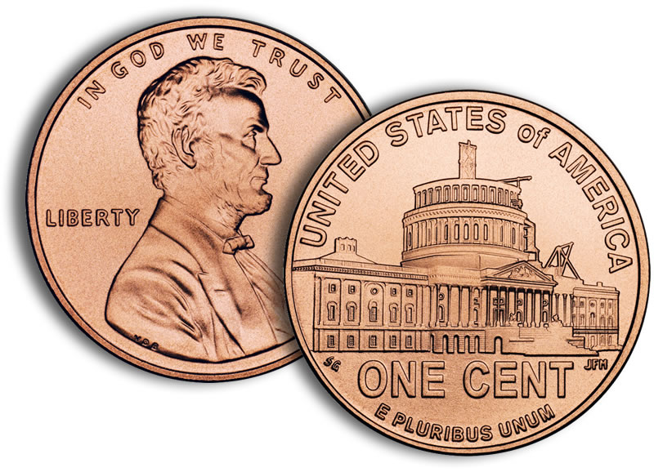
four large none only put around
A penny is ________.
round

Slide 6
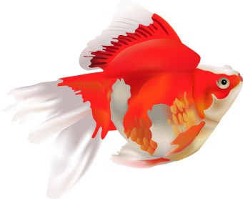
four large none only put around
I see _____ fish in the fish tank.
four

Slide 7
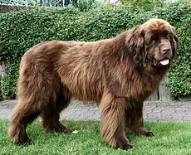
four large none only put around
large
I saw a ______ dog in the park.

Slide 8
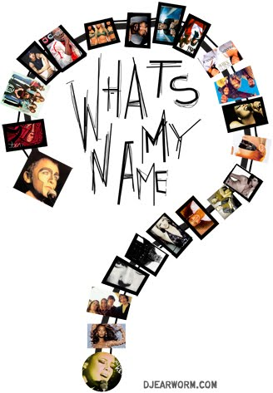
four large none only put around
The card _____ cost five cents.
card

