Slide 1
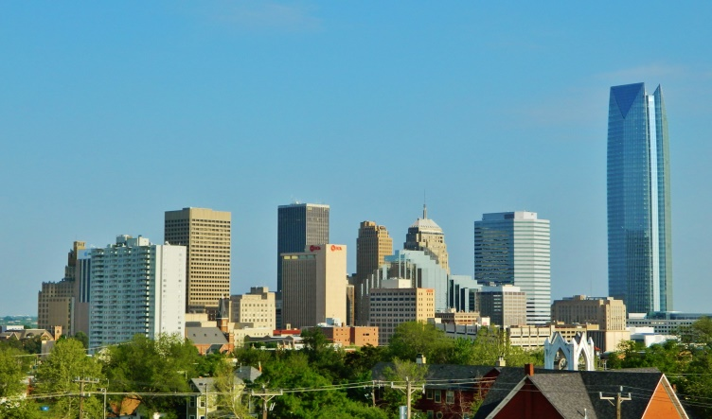
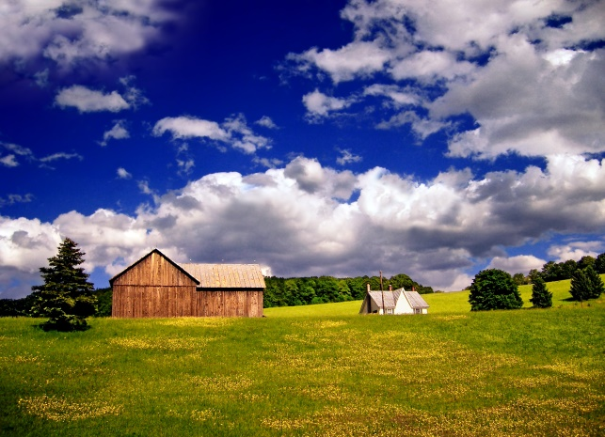
Unit 1 Week 2 Wonders- High Frequency Words
What is it like where you live?

Slide 2
Chant the word as it appears
down
up
out
very

Slide 3
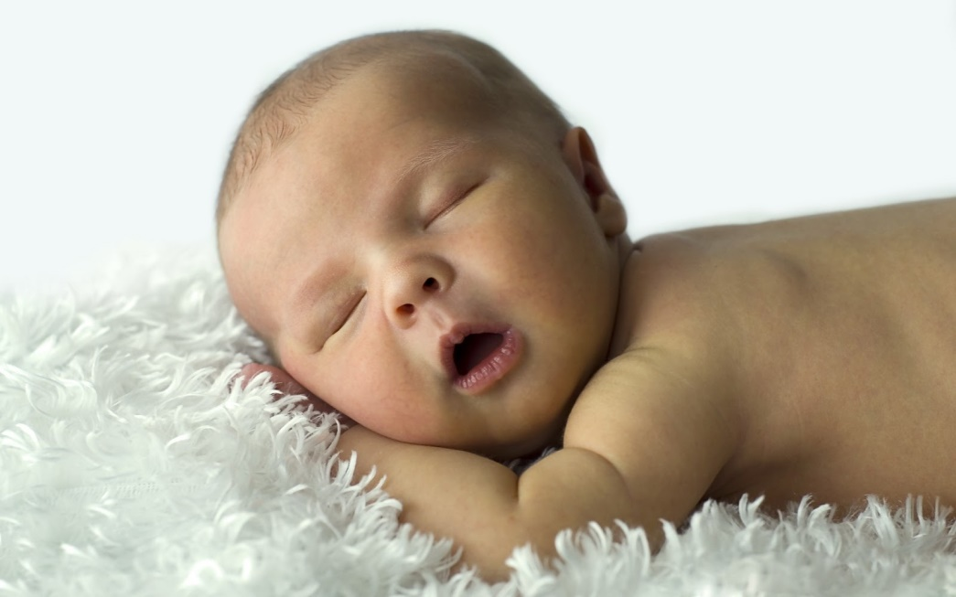
down up out very
I am _____ little.
very

Slide 4
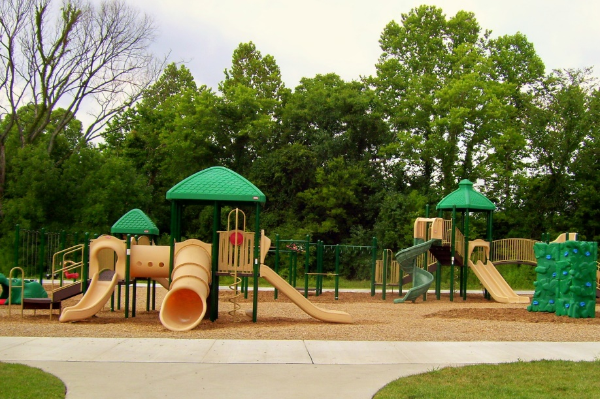
down up out very
We can go ____ to play.
out

Slide 5
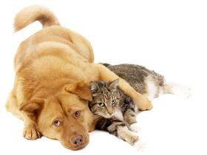
down up out very
Look ____ here at the cat and the dog.
up

Slide 6
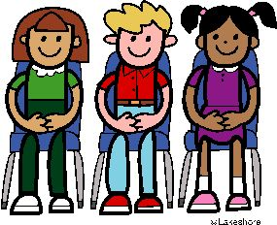
down up out very
She sat _____ with me.
down

