Slide 1
Unit 1 Week 4 Wonders- High Frequency Words
What do friends do together?

Slide 2
Chant the word as it appears
fun
make
they
too

Slide 3
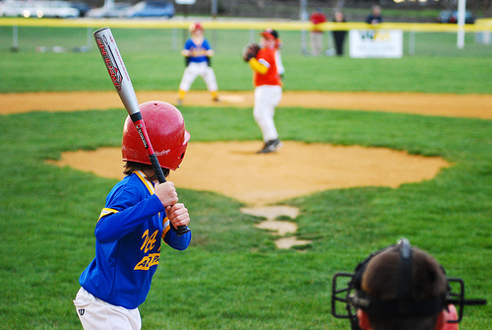
fun make they too
_____ will play and win!
They

Slide 4
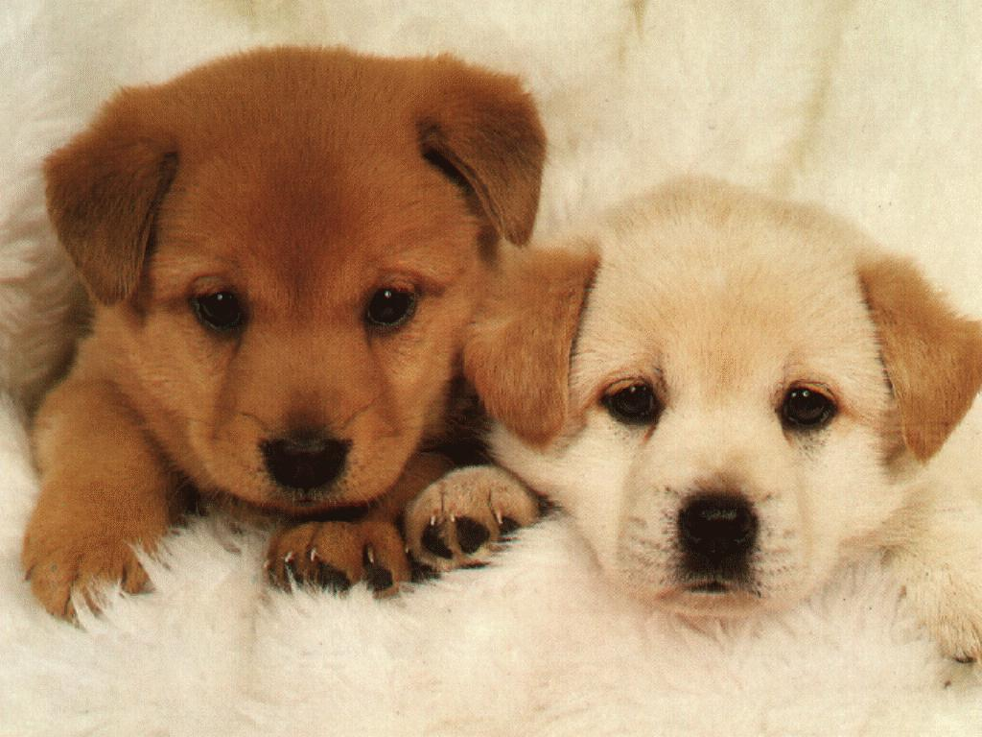
fun make they too
Do you like dogs, ____?
too

Slide 5
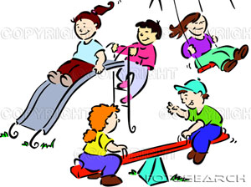
fun make they too
It is _____ to play!
fun

Slide 6
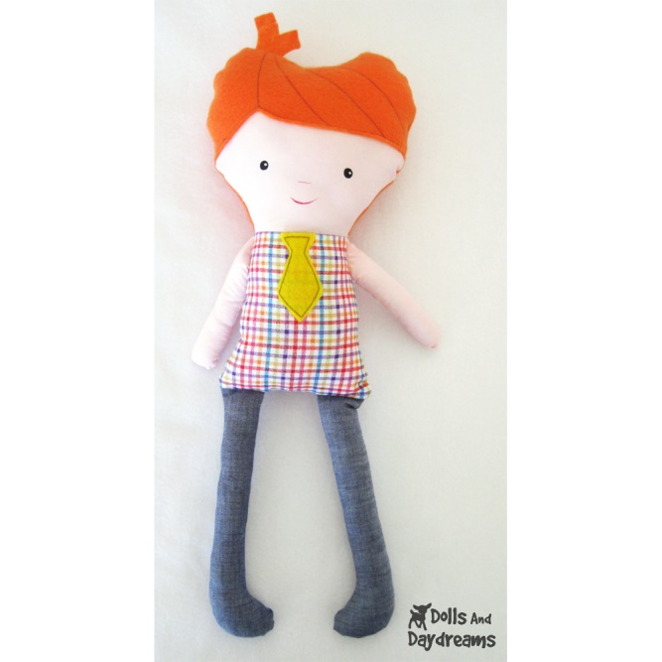
fun make they too
We will ______ a doll.
make

