Slide 1
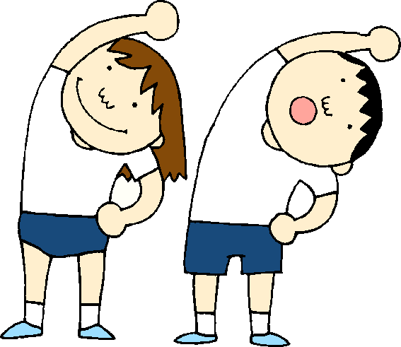
Unit 1 Week 5 Wonders- High Frequency Words
How does your body move?

Slide 2
Spell it!
jump
run
move
two

Slide 3
Chant the word as it appears
jump
move
run
two

Slide 4
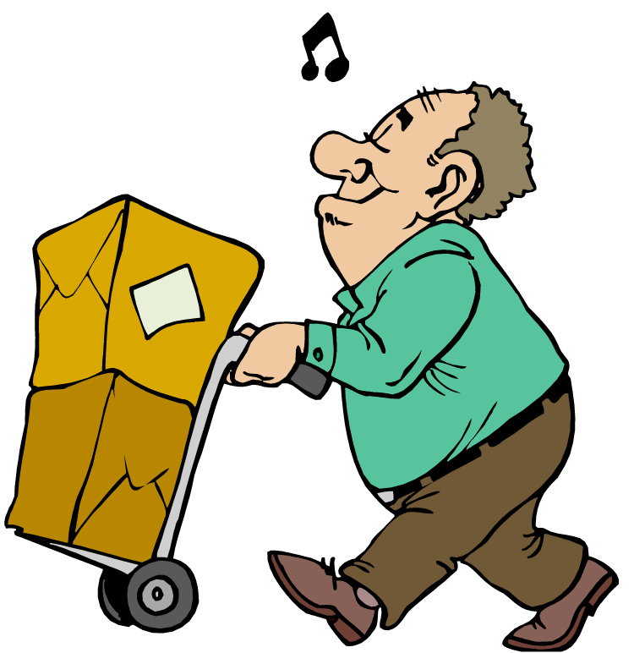
jump move run two
Can you ____ this box?
move

Slide 5
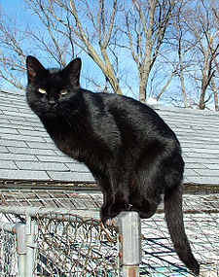
jump move run two
Brad has ____ black cats.
two

Slide 6
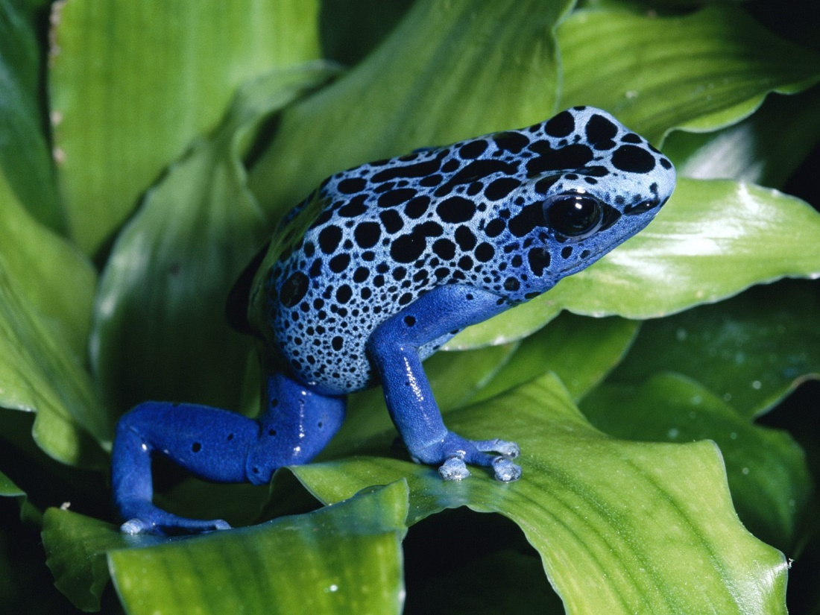
jump move run two
The frog likes to ______.
jump

Slide 7
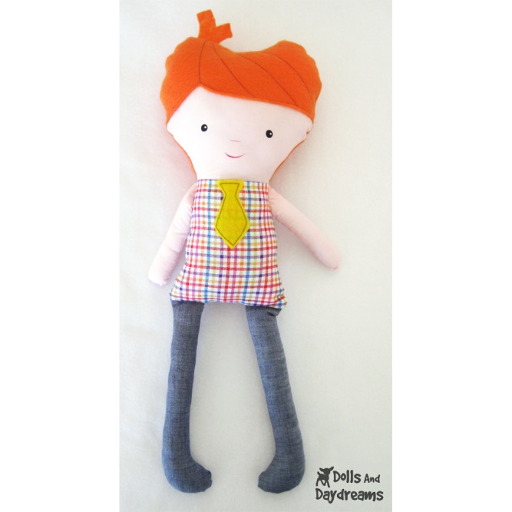
jump move run two
We will ____ to school.
run

