Slide 1
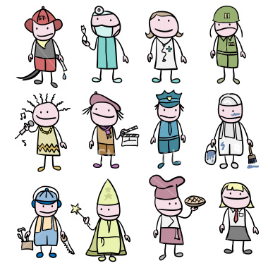
Unit 2 Week 1 Wonders- High Frequency Words
What jobs need to be done in a community?

Slide 2
Chant the word as it appears
again
help
new
there
use

Slide 3
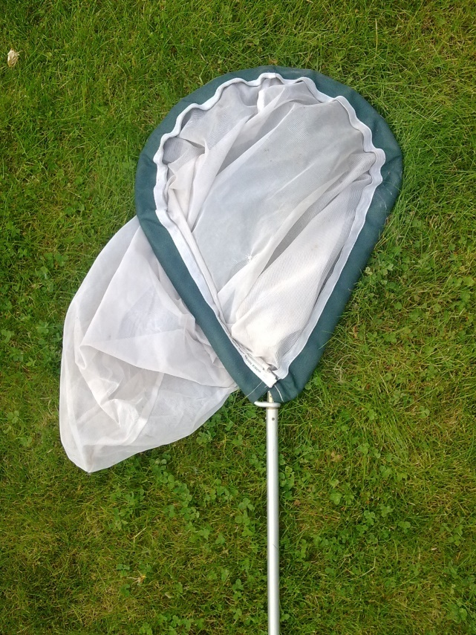
again help new there use
Tell Ben to use a ____.
net

Slide 4
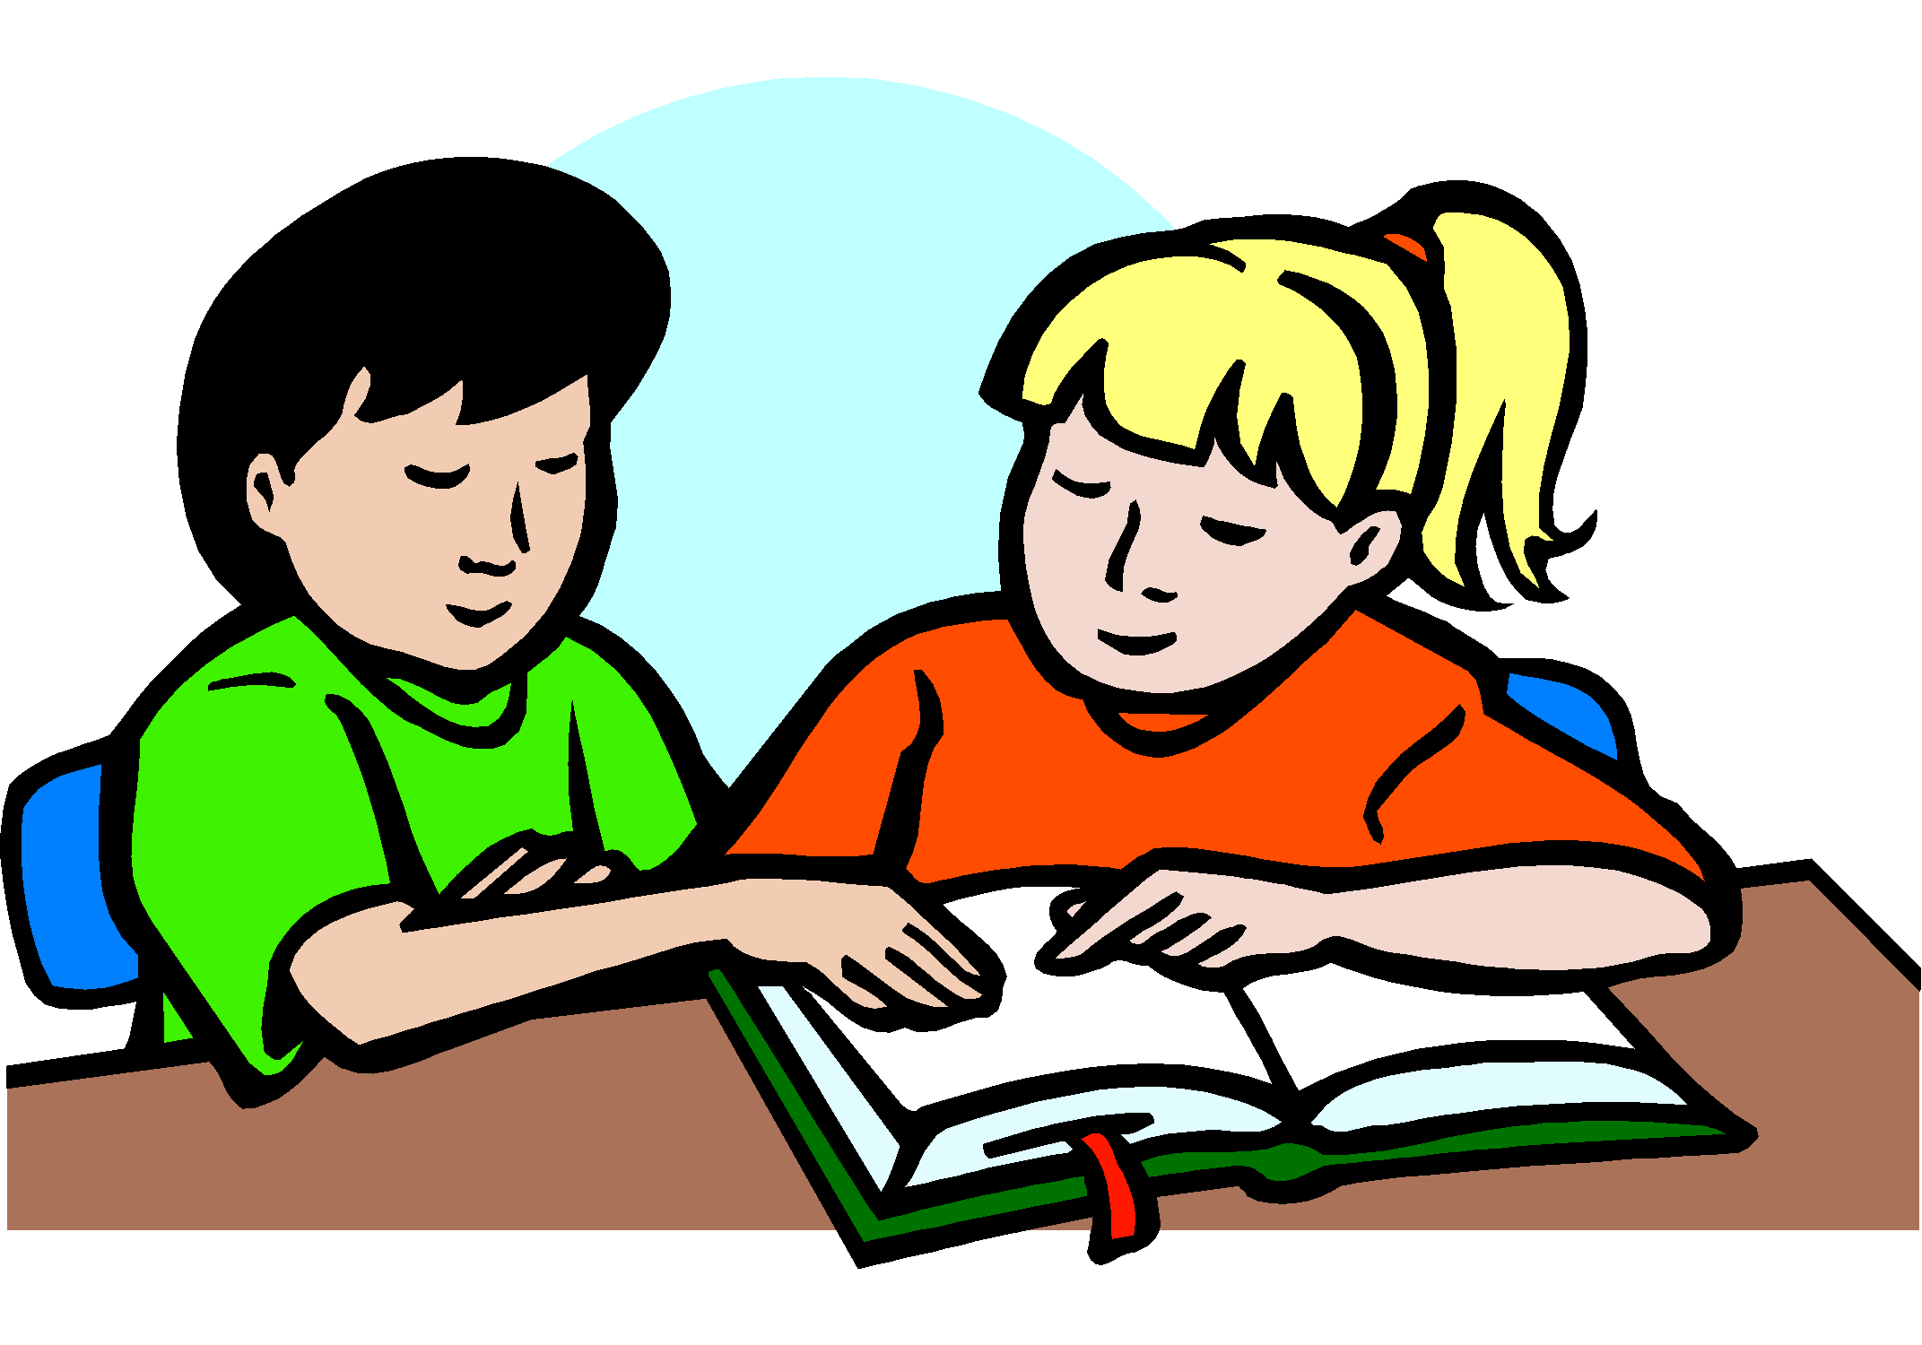
again help new there use
Will you help the ____ kid?
new

Slide 5
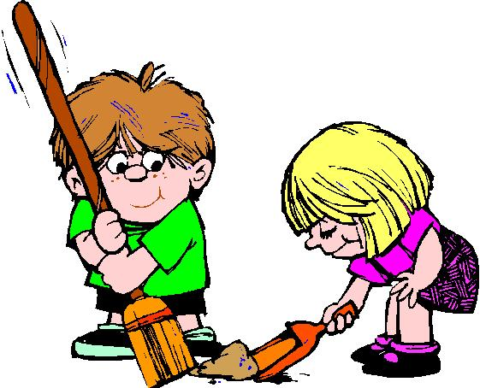
again help new there use
Can you ____ fix this mess?
help

Slide 6
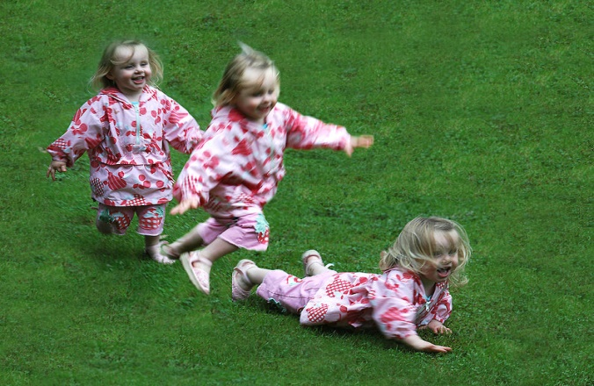
again help new there use
Jen fell down _____.
again

Slide 7
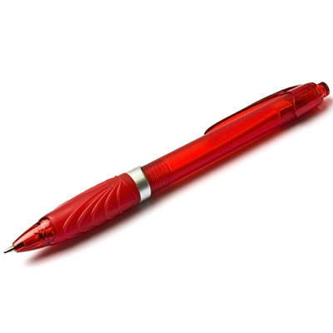
again help new there use
There
________ is my red pen.

