Slide 1
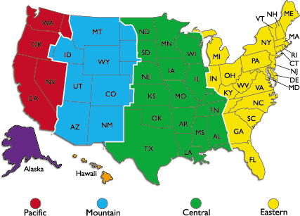
Unit 2 Week 5 Wonders- High Frequency Words
How can you find your way around?

Slide 2
Chant the word as it appears
around
by
many
place
walk

Slide 3
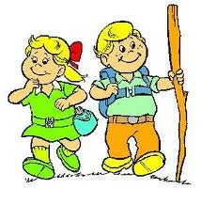
around by many place walk
Seth wants to ____ with you!
walk

Slide 4
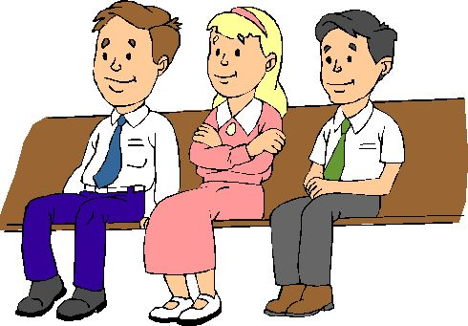
around by many place walk
Pam sat ___ Chad at lunch.
by

Slide 5
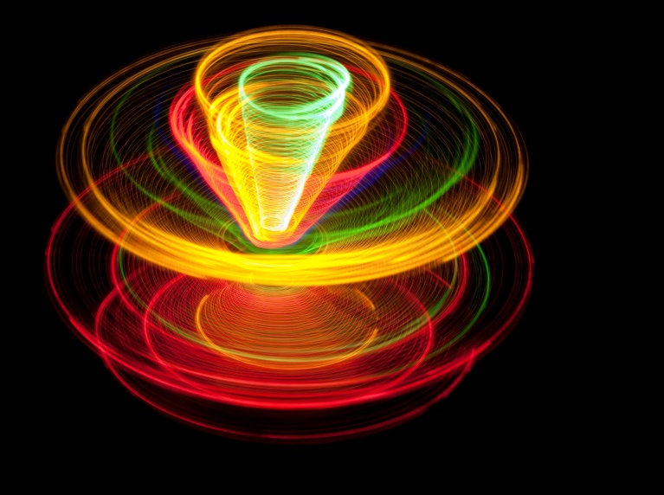
around by many place walk
The top spins _________.
around

Slide 6
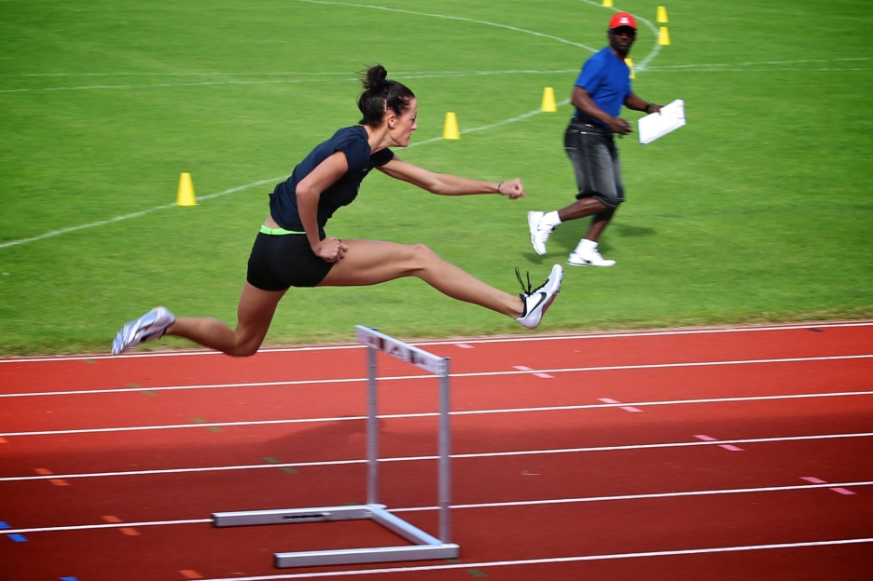
around by many place walk
____ girls like to run track.
Many

Slide 7
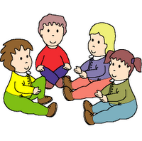
around by many place walk
place
This is a good _______ to sit.

