Slide 1
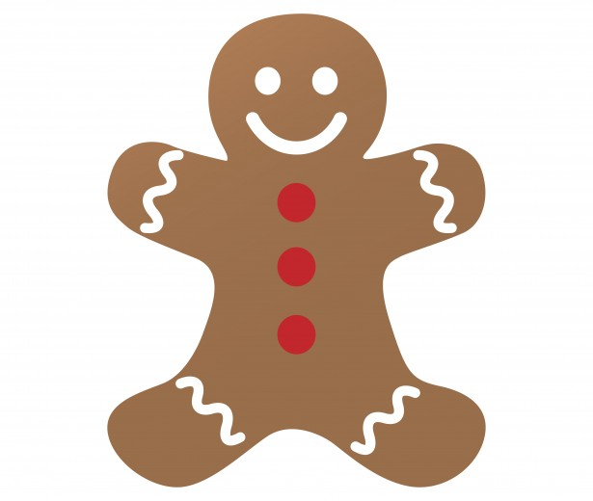
Unit 3 Week 3 Wonders- High Frequency Words
What is a folktale?

Slide 2
Chant the word as it appears
any
from
happy
once
so
upon

Slide 3
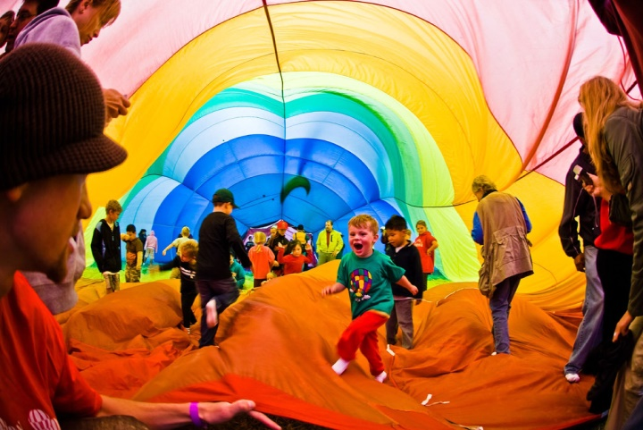
any from happy once so upon
It is hot, ___ I will play inside.
so

Slide 4
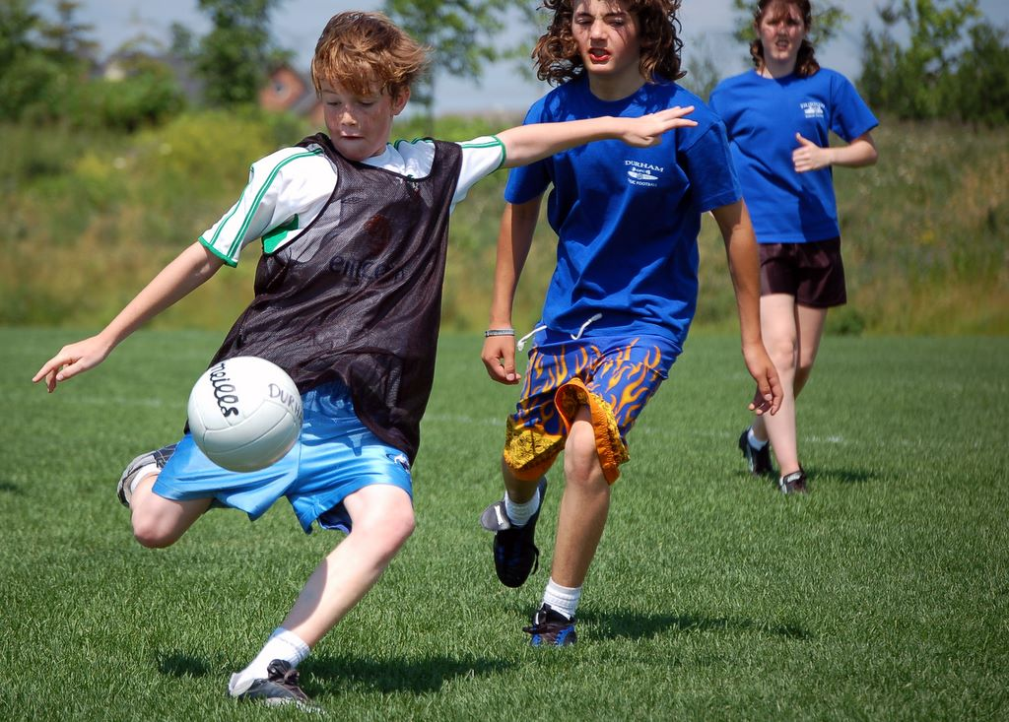
any from happy once so upon
Do you have ____ time to play?
any

Slide 5
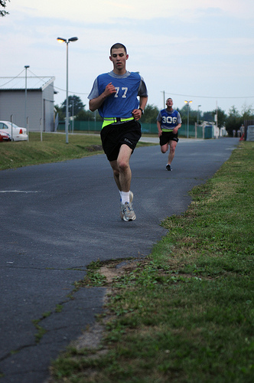
any from happy once so upon
______ I ran a mile.
Once

Slide 6
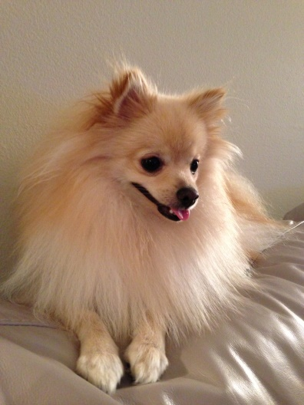
any from happy once so upon
The dog is ____ when I pet his face.
dog

Slide 7
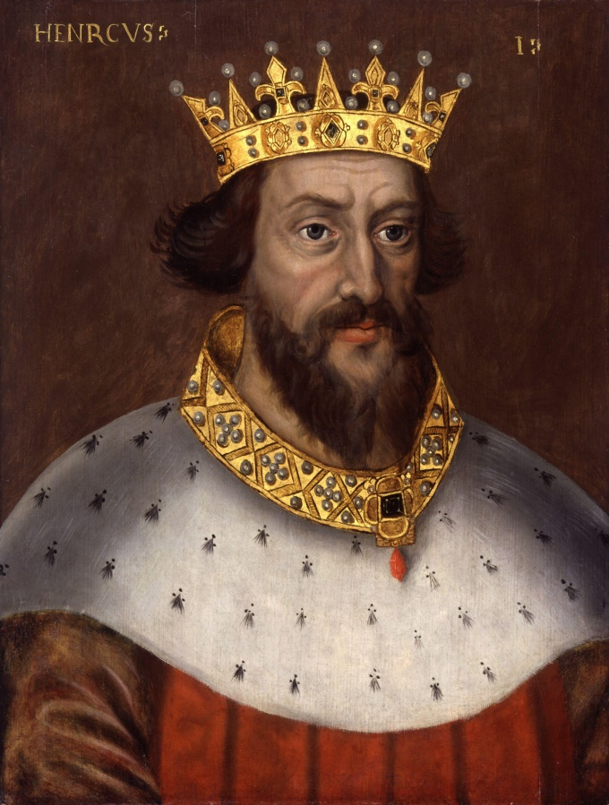
any from happy once so upon
upon
Once _____ a time, a king had a magic stone.

