Slide 1
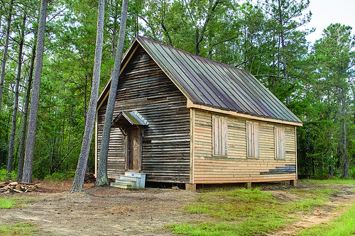
Unit 3 Week 4 Wonders- High Frequency Words
How is life different than it was long ago?

Slide 2
Chant the word as it appears
ago
boy
girl
how
old
people

Slide 3
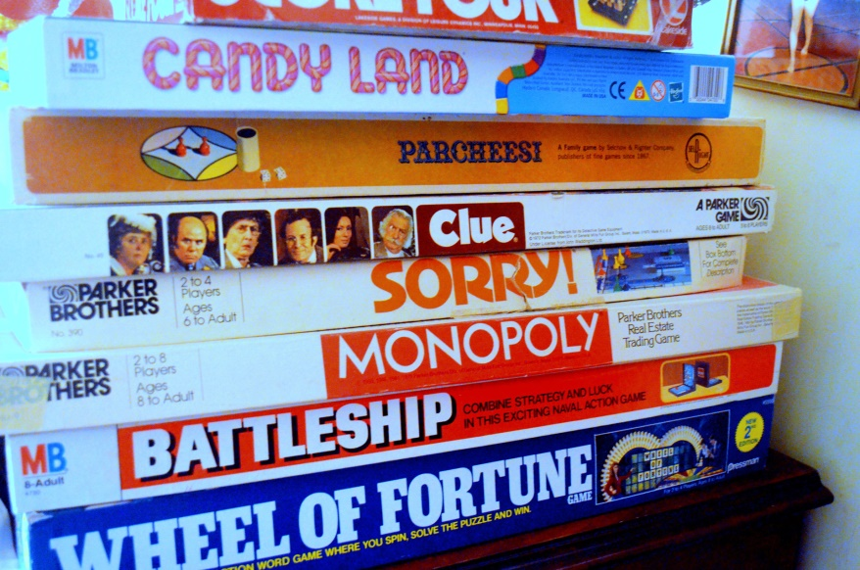
ago boy girl how old people
_____ like those games.
People

Slide 4
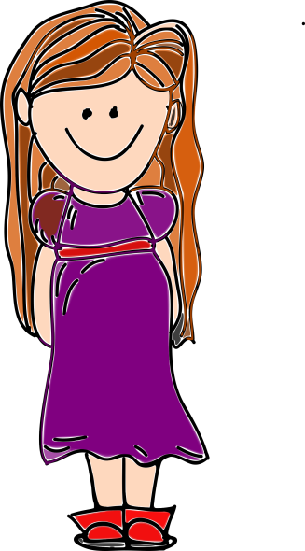
ago boy girl how old people
A new ____ is in the class.
girl

Slide 5
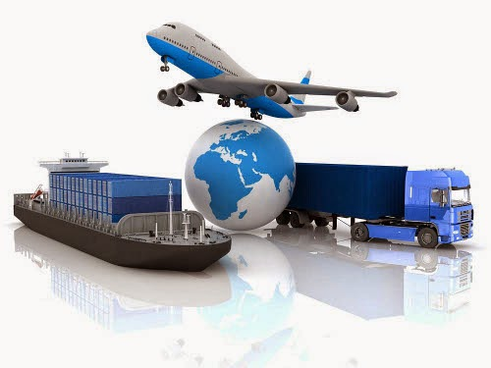
ago boy girl how old people
______ will you get home?
How

Slide 6
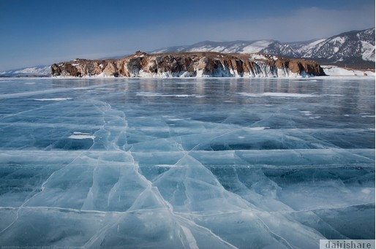
ago boy girl how old people
The lake froze five days ______.
ago

Slide 7
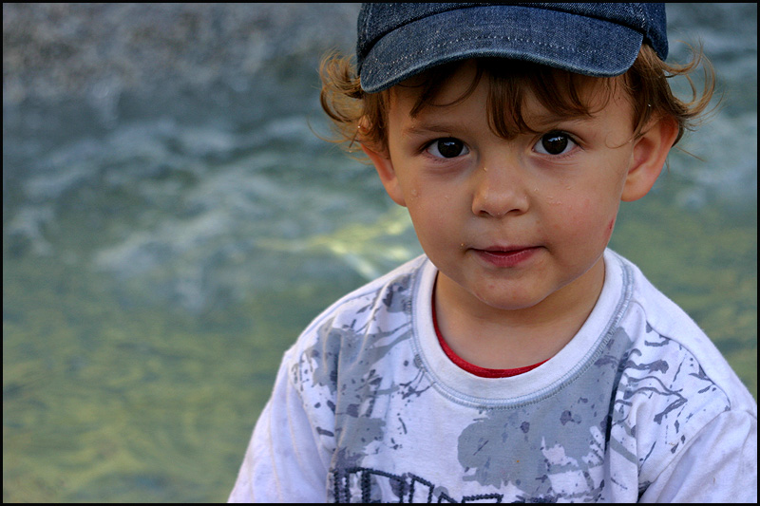
ago boy girl how old people
Pete is a nice _______.
boy

Slide 8
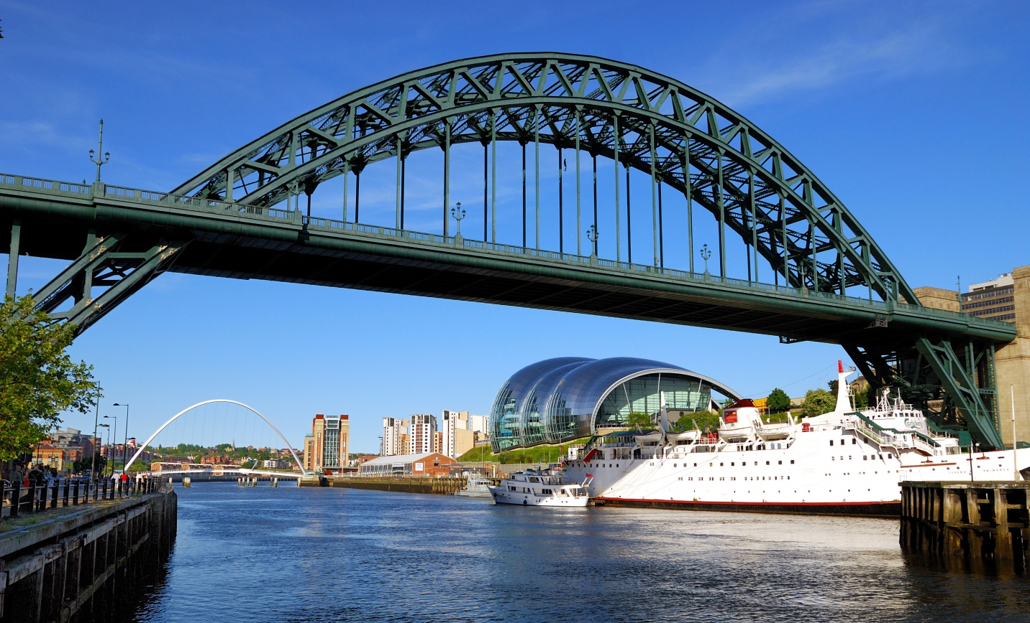
ago boy girl how old people
old
The bridge is ______.

