Slide 1
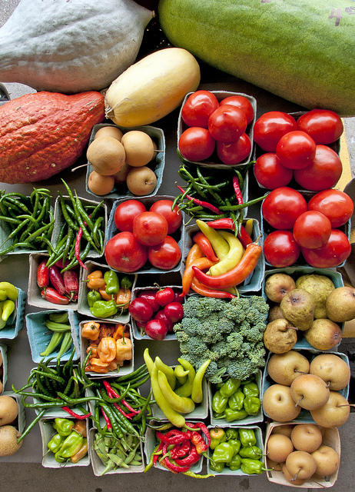
Unit 3 Week 5 Wonders- High Frequency Words
Where does food come from?

Slide 2
Chant the word as it appears
after
buy
done
every
soon
work

Slide 3
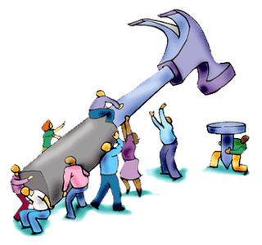
after buy done every soon work
This is so much _____.
work

Slide 4
after buy done every soon work
What did you ___?
buy

Slide 5
after buy done every soon work
_____ kid got a book.
Every

Slide 6
after buy done every soon work
We can play ____ school.
after

Slide 7
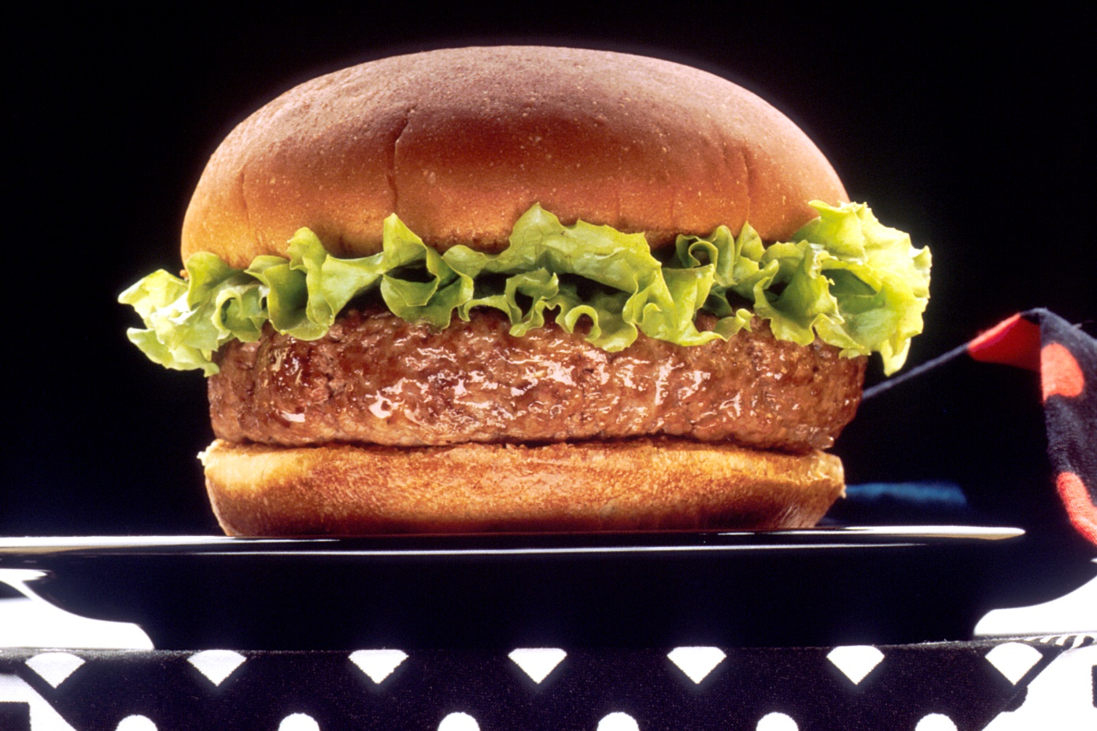
after buy done every soon work
done
When will the food be _____?

Slide 8
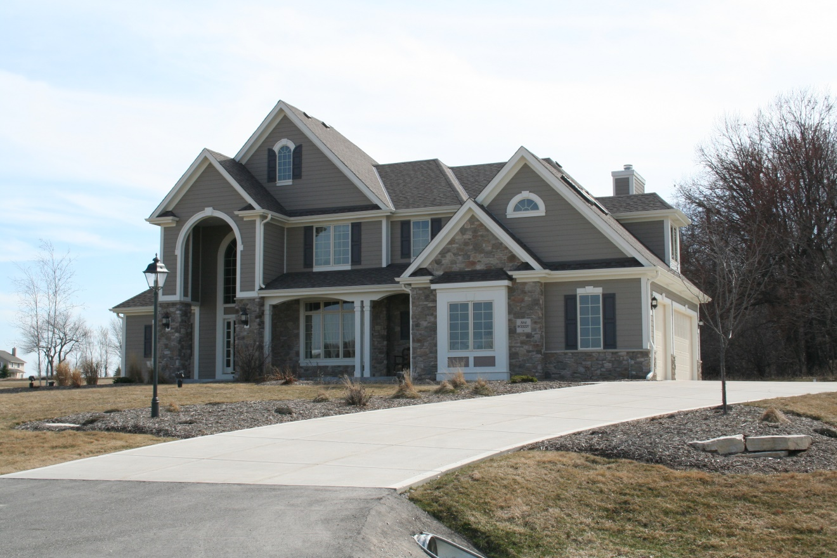
ago boy girl how old people
soon
We can go home _____.

