Slide 1
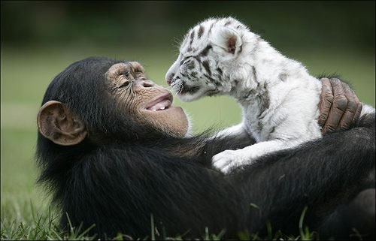
Unit 4 Week 2 Wonders- High Frequency Words
How do animals help each other?

Slide 2
Chant the word as it appears
because
blue
into
Or
other
small

Slide 3
because blue into or other small
Will he pick blue ___ red?
or

Slide 4
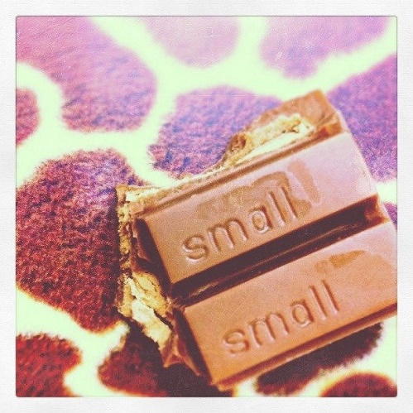
because blue into or other small
Jane will take a ______ piece.
small

Slide 5
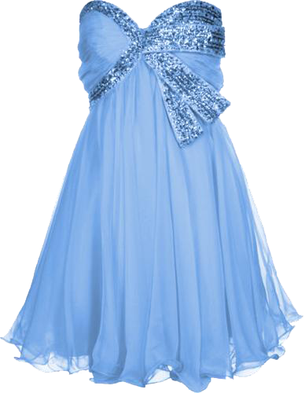
because blue into or other small
I like the dress _______ it is blue.
because

Slide 6
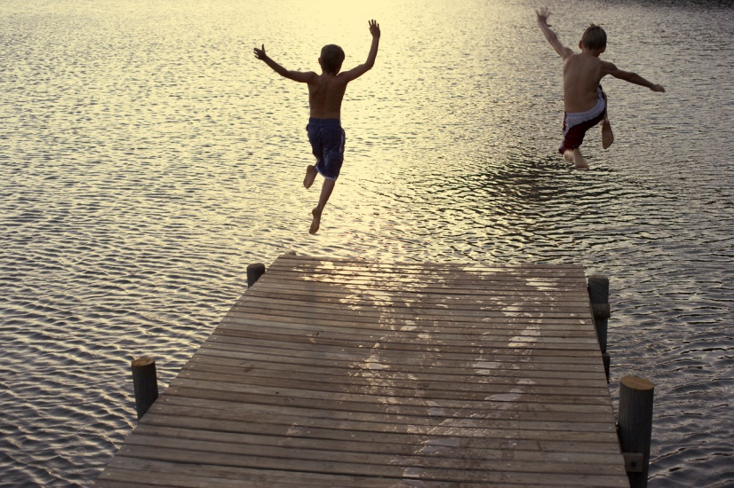
because blue into or other small
Don’t jump ______ the lake!
into

Slide 7
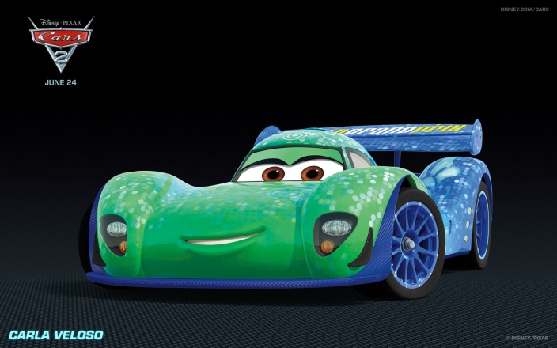
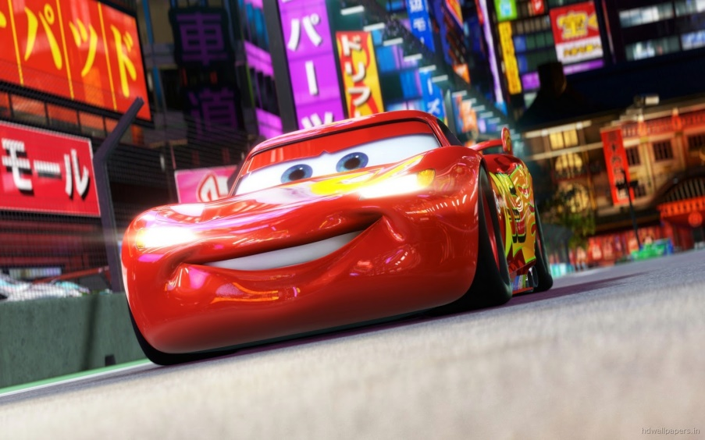
because blue into or other small
Should we buy this one or that
______ one?
other

Slide 8
because blue into or other small
Do you have a ______ rug?
blue

