Slide 1
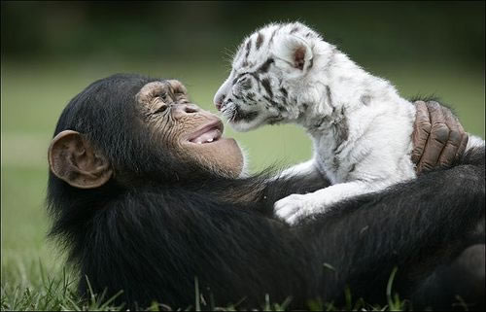
Unit 4 Week 3 Wonders- High Frequency Words
How do animals survive in nature?

Slide 2
Chant the word as it appears
find
food
more
over
start
warm

Slide 3
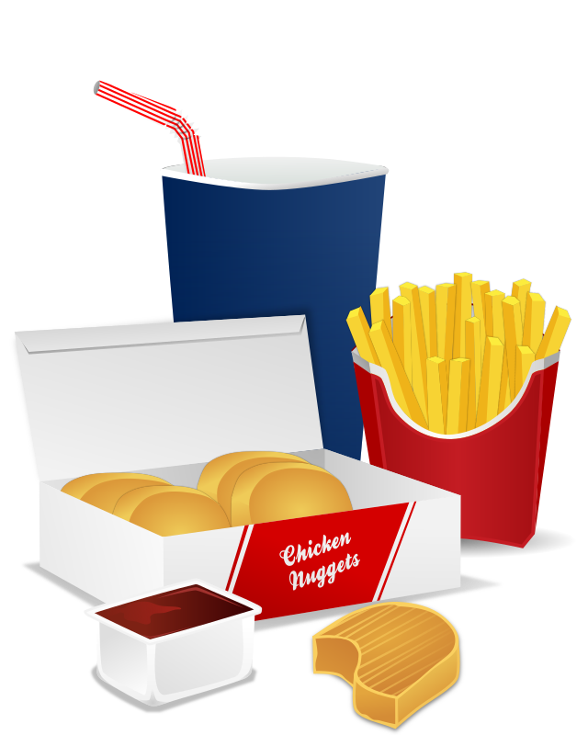
find food more over start warm
Did you find some _____?
food

Slide 4
find food more over start warm
This hat can keep you ______.
warm

Slide 5
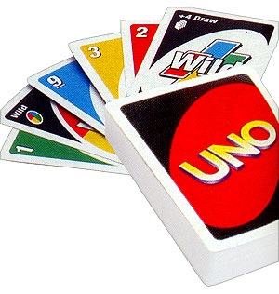
find food more over start warm
We can _____ the game over.
start

Slide 6
find food more over start warm
Do you need ______ time?
more

Slide 7
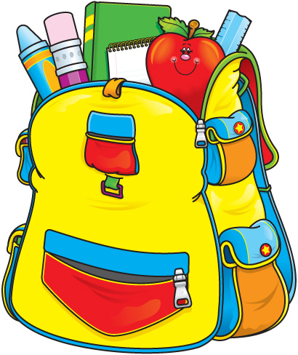
find food more over start warm
find
Help me ______ my backpack.

Slide 8
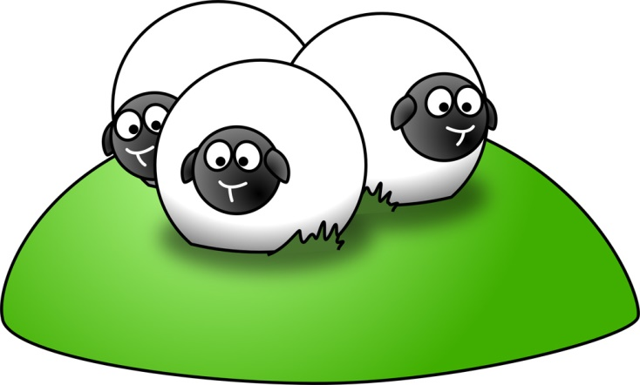
find food more over start warm
The sheep will come ____ the hill.
over

