Slide 1
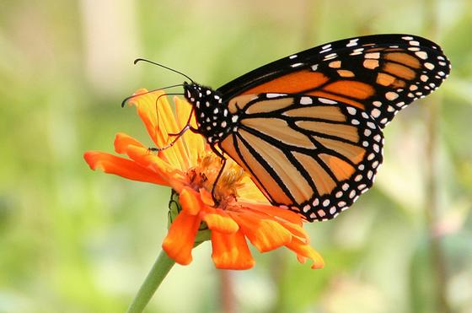
Unit 4 Week 4 Wonders- High Frequency Words
What insects do you know about? How are they alike and different?

Slide 2
Chant the word as it appears
caught
flew
know
laugh
listen
were

Slide 3
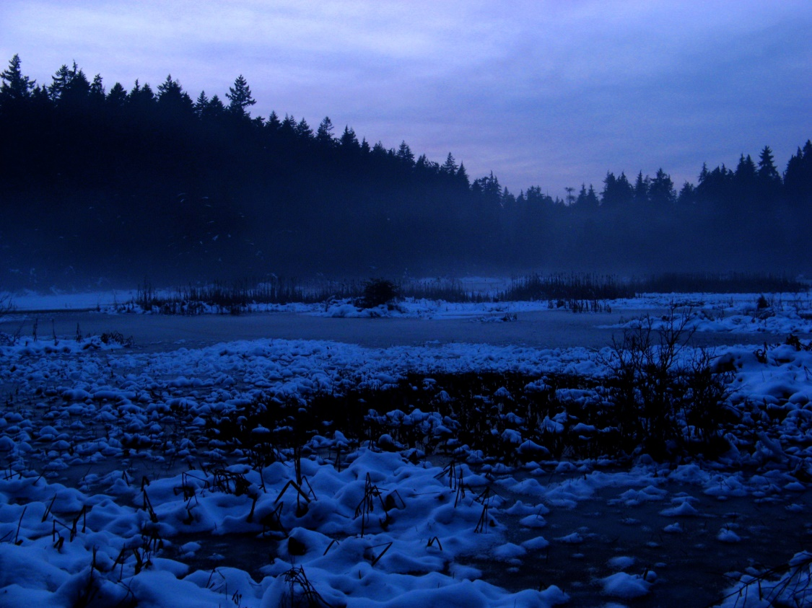
caught flew know laugh listen were
We ____ cold at night.
were

Slide 4
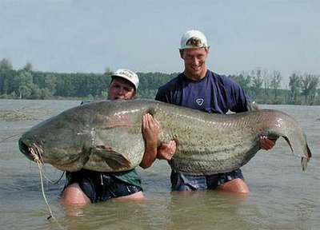
caught flew know laugh listen were
He ________ a big fish.
caught

Slide 5
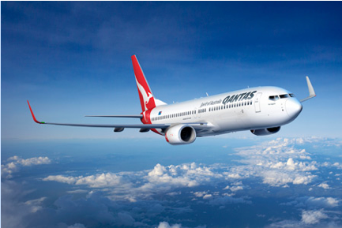
caught flew know laugh listen were
The plane ________ high in the sky.
flew

Slide 6
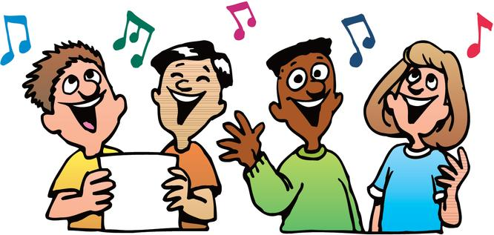
caught flew know laugh listen were
______ to this song.
Listen

Slide 7
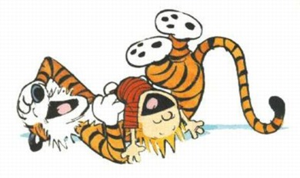
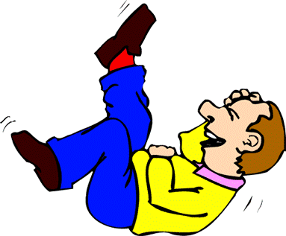
caught flew know laugh listen were
The joke made me _______.
laugh

Slide 8
caught flew know laugh listen were
Do you _____ my name?
know

