Slide 1
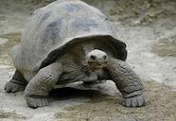
Unit 4 Week 1 Wonders- High Frequency Words
How do animals’ bodies help them?

Slide 2
Chant the word as it appears
about
animal
carry
eight
give
our

Slide 3
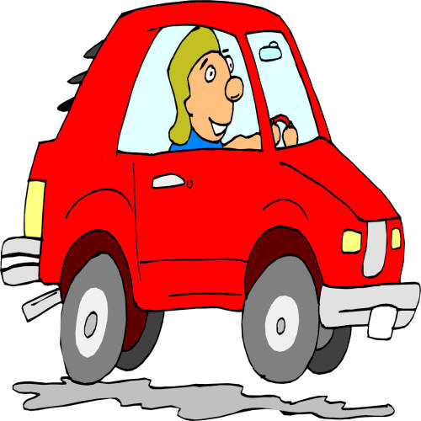
About animal carry eight give our
Will Mom ____ us a ride to school?
give

Slide 4
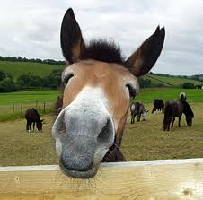
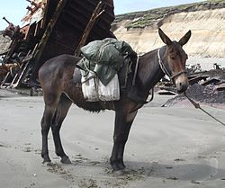
About animal carry eight give our
A mule is an ______.
animal

Slide 5
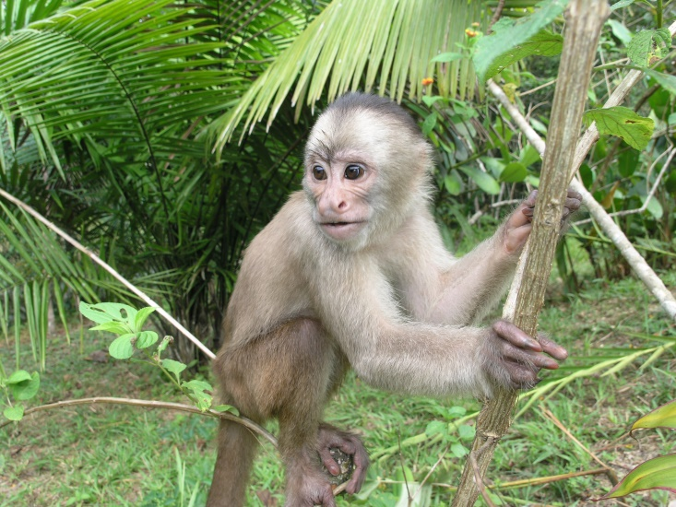
About animal carry eight give our
I read a story _______ a monkey with a long tail.
about

Slide 6
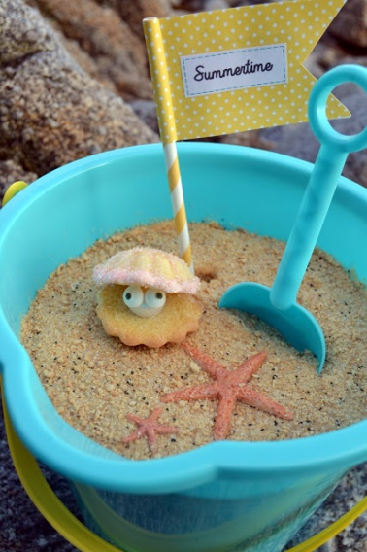
About animal carry eight give our
We use a pail to ______ the shells.
carry

Slide 7
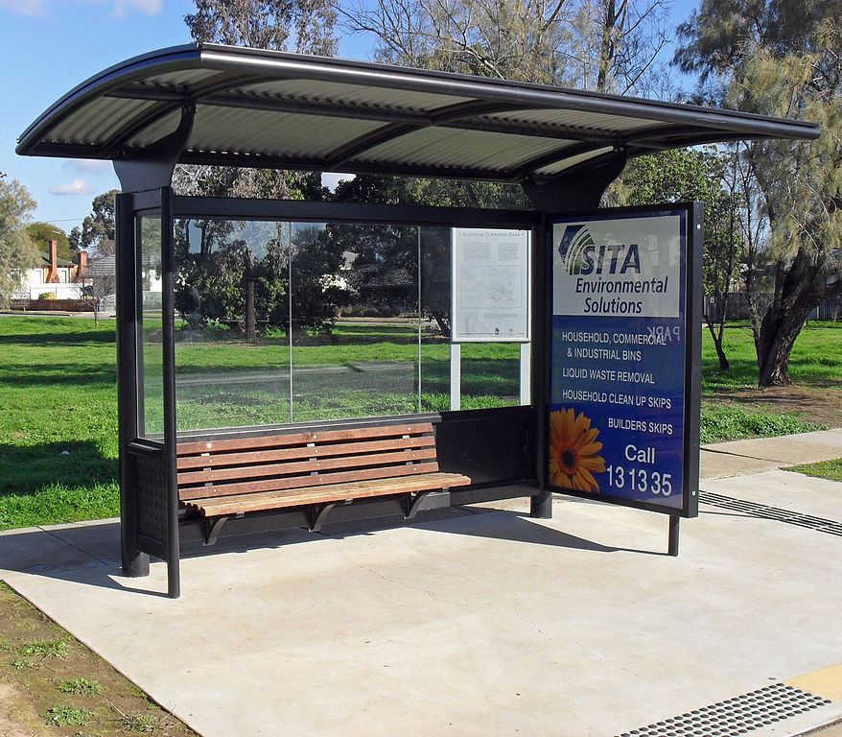
About animal carry eight give our
our
We will wait for _____ bus at the bus stop.

Slide 8
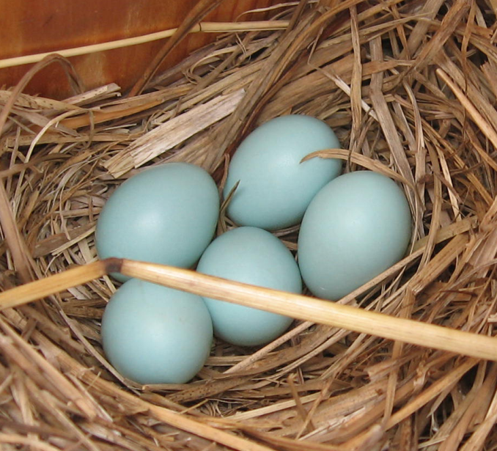
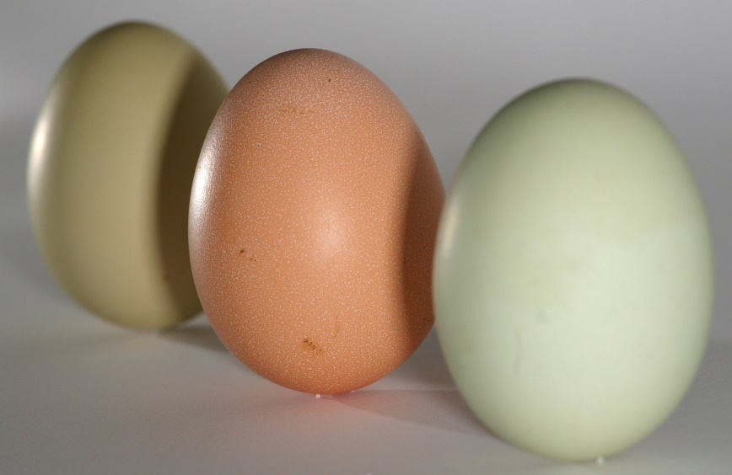
About animal carry eight give our
Eight
eight
______ eggs hatched from _____
eggs.

