Slide 1
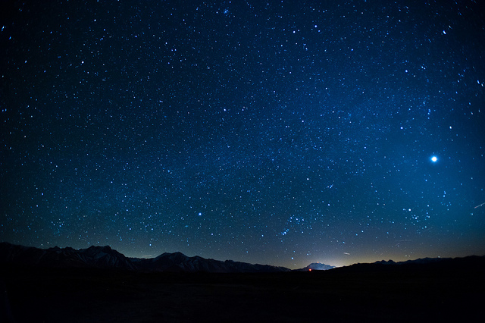
Unit 5 Week 2 Wonders- High Frequency Words What can you see in the night sky?

Slide 2
Chant the word as it appears
another
climb
full
great
poor
through

Slide 3
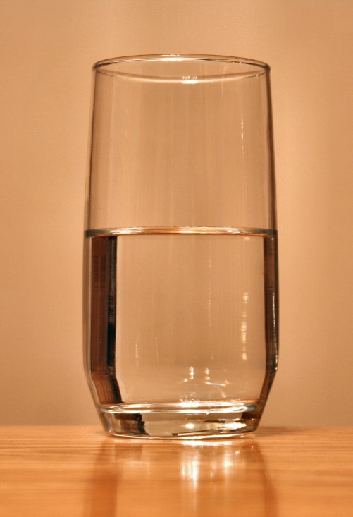
another climb full great poor through
The glass is not _____.
full

Slide 4
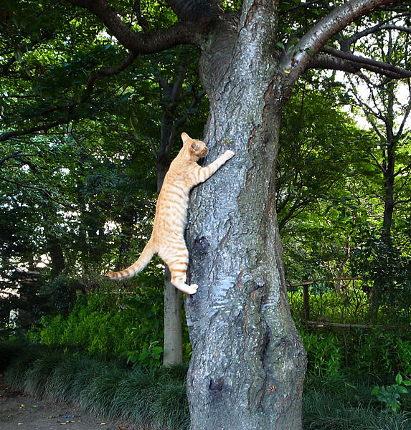
another climb full great poor through
The cat will ______
another tree.
climb

Slide 5
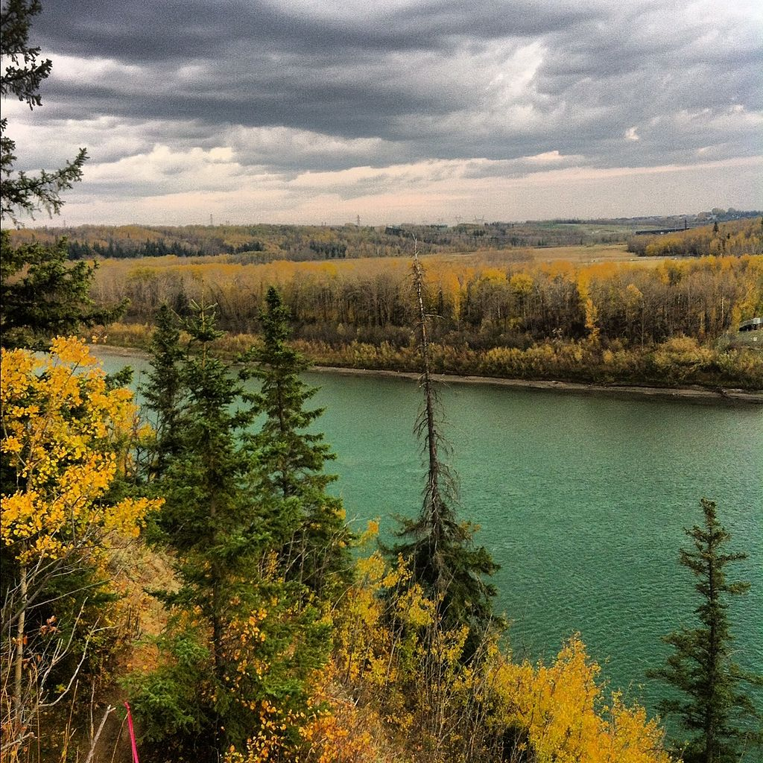
another climb full great poor through
Let's walk ________ the park today.
through

Slide 6
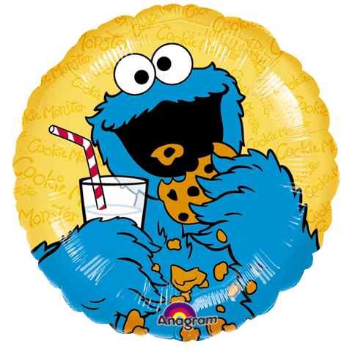
another climb full great poor through
Will you get Cookie Monster _____ cookie to eat?
another

Slide 7
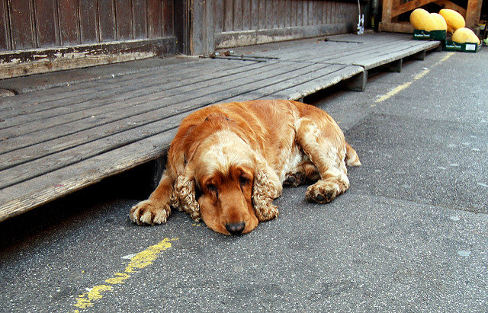
another climb full great poor through
The _____ dog needs more water.
poor

Slide 8
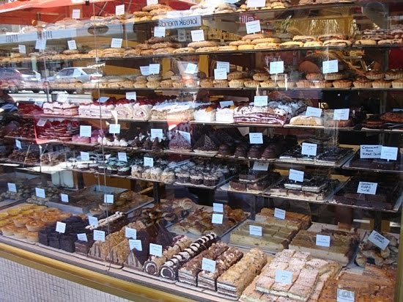
another climb full great poor through
great
There was a ______ cake shop downtown.

