Slide 1
Unit 1, Week 2 Spelling Words
Go, Pip!

Slide 2
pin

Slide 3
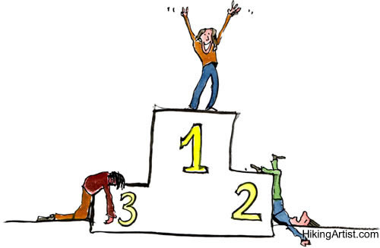
win

Slide 4
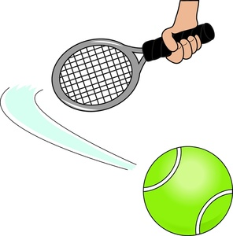
hit

Slide 5
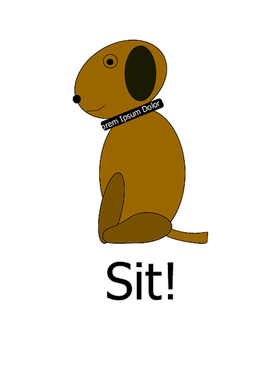
sit

Slide 6
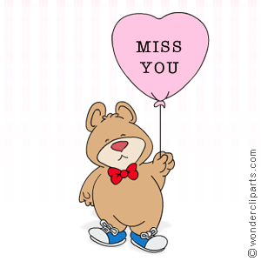
miss

Slide 7
kiss

Slide 8
six

Slide 9
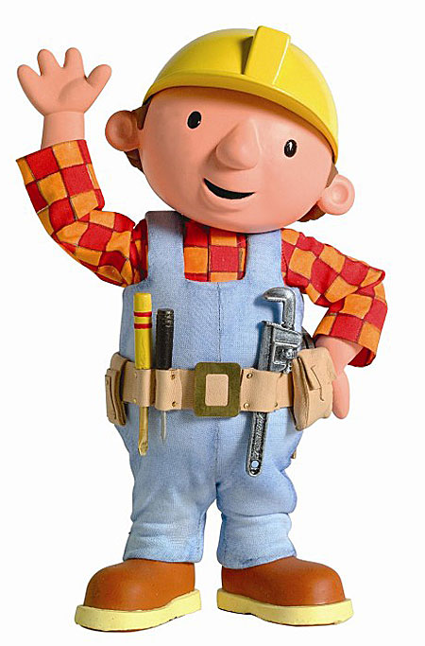
fix

Slide 10
big

Slide 11
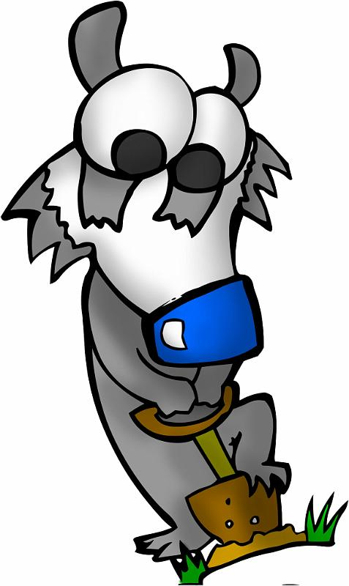
dig

Slide 12
Challenge Words
out
up

