Slide 1

Flip
Unit 1, Week 3
Spelling Words

Slide 2

Clip

Slide 3
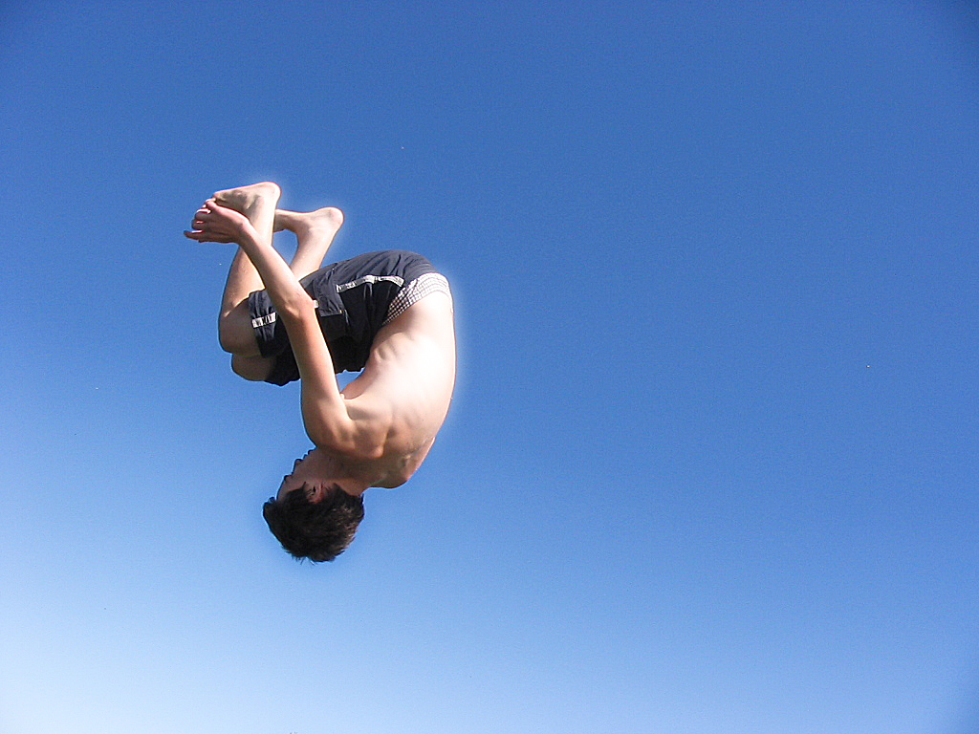
Flip

Slide 4

Slip

Slide 5

Flag

Slide 6

Black

Slide 7
Plan

Slide 8

Clap

Slide 9

Glad

Slide 10
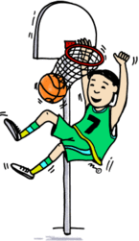
Slam

Slide 11

Clam

Slide 12
Challenge Words
Be
Pull

