Slide 1
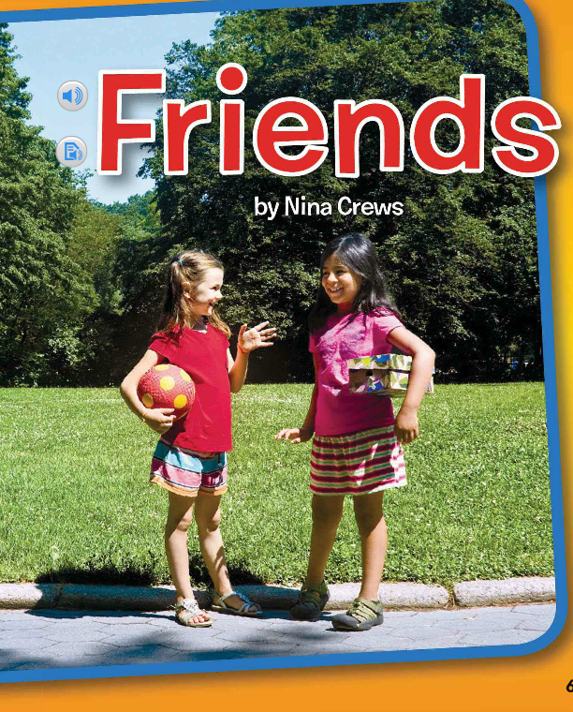
Unit 1, Week 4 Spelling Words
Friends

Slide 2
top

Slide 3
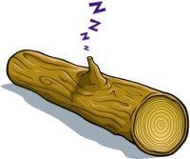
log

Slide 4
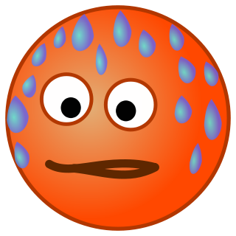
hot

Slide 5
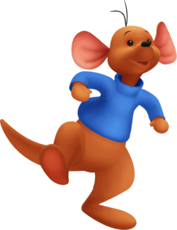
hop

Slide 6
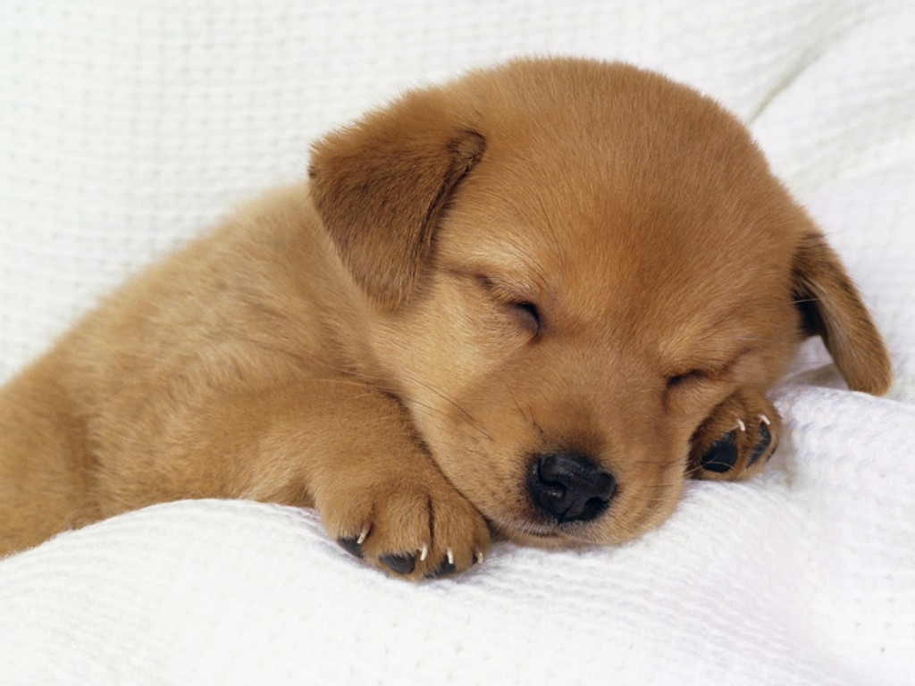
dog

Slide 7
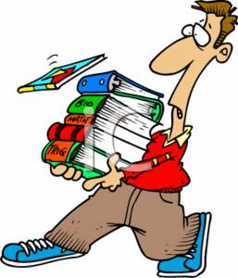
lot

Slide 8
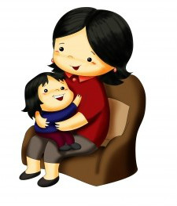
mom

Slide 9
got

Slide 10
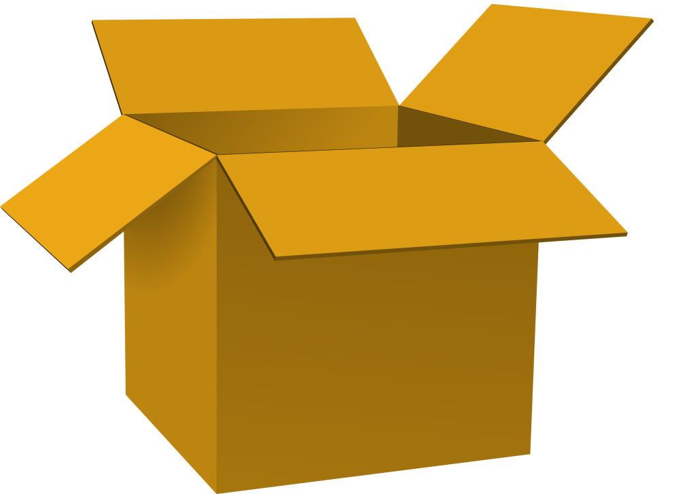
box

Slide 11
Challenge Words
they
too

