Slide 1
The Red Hat
Unit 2, Week 1
Spelling Words

Slide 2
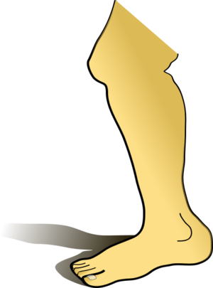
leg

Slide 3
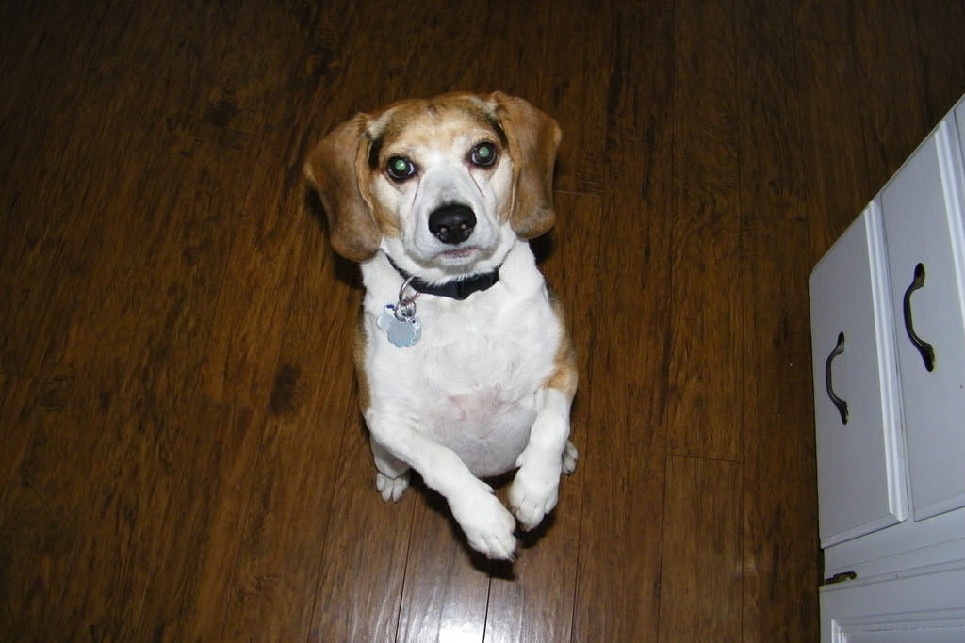
beg

Slide 4
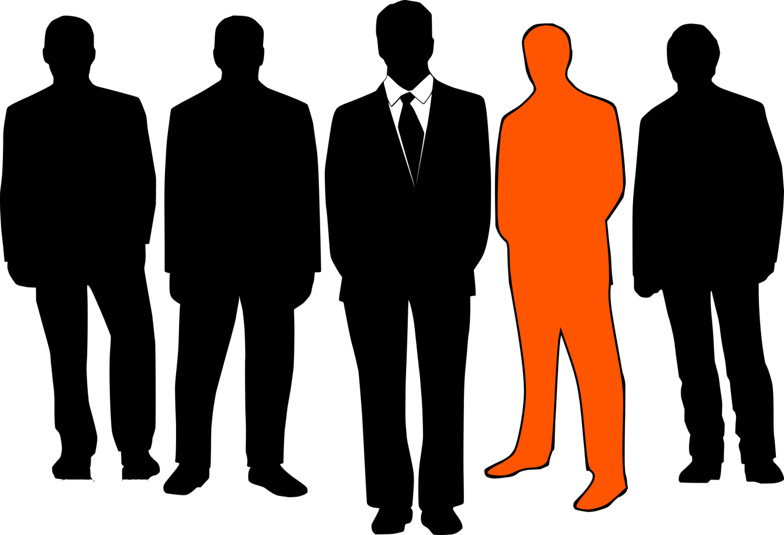
men

Slide 5
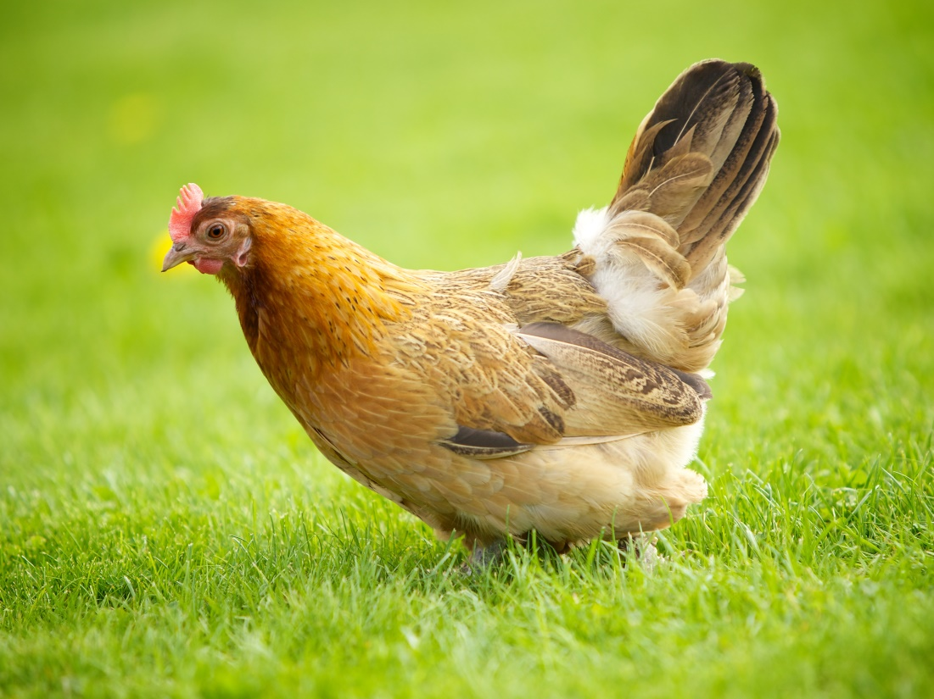
hen

Slide 6
head

Slide 7
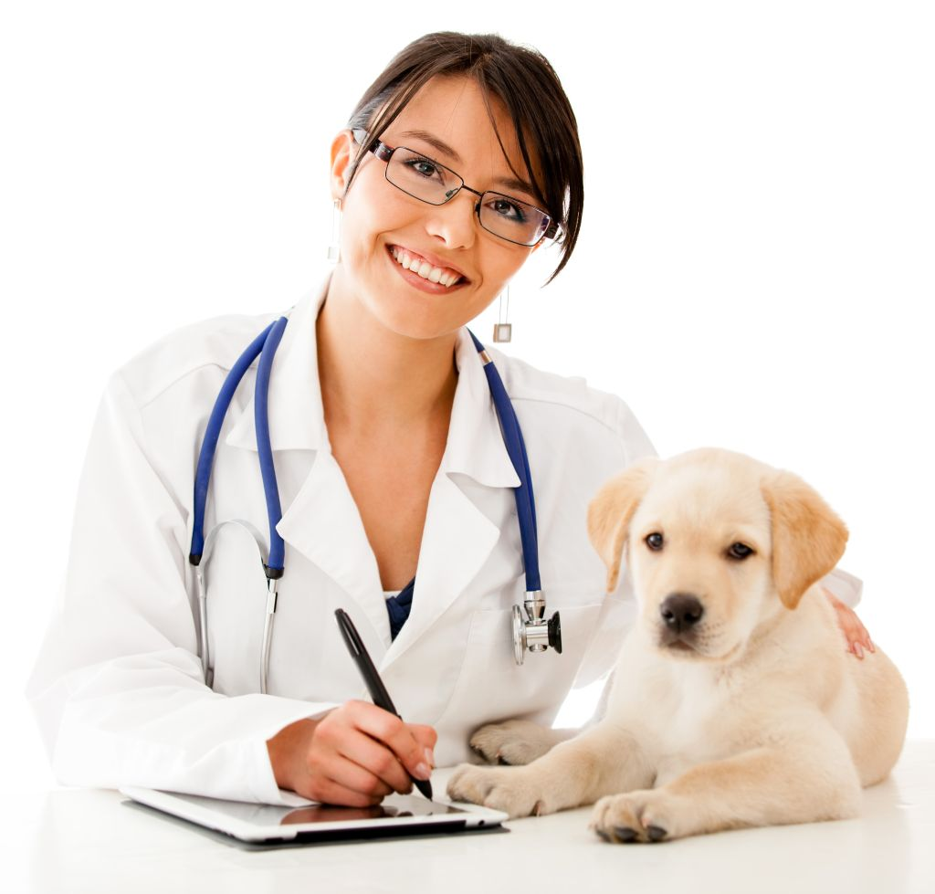
vet

Slide 8
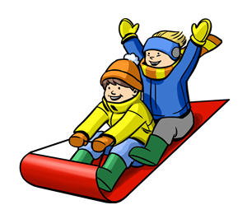
sled

Slide 9
red

Slide 10
get

Slide 11
High-Frequency Words
there
again

