Slide 1
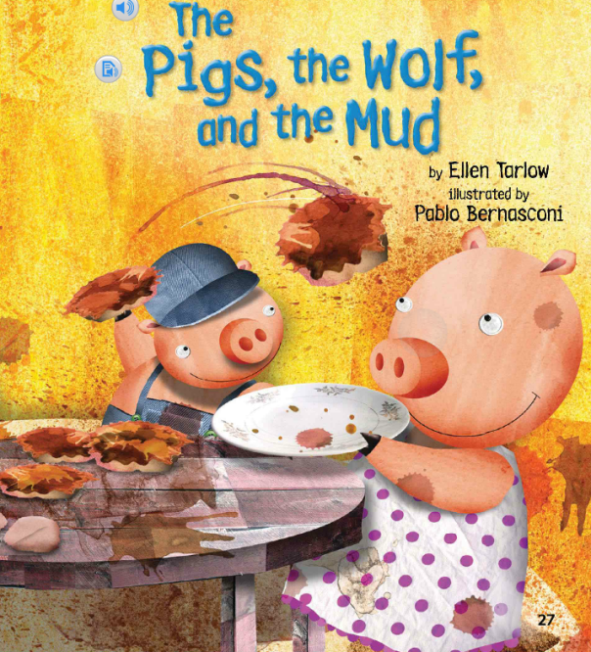
The Pigs, the Wolf, and the Mud Unit 2, Week 2 Spelling Words

Slide 2
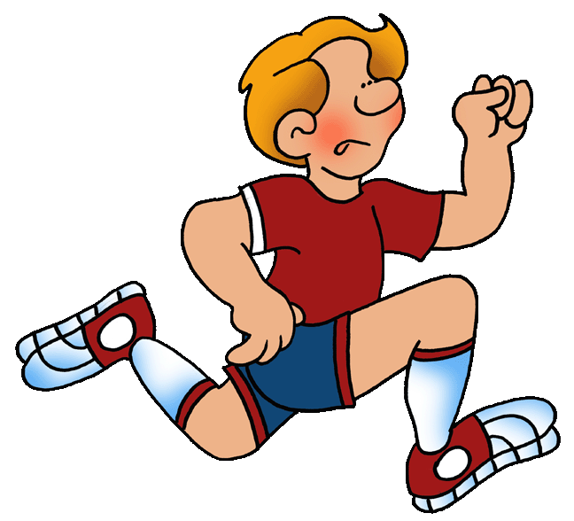
run

Slide 3
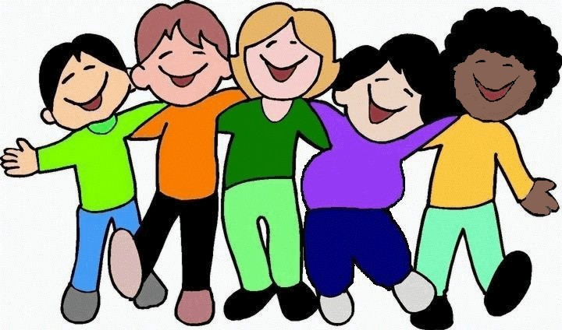
fun

Slide 4
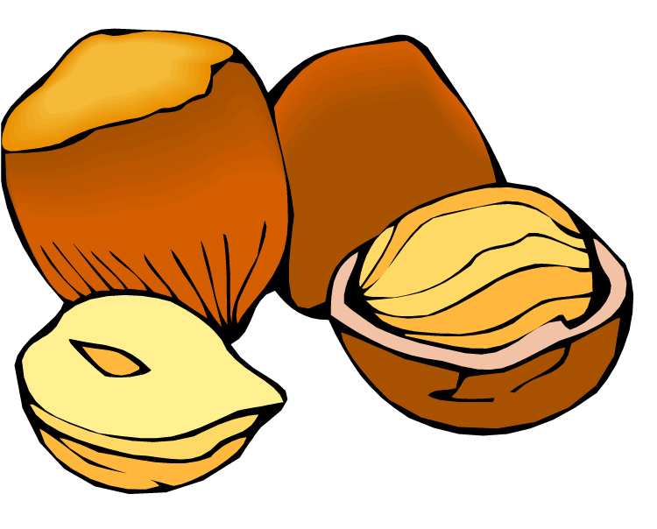
nut

Slide 5
cut

Slide 6
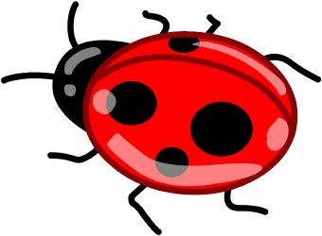
bug

Slide 7
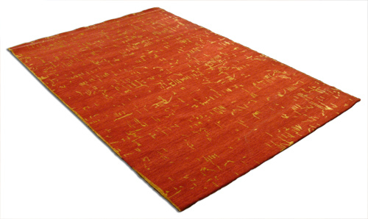
rug

Slide 8
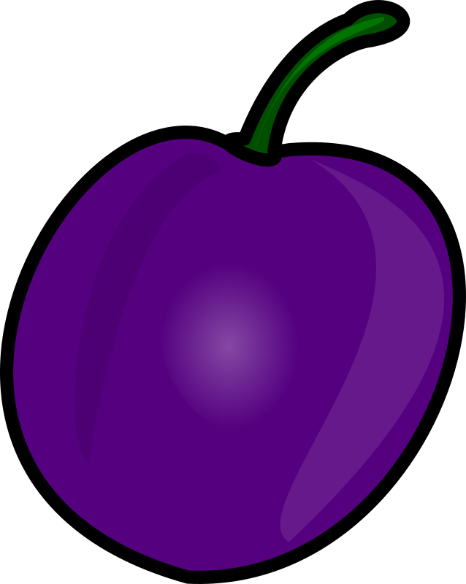
plum

Slide 9
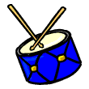
drum

Slide 10
up

Slide 11
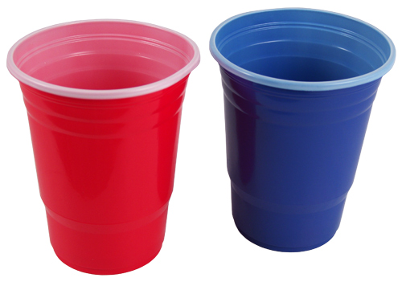
cup

Slide 12
High-Frequency Words
could
one

