Slide 1
At a Pond
Where do animals live together?
Unit 2, Week 3
Spelling Words

Slide 2
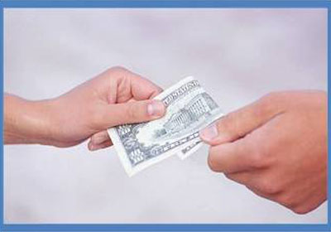
lend

Slide 3
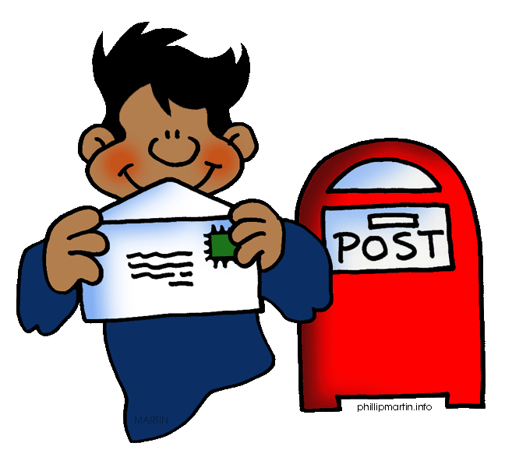
send

Slide 4
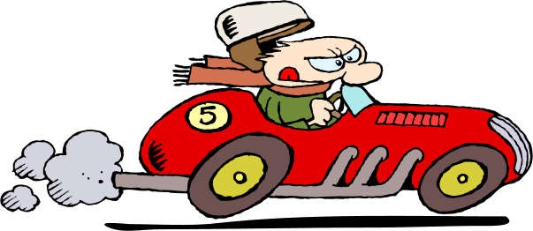
fast

Slide 5
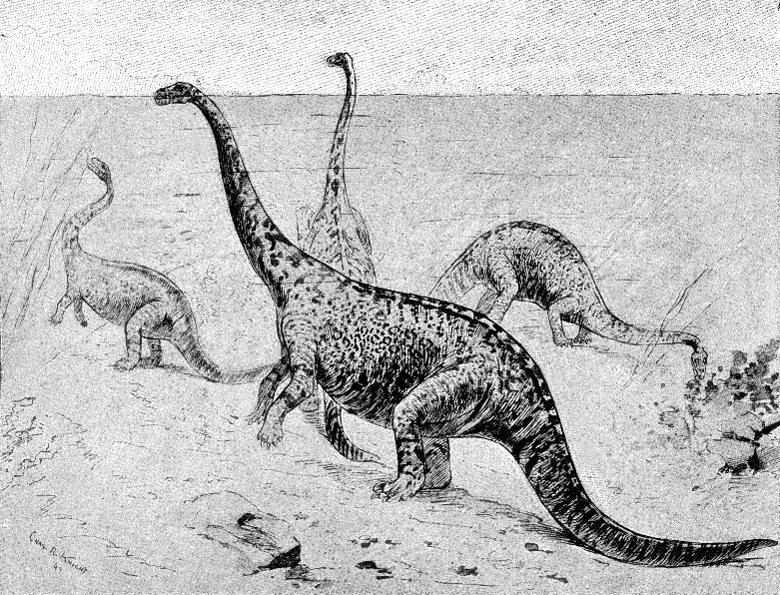
past

Slide 6
sink

Slide 7
wink

Slide 8
plant

Slide 9
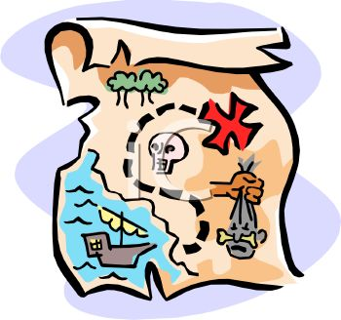
hunt

Slide 10
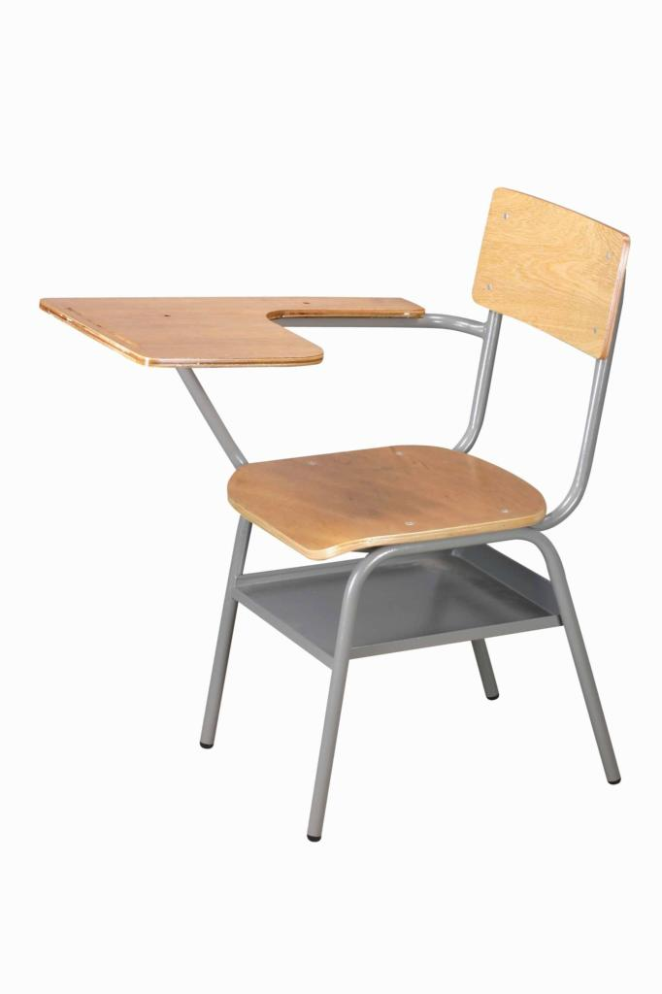
desk

Slide 11
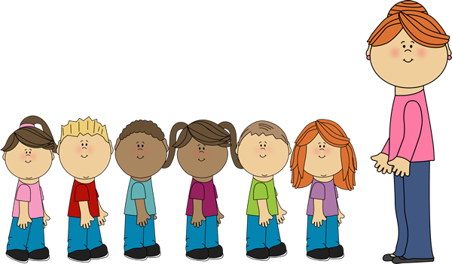
last

Slide 12
Challenge Words
of
who

