Slide 1
Nell’s Books
Unit 2, Week 4
Spelling Words

Slide 2
fish

Slide 3
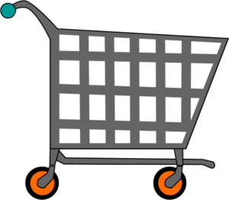
shop

Slide 4
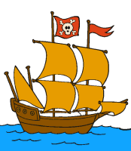
ship

Slide 5
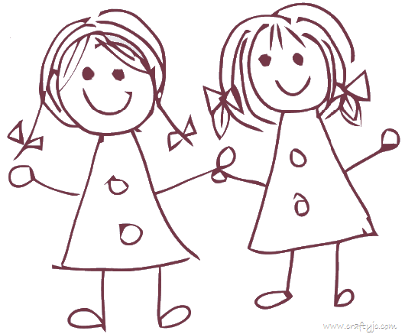
with

Slide 6
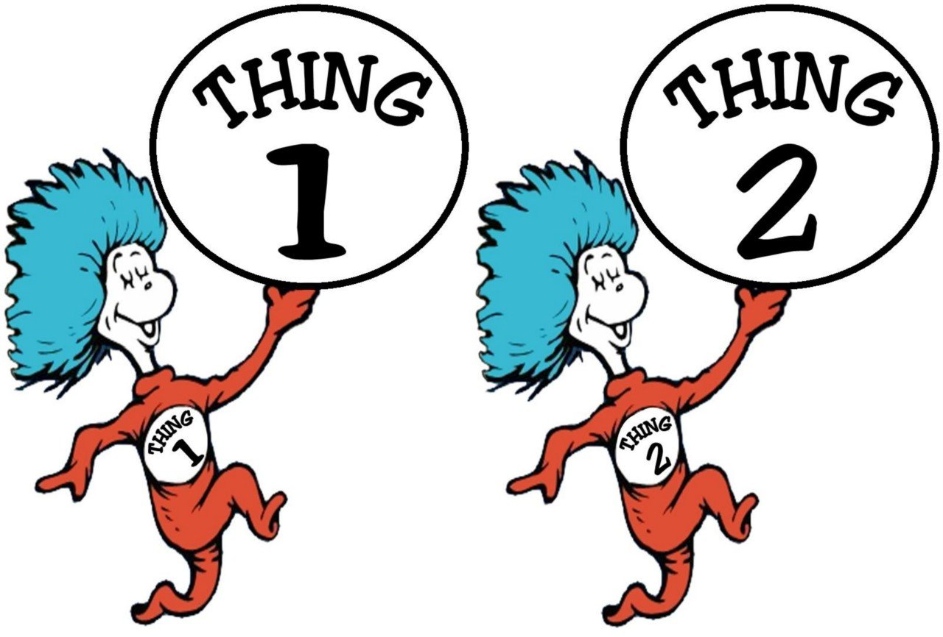
thing

Slide 7
sang

Slide 8
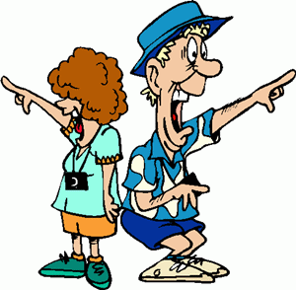
that

Slide 9
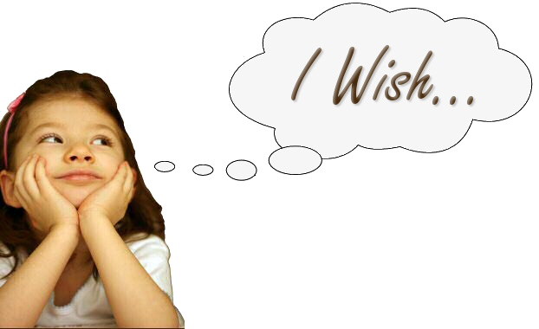
wish

Slide 10
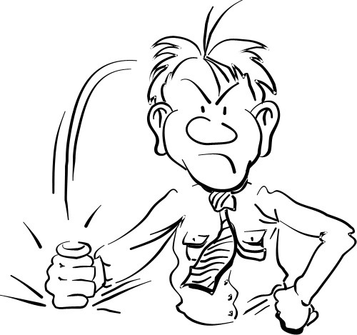
bang

Slide 11
this

Slide 12
Challenge Words
want
call

