Slide 1

On My way to school
Unit 3, Week 1
Spelling Words

Slide 2
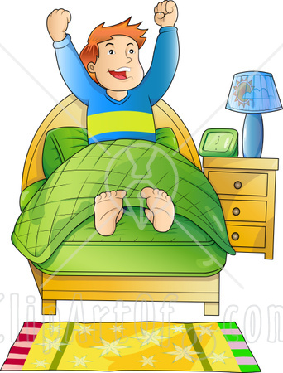
wake

Slide 3

take

Slide 4
Came

Slide 5
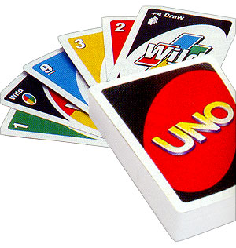
game

Slide 6
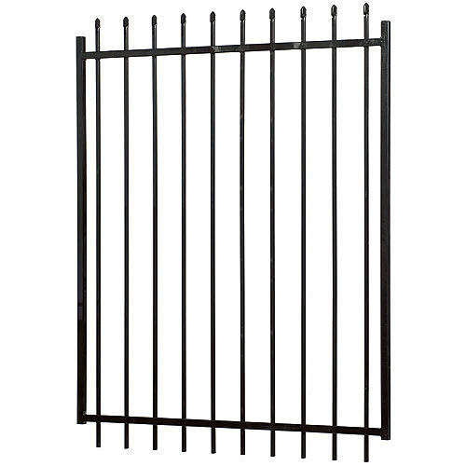
gate

Slide 7

late

Slide 8
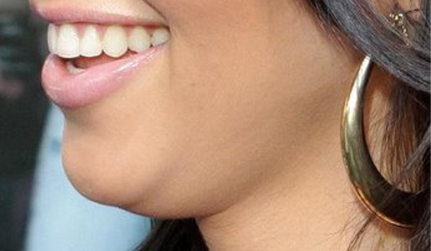
chin

Slide 9
graph

Slide 10
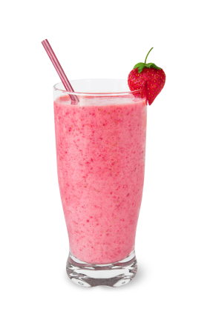
shake

Slide 11

Can’t

Slide 12
Challenge Words
today
some

