Slide 1
The Big Yuca Plant
Unit 3, Week 2
Spelling Words

Slide 2
like

Slide 3
spike

Slide 4
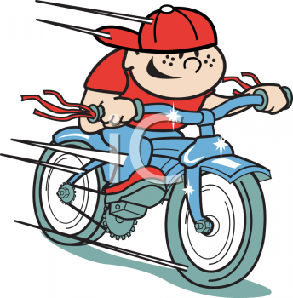
ride

Slide 5
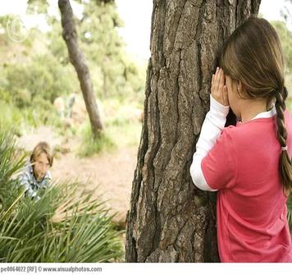
hide

Slide 6
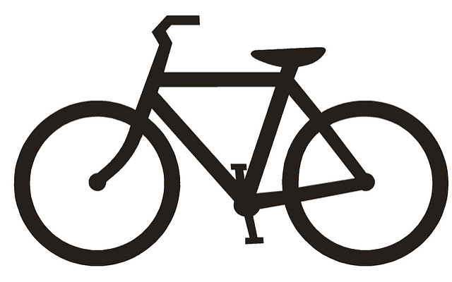
bike

Slide 7
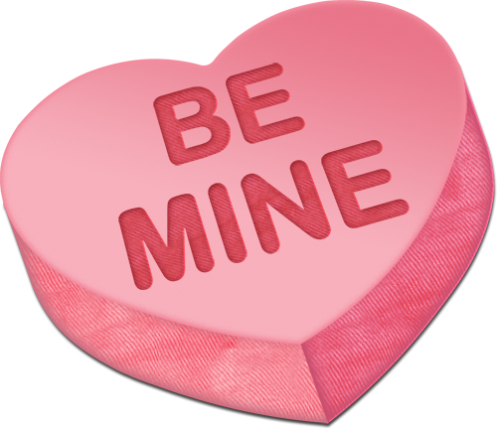
mine

Slide 8
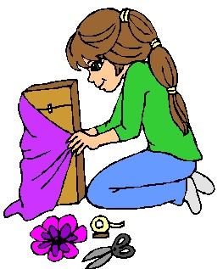
make

Slide 9
came

Slide 10
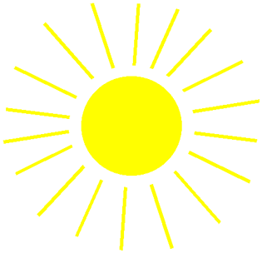
shine

Slide 11
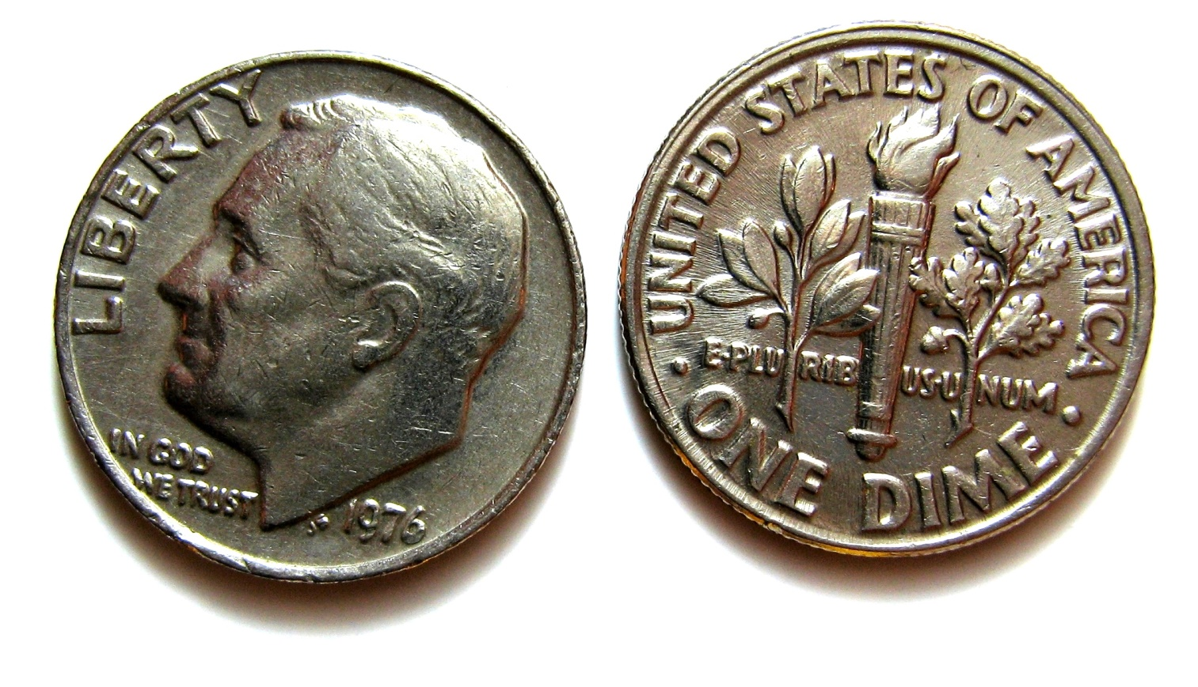
dimes

Slide 12
High-Frequency Words
water
should

