Slide 1
Long ago and now
Unit 3, Week 4
How is life different than it was long ago?

Slide 2
hope

Slide 3
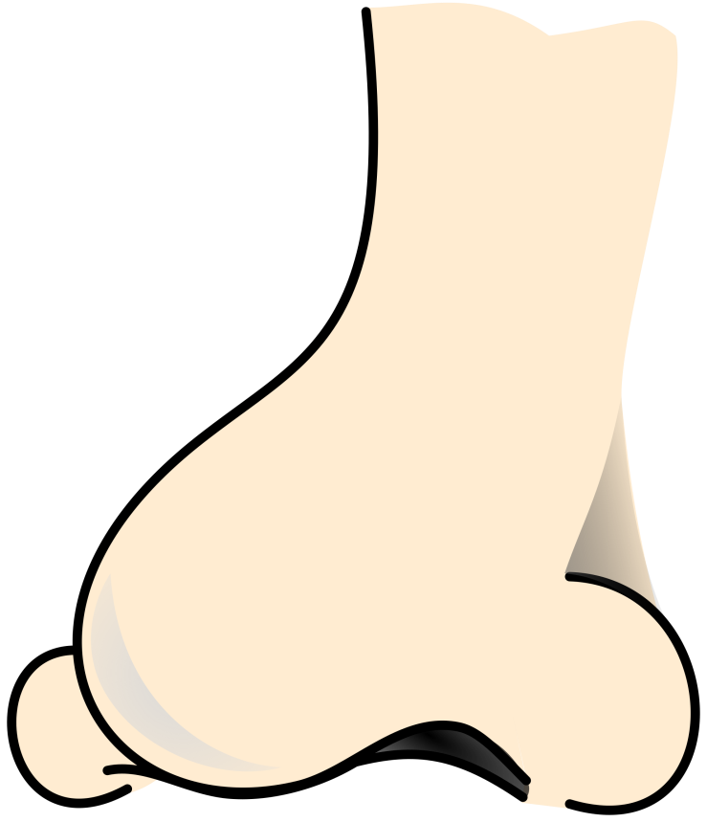
nose

Slide 4
note

Slide 5
rope

Slide 6
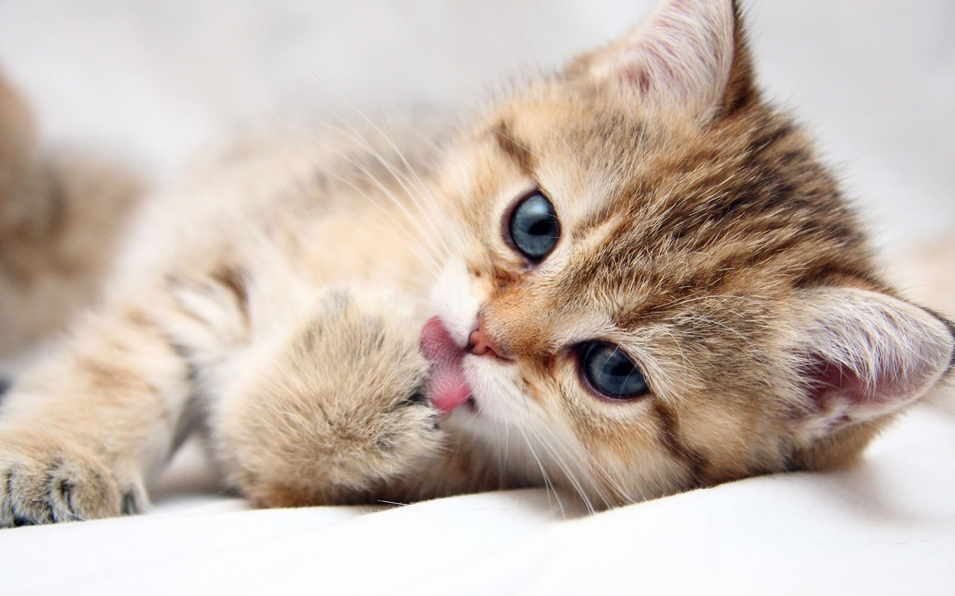
cute

Slide 7
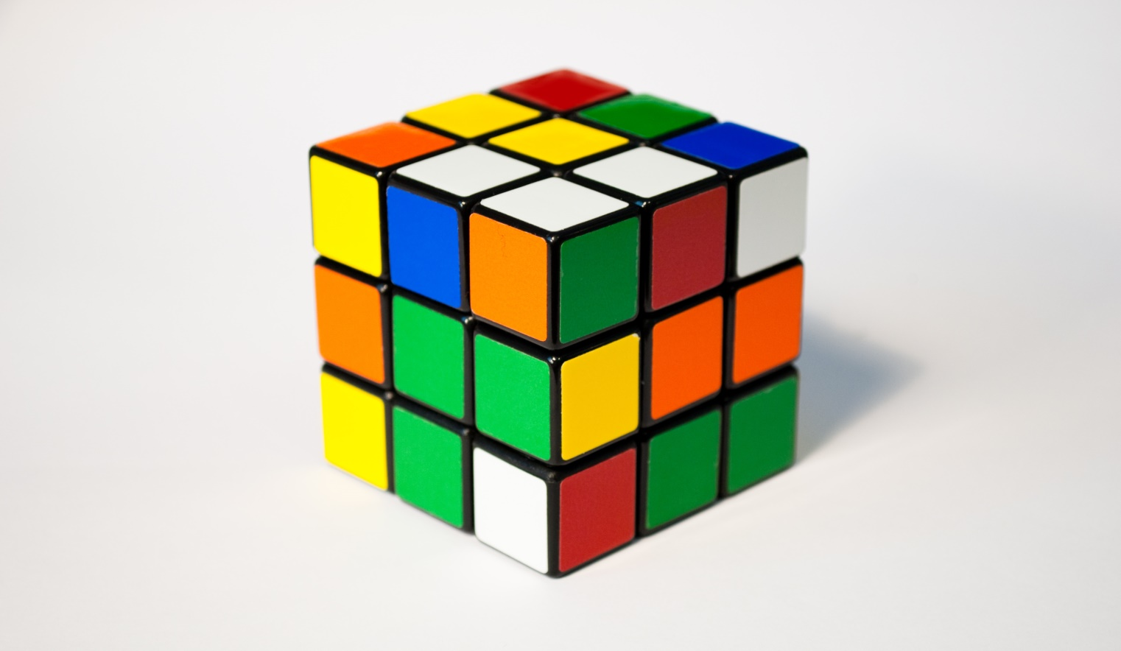
cube

Slide 8
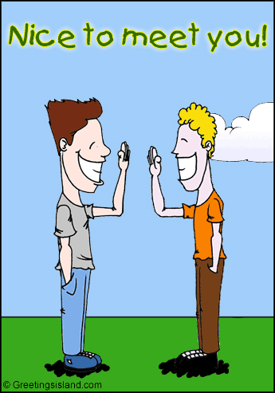
nice

Slide 9
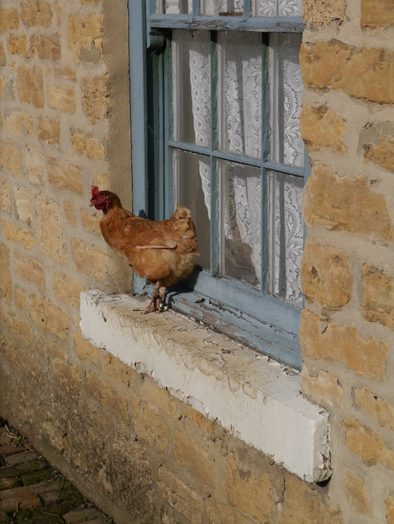
ledge

Slide 10
quote

Slide 11
close

Slide 12
High-Frequency Words
ago
people

