Slide 1
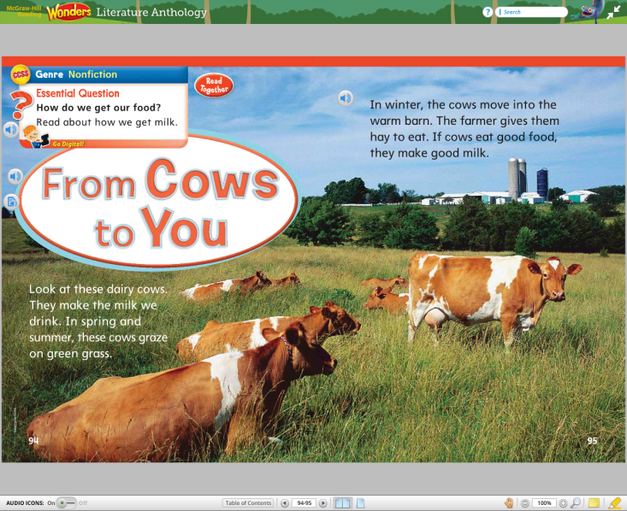
From Cows to You
Unit 3, Week 5
How do we get our food?

Slide 2
book

Slide 3
look

Slide 4
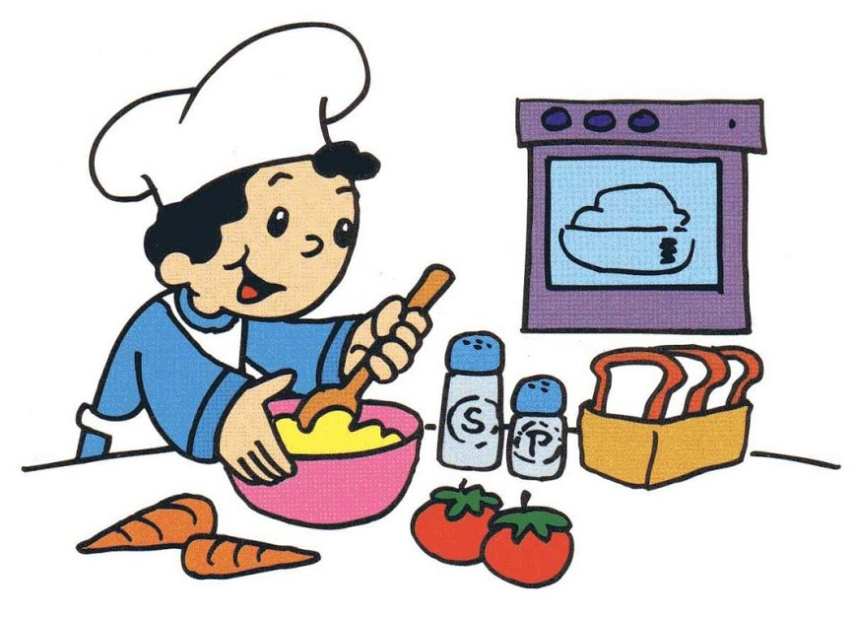
cook

Slide 5
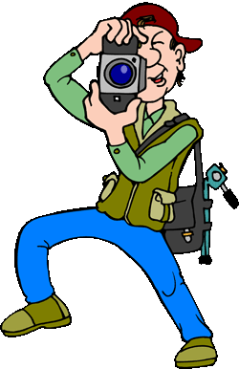
took

Slide 6
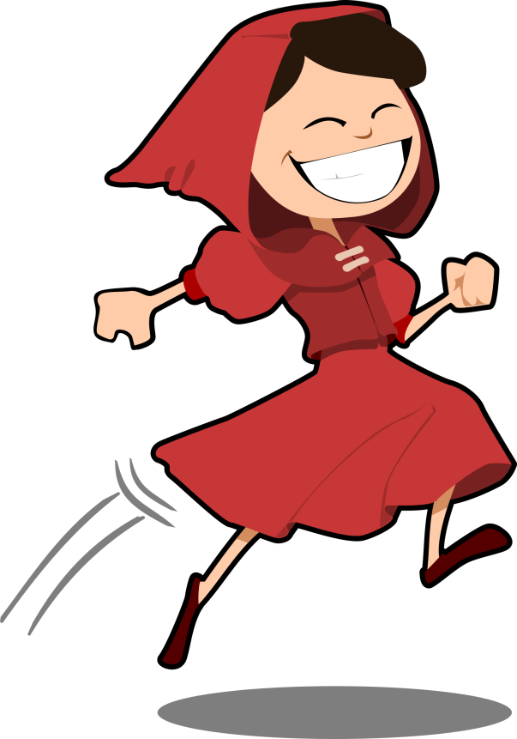
hood

Slide 7
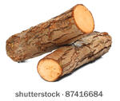
wood

Slide 8
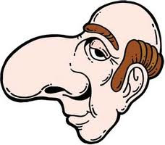
nose

Slide 9
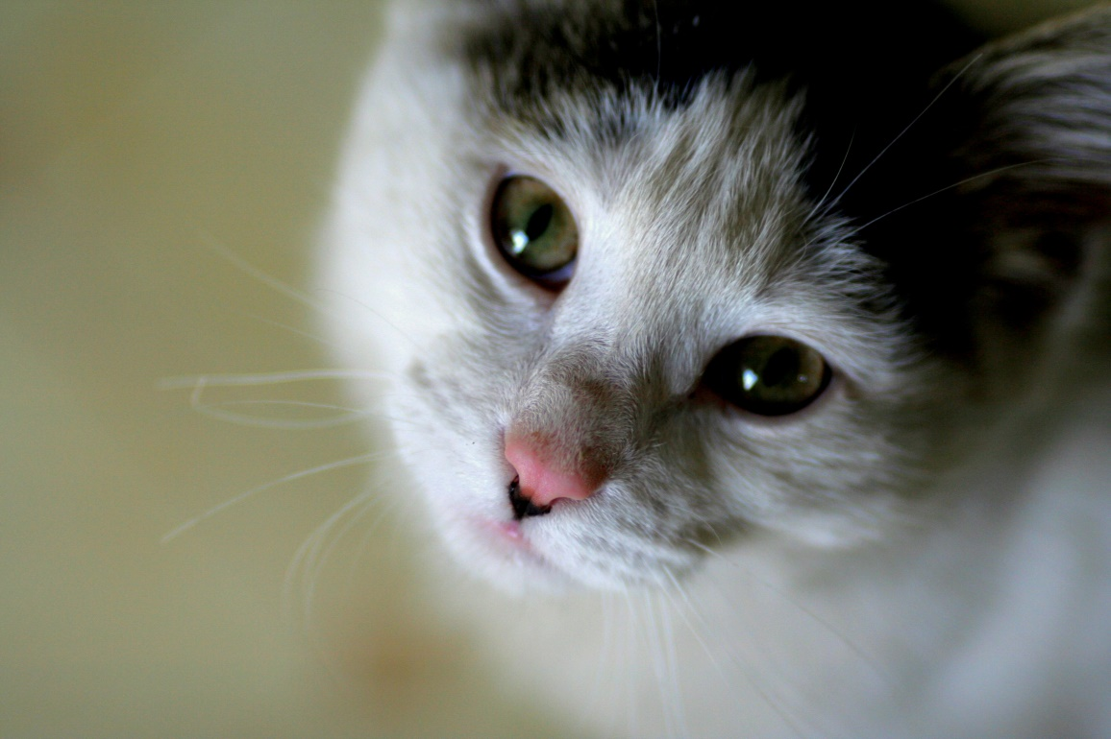
cute

Slide 10
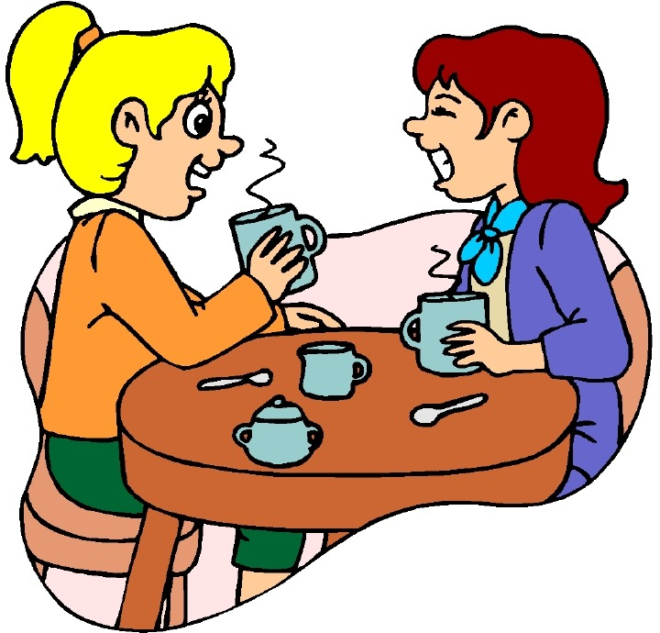
Chatted
Chatting

Slide 11
High-Frequency Words
buy
done

