Slide 1
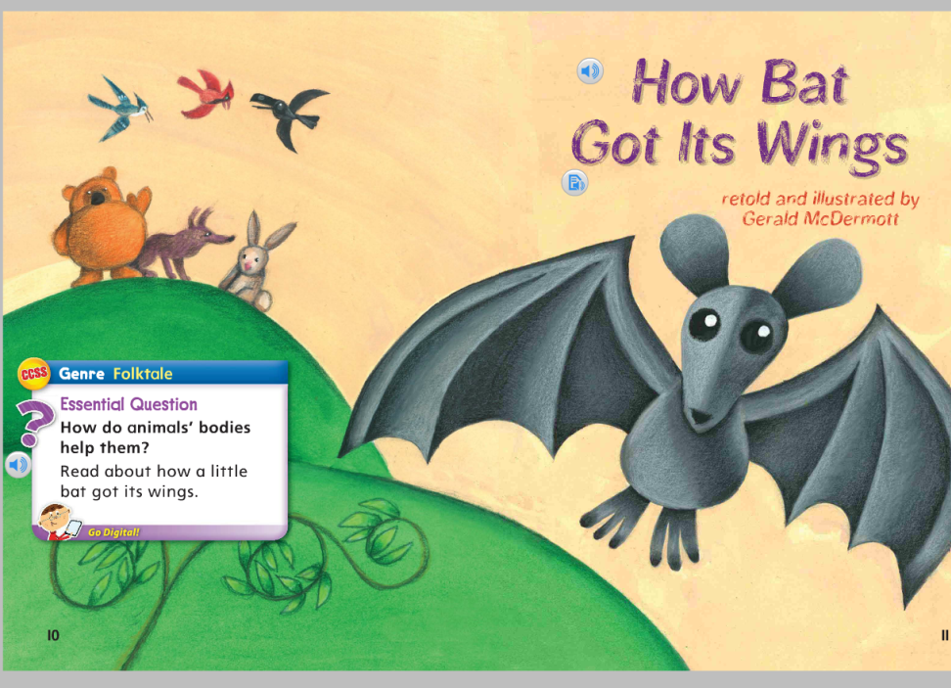
How Bat Got Its Wings
Unit 4, Week 1
How do animals’ bodies help them?

Slide 2
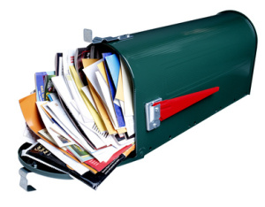
mail

Slide 3
rain

Slide 4
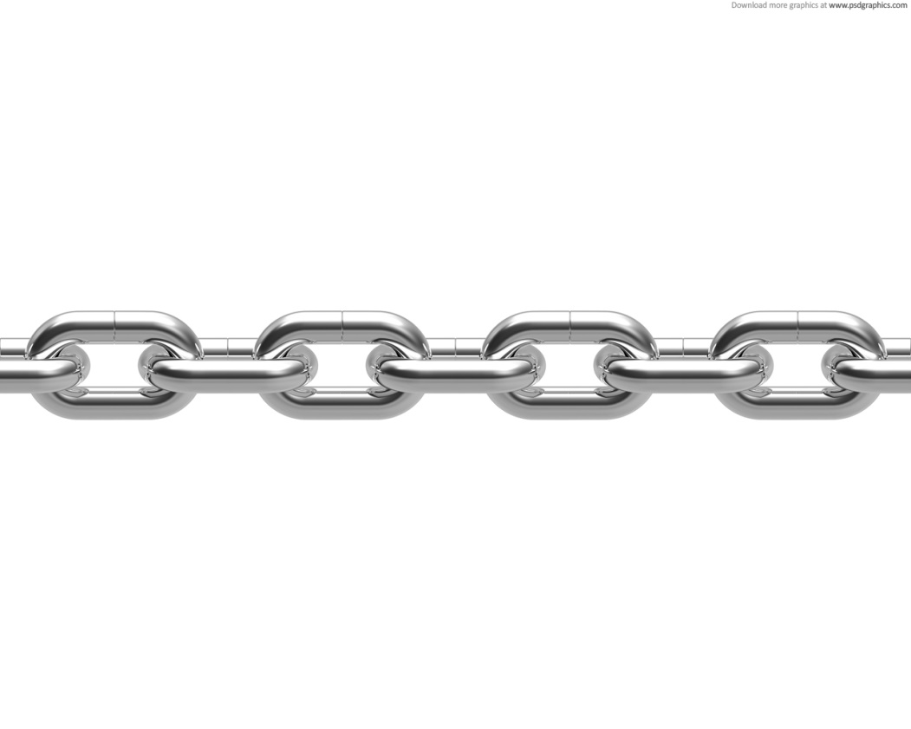
chain

Slide 5
way

Slide 6
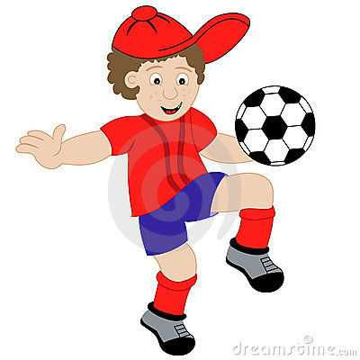
play

Slide 7
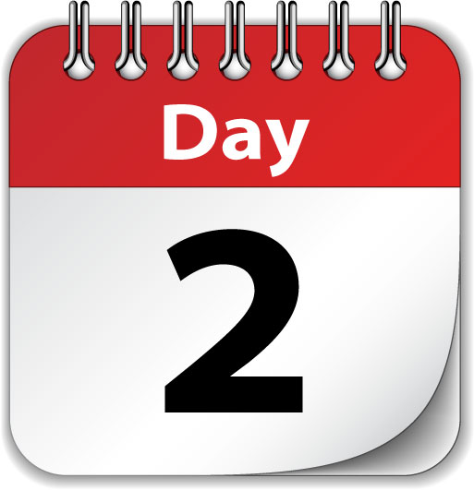
day

Slide 8
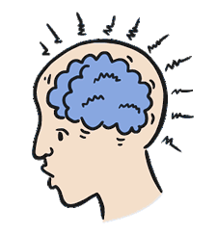
brain

Slide 9
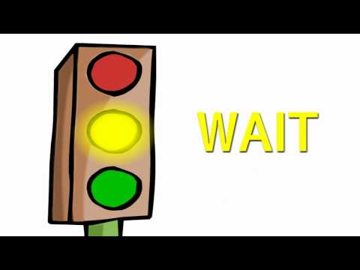
wait

Slide 10
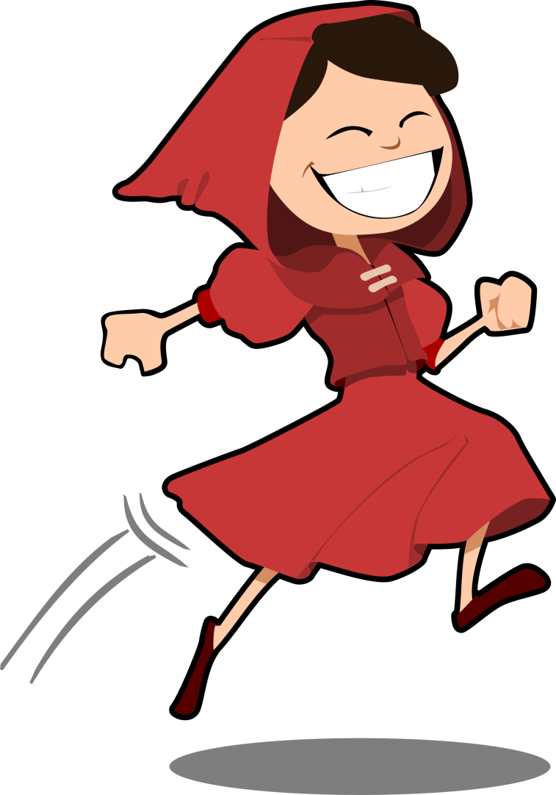
hood

Slide 11
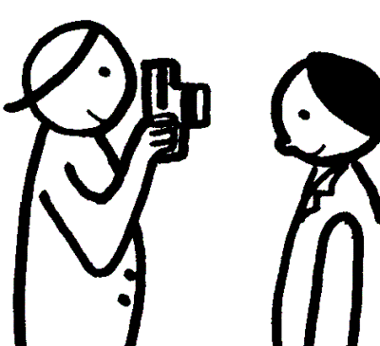
took

Slide 12
our carry
High-Frequency Words

