Slide 1
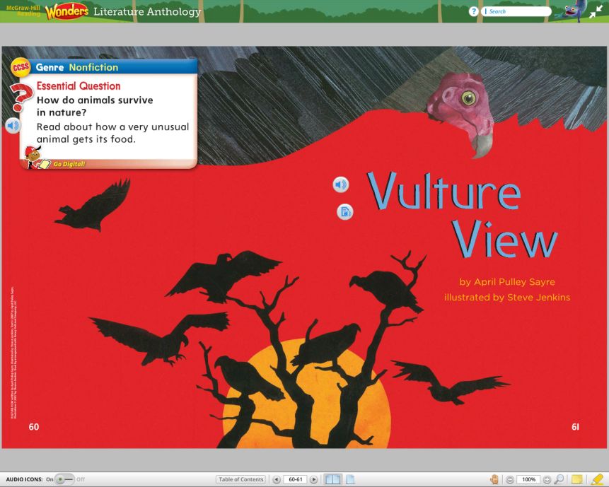
Vulture View
Unit 4, Week 3
How do animals survive in nature?

Slide 2
low

Slide 3
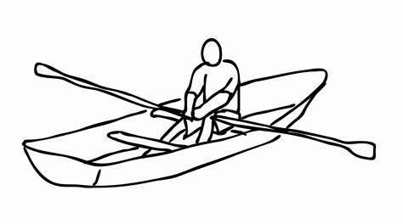
row

Slide 4
boat

Slide 5
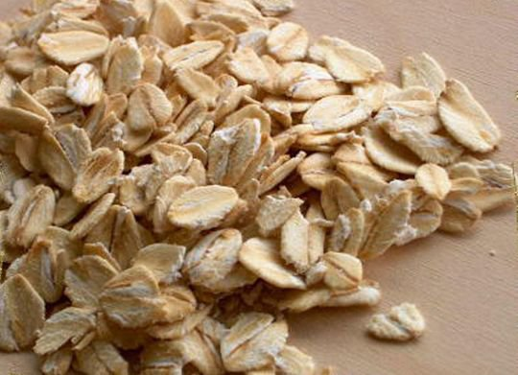
oat

Slide 6
coat

Slide 7
no

Slide 8
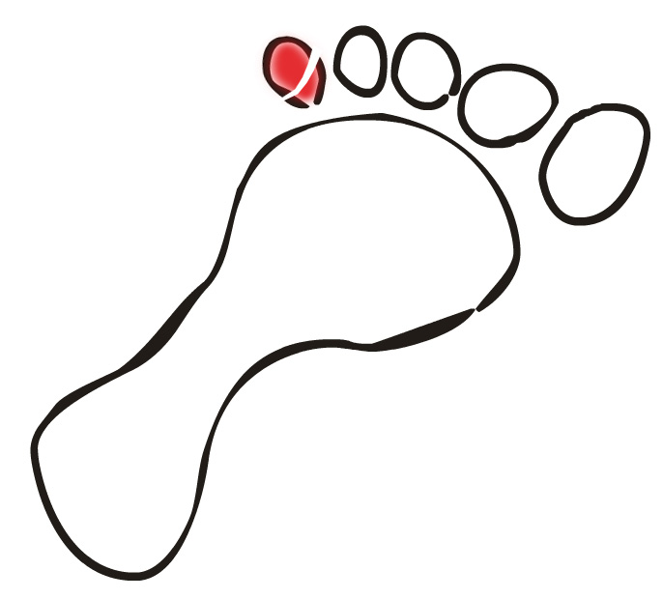
toe

Slide 9
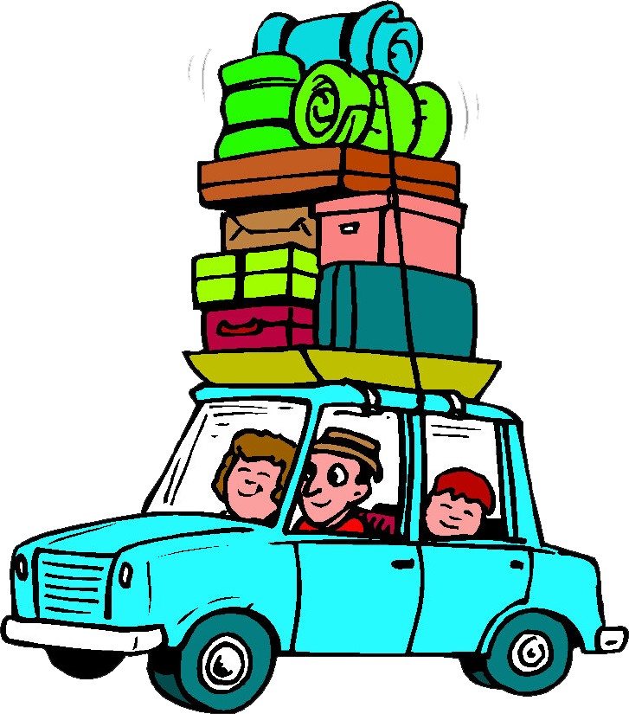
goes

Slide 10
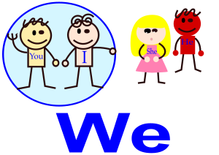
we

Slide 11
keep

Slide 12
High-Frequency Words
over
more

