Slide 1
Hi! Fly Guy
Unit 4, Week 4
What insects do you know about?

Slide 2
find

Slide 3
kind

Slide 4
night

Slide 5
right

Slide 6
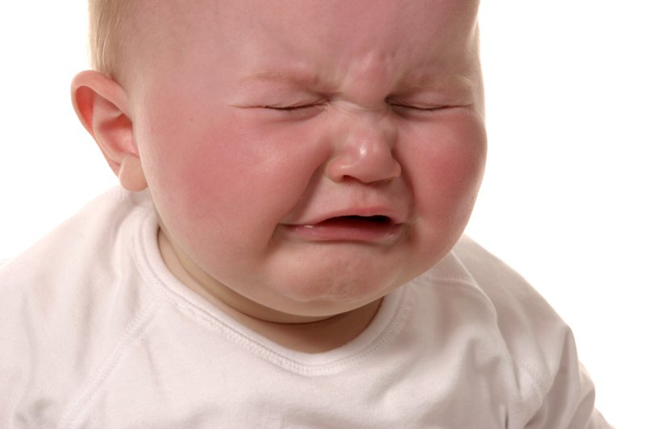
cry

Slide 7
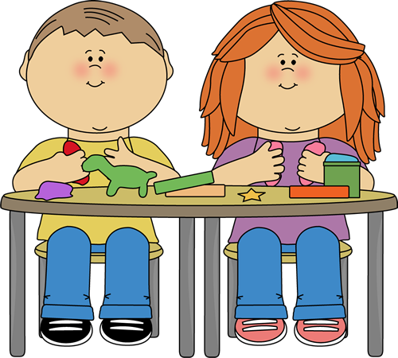
by

Slide 8
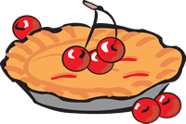
pie

Slide 9
no

Slide 10
boat

Slide 11
Challenge Words
caught
listen

