Slide 1
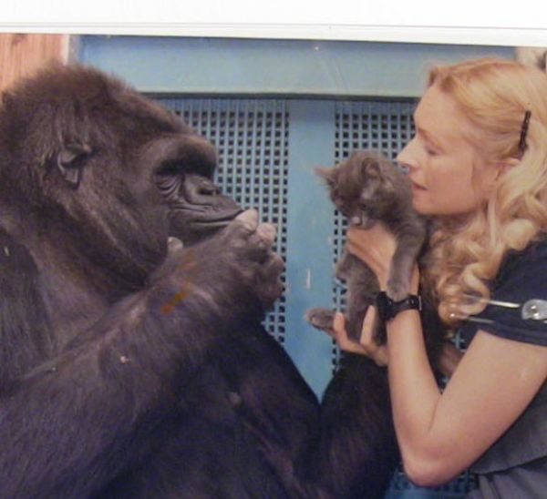
Koko and Penny
Unit 4, Week 5
Sight Words

Slide 2
Read the words as they appear.
found
hard
near
woman
would
write
wash

Slide 3
found hard near woman would write wash
found
We ______ our lost dog.

Slide 4
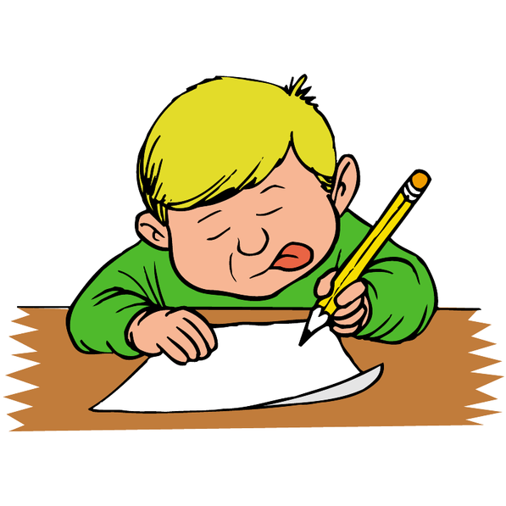
found hard near woman would write wash
It is not _____ to write your name.
hard

Slide 5
found hard near woman would write wash
The ______ has a dress on.
woman

Slide 6
found hard near woman would write wash
Do you live _______ the school?
near

Slide 7
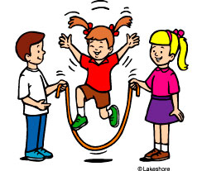
found hard near woman would write wash
I ________ like you to play with us.
would

Slide 8
found hard near woman would write wash
We _______ a lot in 1st grade.
write

Slide 9
found hard near woman would write wash
Please _____ your hands before you eat.
wash

