Slide 1
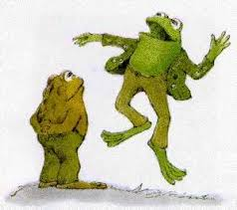
A Lost Button
Unit 5, Week 1
How can we classify and categorize things?

Slide 2
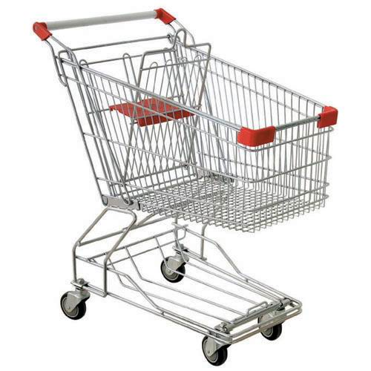
cart

Slide 3
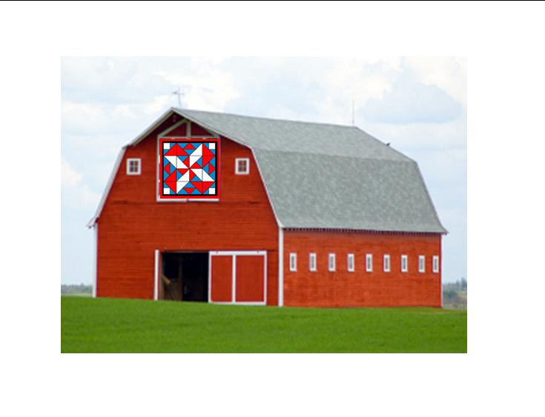
barn

Slide 4
arm

Slide 5
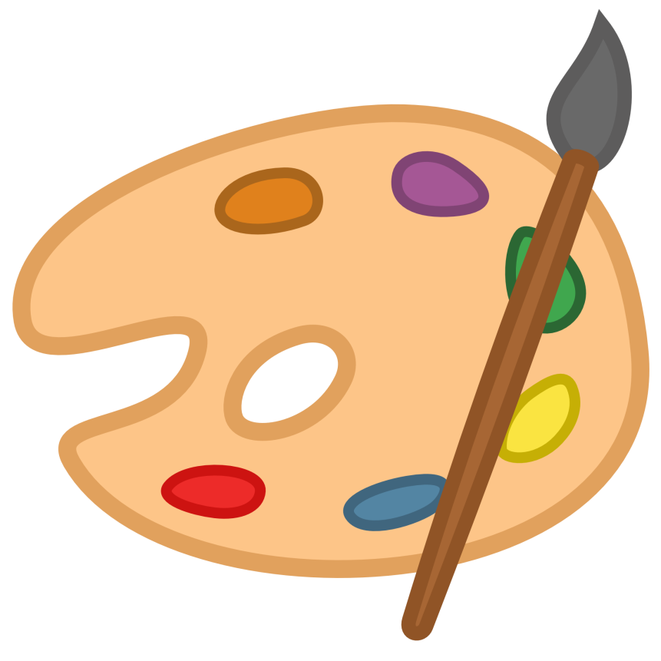
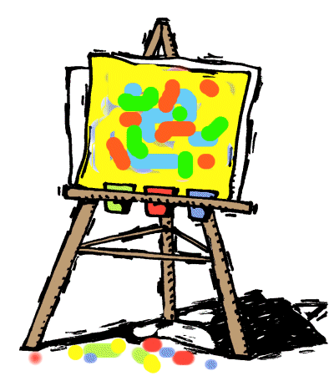
art

Slide 6
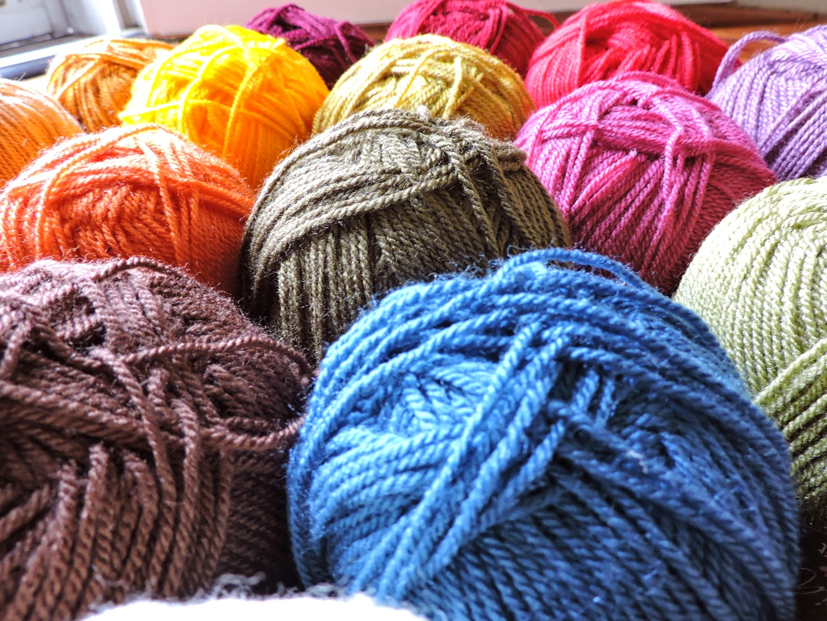
yarn

Slide 7
harm

Slide 8
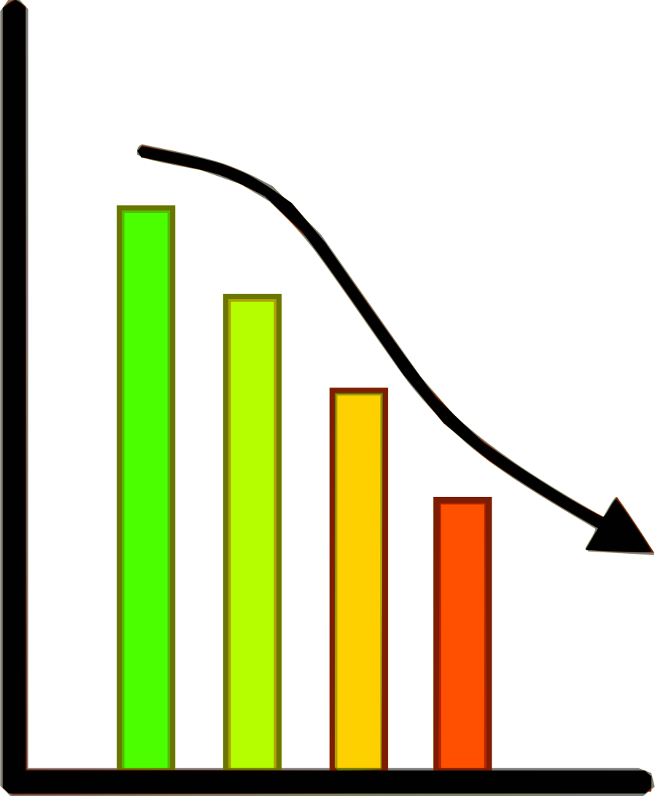
chart

Slide 9
smart

Slide 10
happy

Slide 11
key

Slide 12
Challenge Words
four
none

