Slide 1
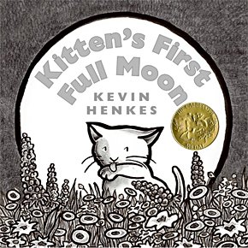
Kitten’s First Full Moon
Unit 5, Week 2
Spelling Words

Slide 2
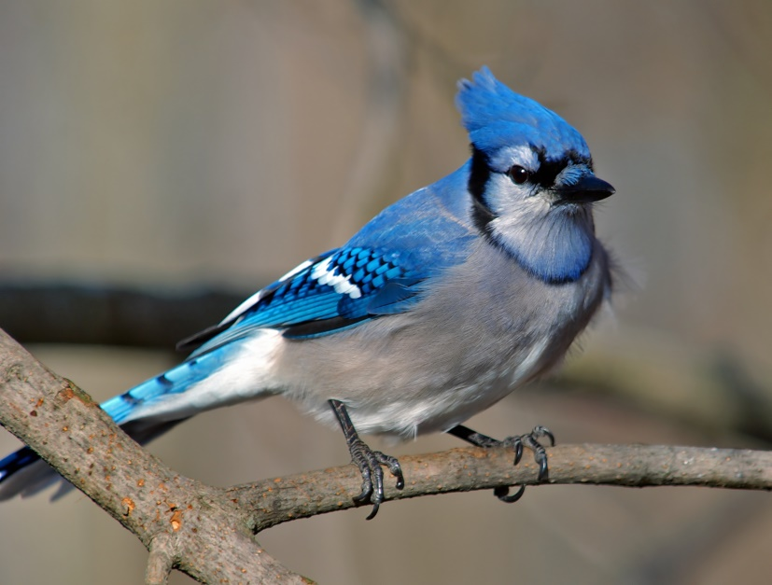
bird

Slide 3
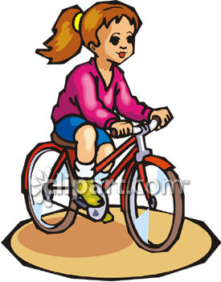
her

Slide 4
work

Slide 5
dirt

Slide 6
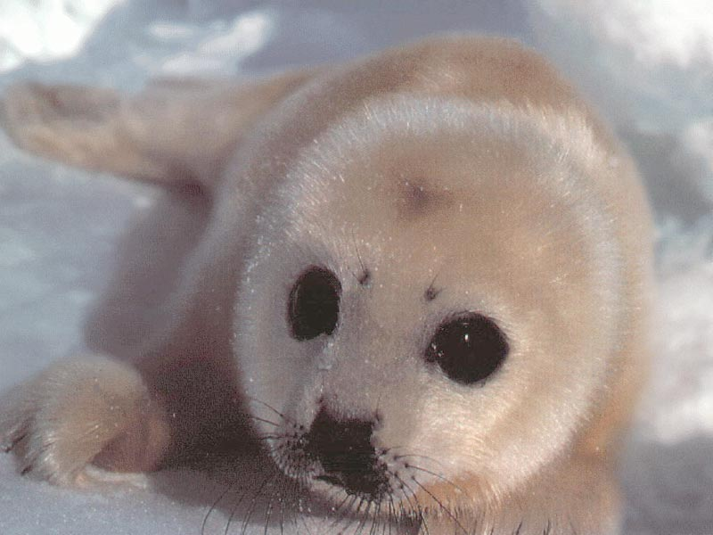
fur

Slide 7
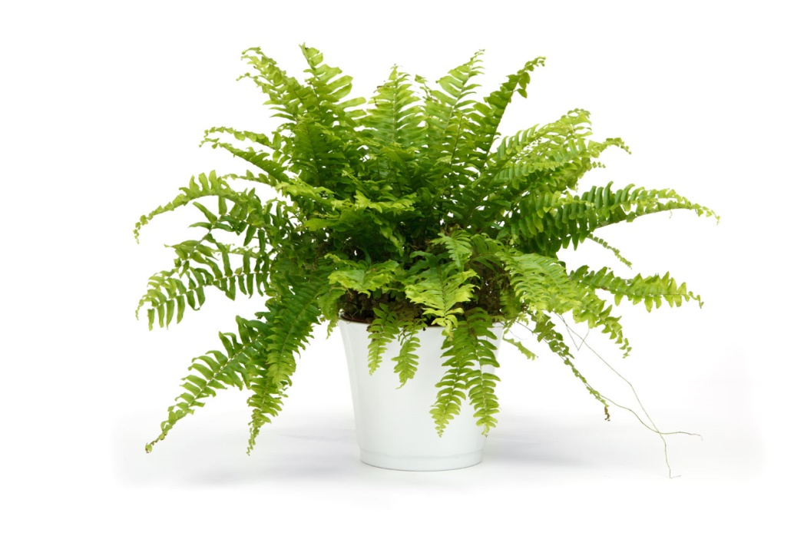
fern

Slide 8
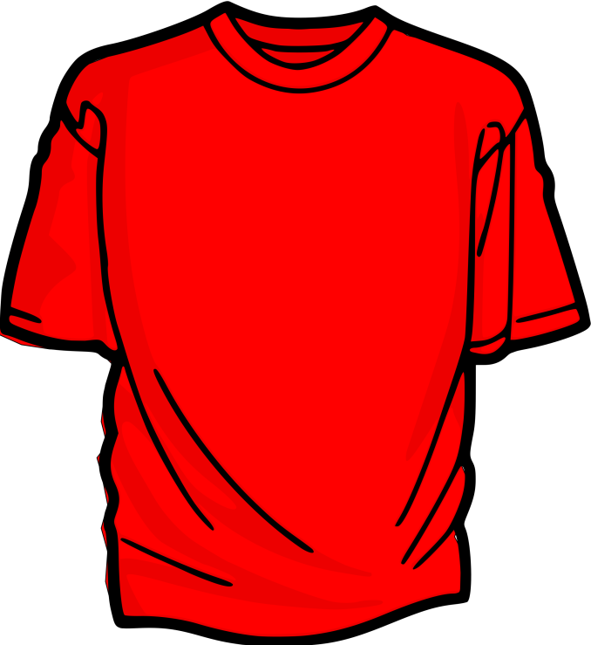
shirt

Slide 9
burn

Slide 10
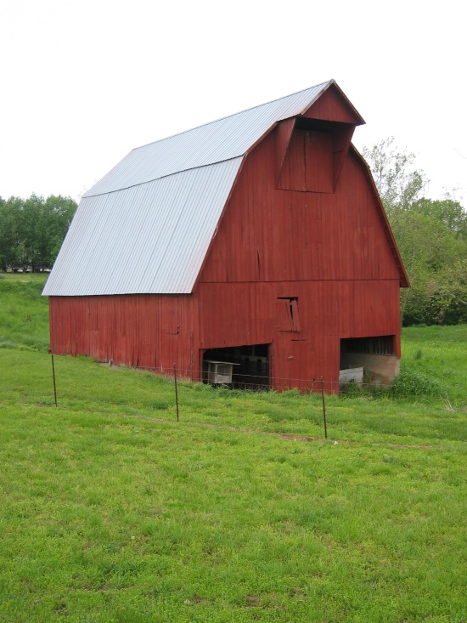
barn

Slide 11
arm

Slide 12
Challenge words
climb
through

