Slide 1
Whistle for Willie
Unit 5, Week 4
What sounds can you hear? How are they made?

Slide 2
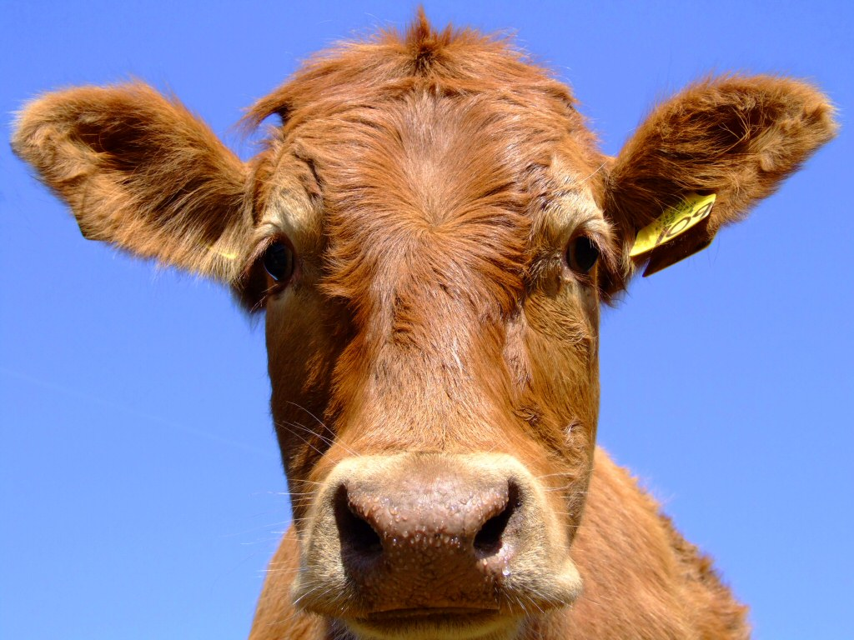
cow

Slide 3
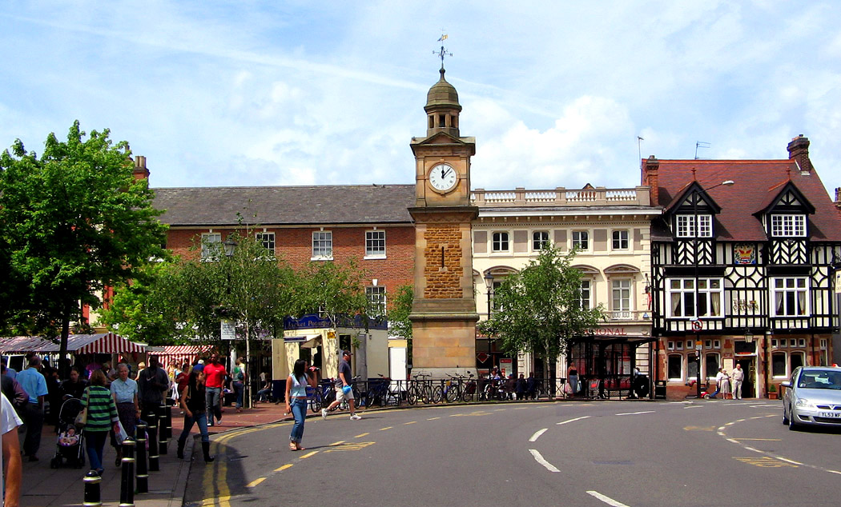
town

Slide 4
mouse

Slide 5
how

Slide 6
out

Slide 7
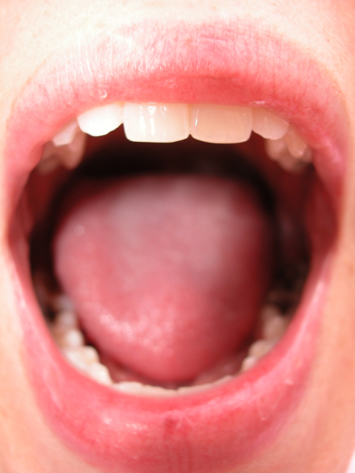
mouth

Slide 8
brown

Slide 9
cloud

Slide 10
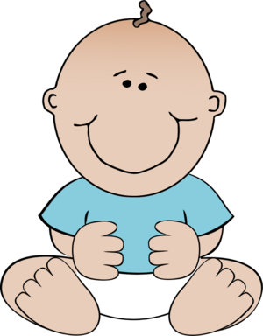
born

Slide 11
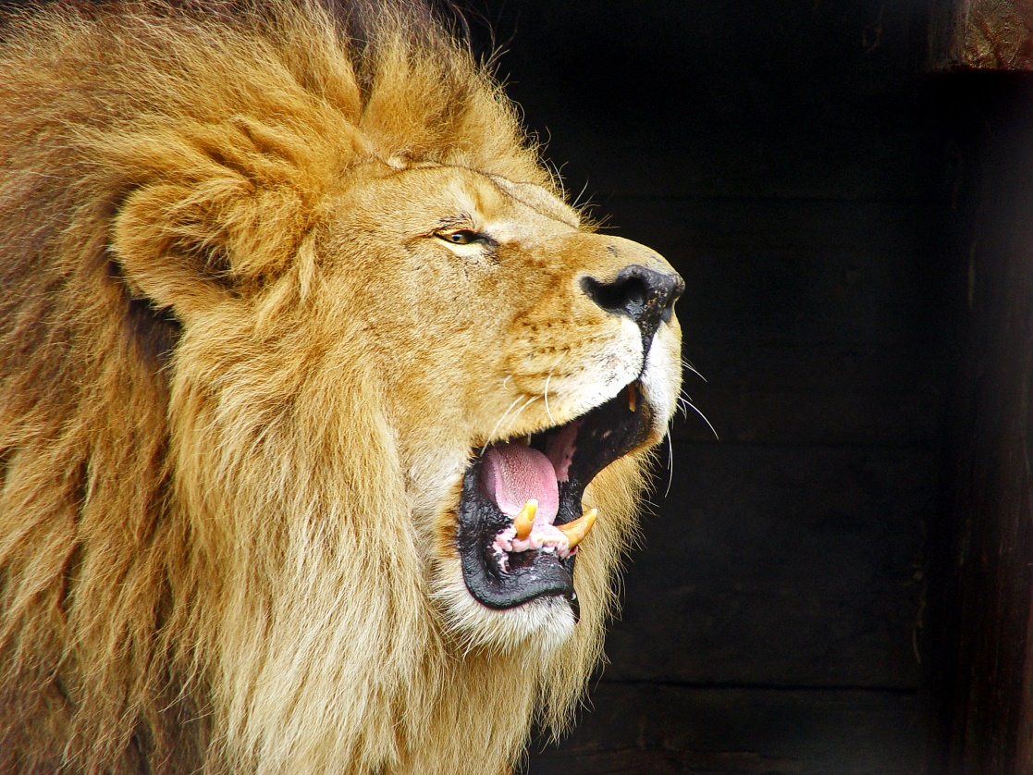
roar

Slide 12
Challenge Words
nothing
early

