Slide 1
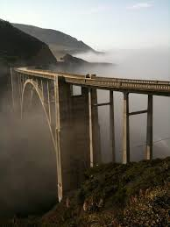
Building Bridges
Unit 5, Week 5
Spelling Words
How do things get built?

Slide 2
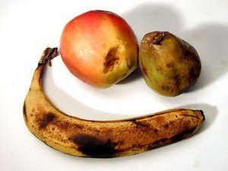
spoil

Slide 3
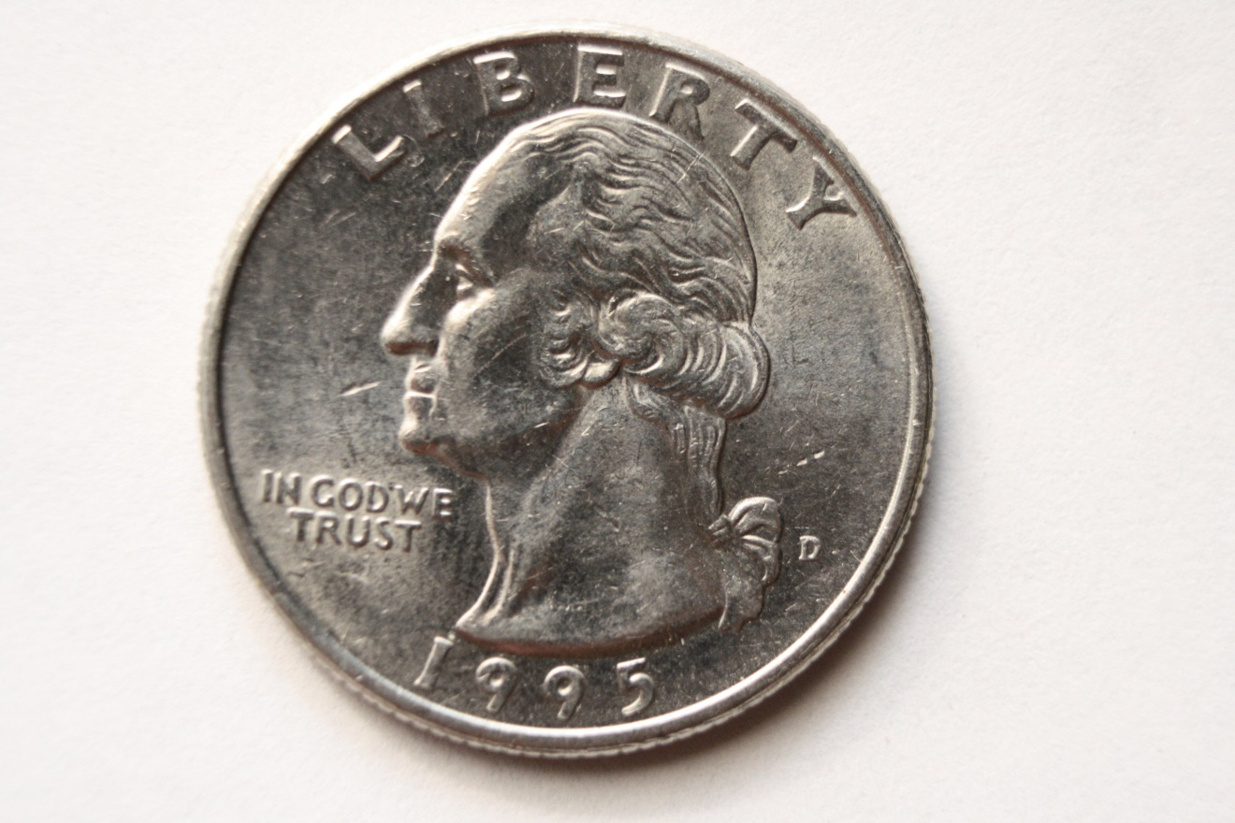
coin

Slide 4
join

Slide 5
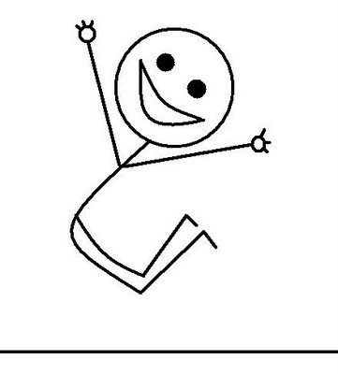
joy

Slide 6
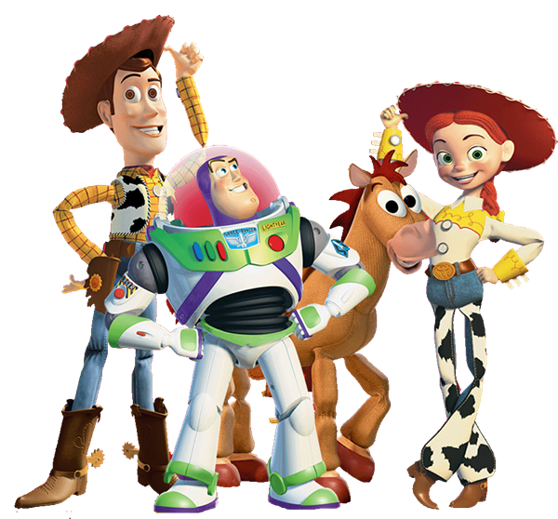
toy

Slide 7
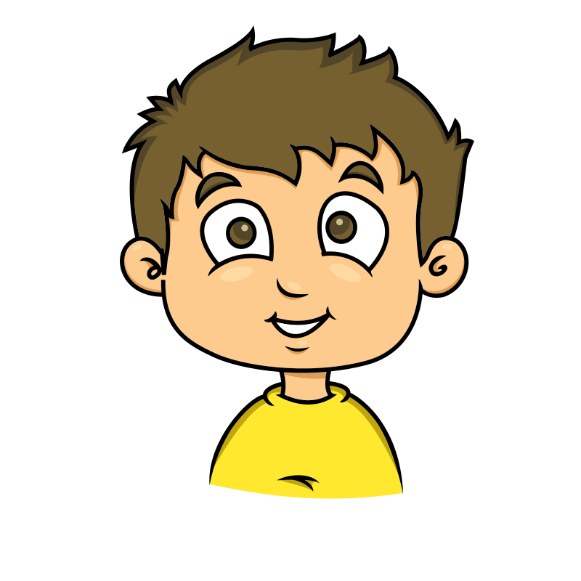
boy

Slide 8
enjoy

Slide 9
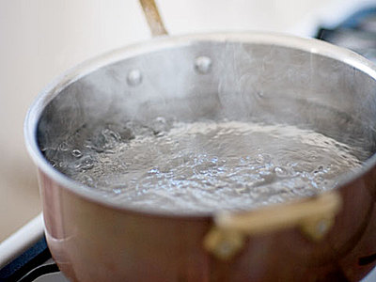
boil

Slide 10
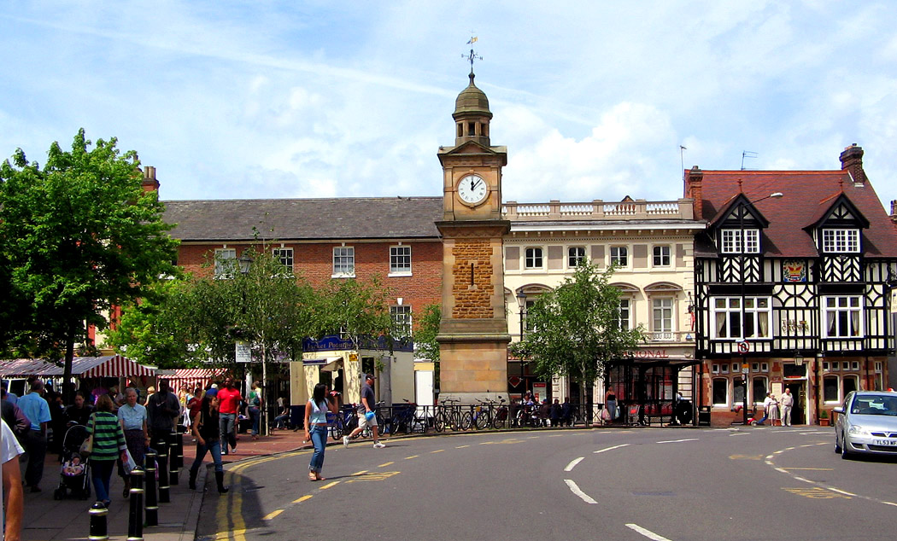
town

Slide 11
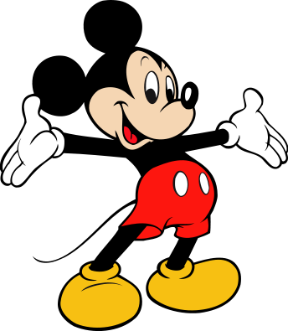
mouse

Slide 12
Challenge Words
build
fall

