Slide 1
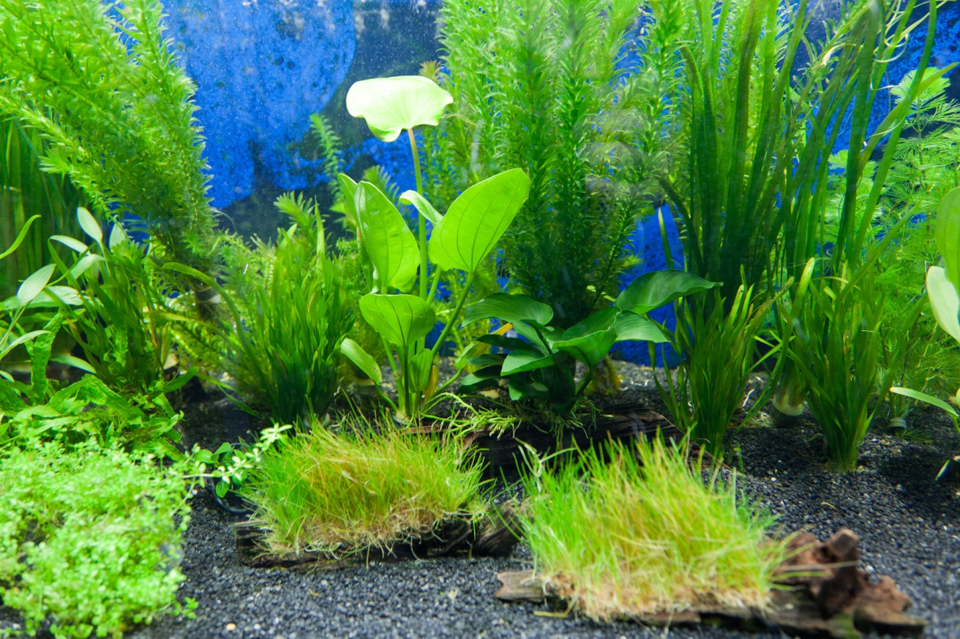
Unit 3 Week 2 Wonders- High Frequency Words
How do plants change as they grow?

Slide 2
Chant the word as it appears
green
grow
pretty
should
together
water

Slide 3
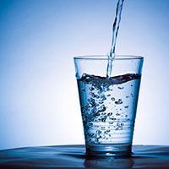
green grow pretty should together water
Do you want a drink of ____.
water

Slide 4
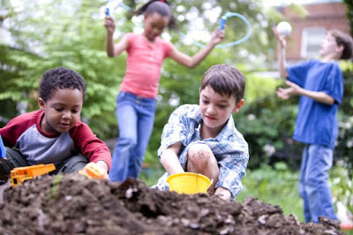
green grow pretty should together water
We can play _____.
together

Slide 5
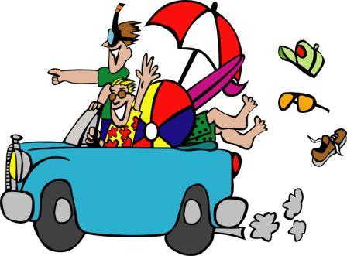
green grow pretty should together water
When _____ I come to see you?
should

Slide 6
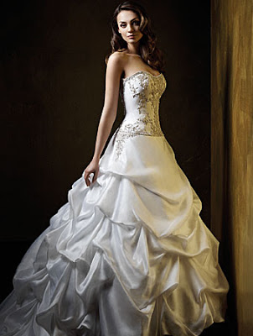
green grow pretty should together water
This is a ____ dress.
pretty

Slide 7
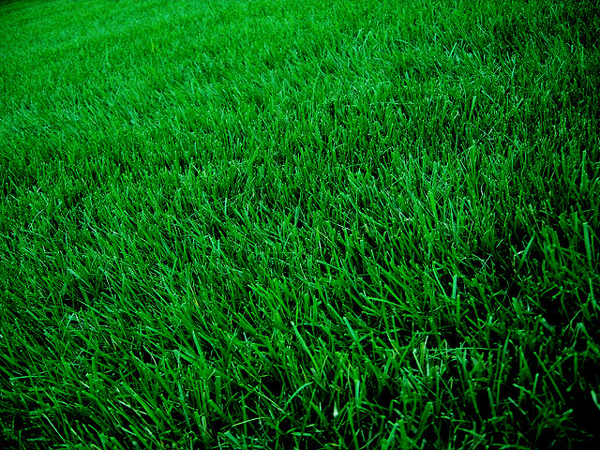
green grow pretty should together water
grow
The grass will _______.

Slide 8
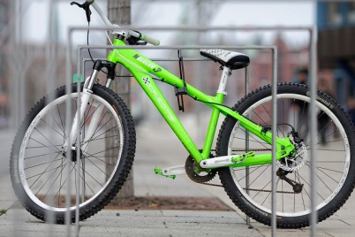
green grow pretty should together water
green
My new bike is ____ and white.

