Slide 1
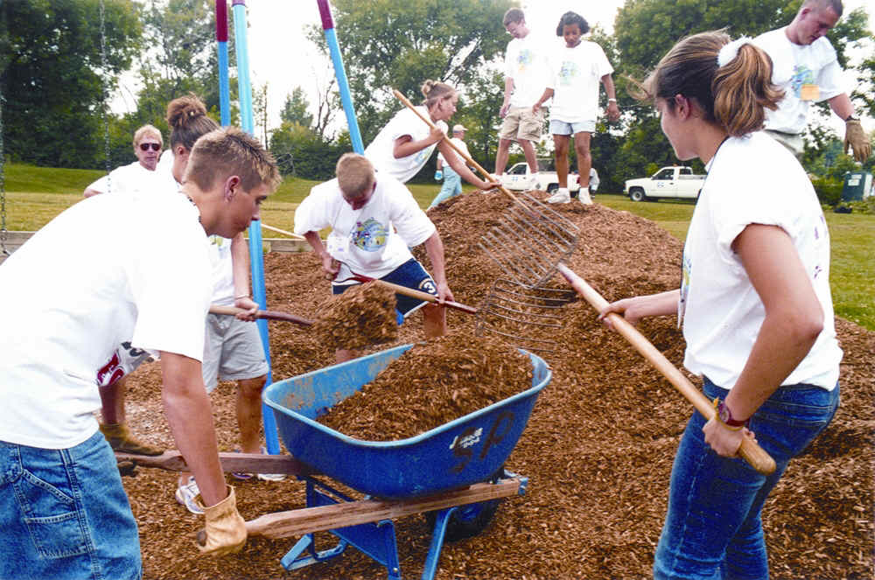
Unit 2 Week 4 Wonders- High Frequency Words
How do people help out in the community?

Slide 2
Chant the word as it appears
all
call
day
her
want

Slide 3
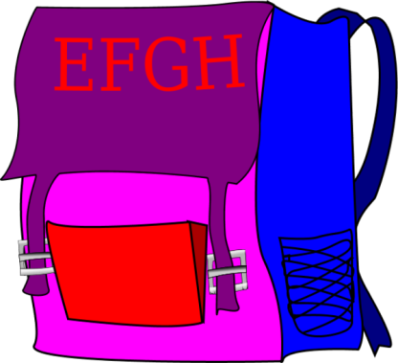
all call want day her
Beth lost ____ big bag!
her

Slide 4
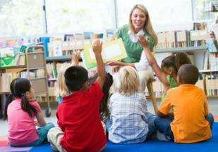
all call want day her
I see ____ the kids in the class.
all

Slide 5
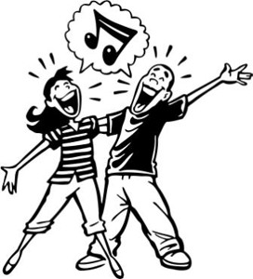
all call want day her
Do you _____ to sing a song with me?
want

Slide 6
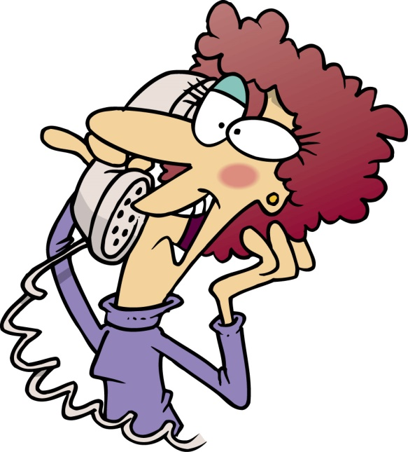
all call want day her
He thinks she should ____
Seth.
call

Slide 7
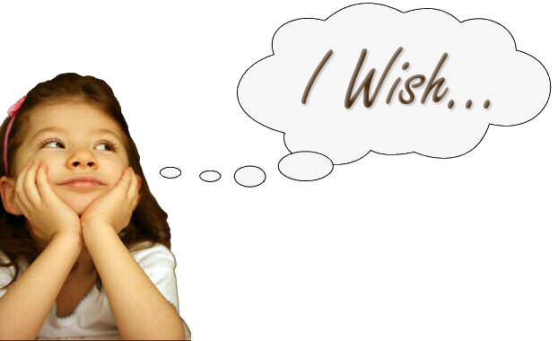
all call want day her
day
Beth will make a wish one _____.

