Slide 1
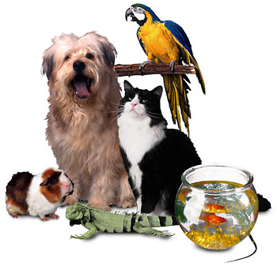
High Frequency Words Unit 1 Week 3
What makes a pet special?

Slide 2
Chant the words as they appear
be
come
good
pull

Slide 3
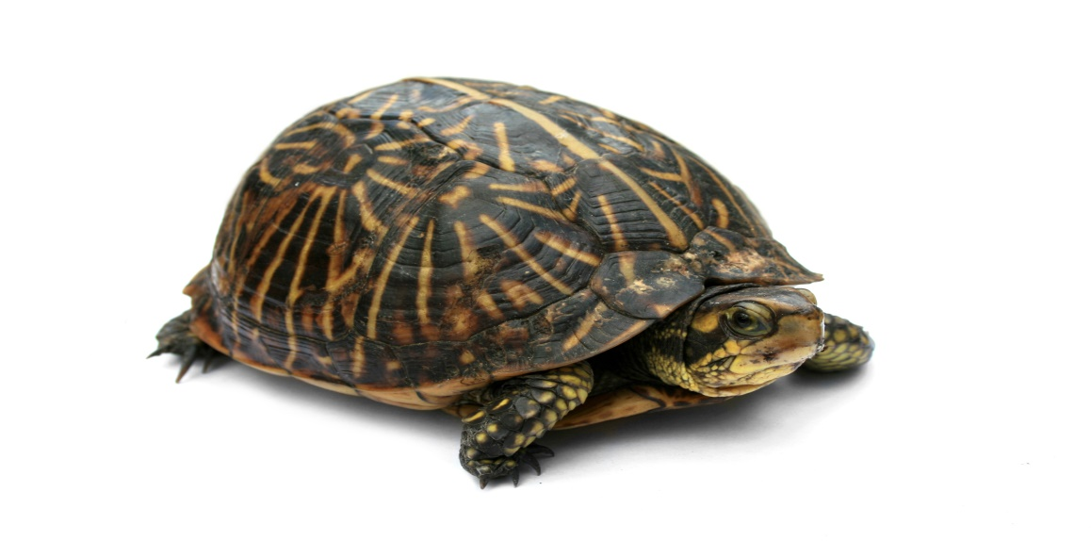
be come good pull
A turtle can _____ a good pet.
be

Slide 4
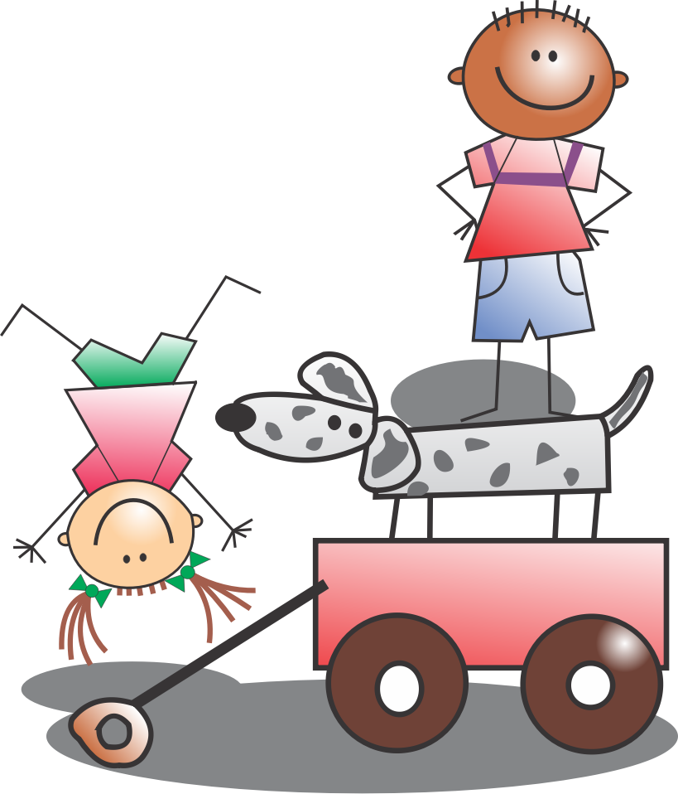
be come good pull
I will ____my dog in a wagon.
pull

Slide 5
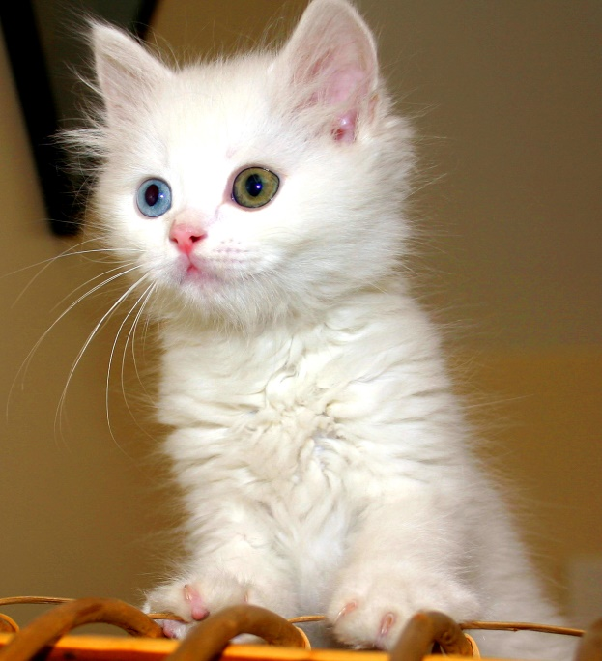
be come good pull
A cat is a ______ pet.
good

Slide 6
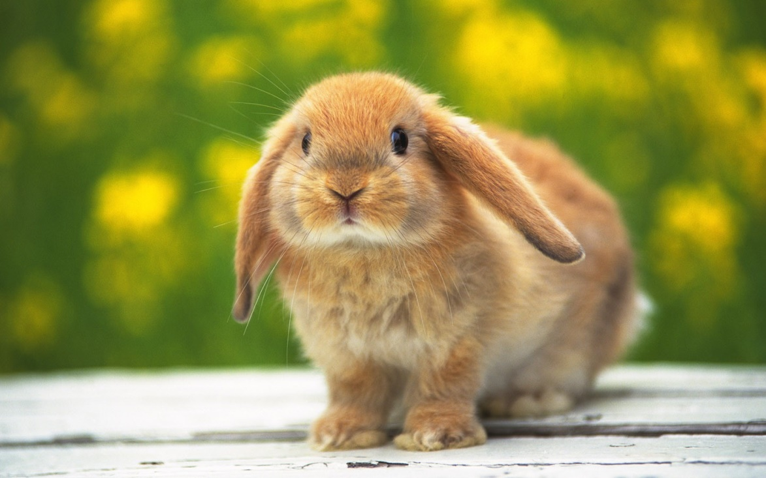
be come good pull
My bunny will _____ to eat.
come

