Slide 1
Unit 1, Week 1 Spelling Words
Nat and Sam

Slide 2
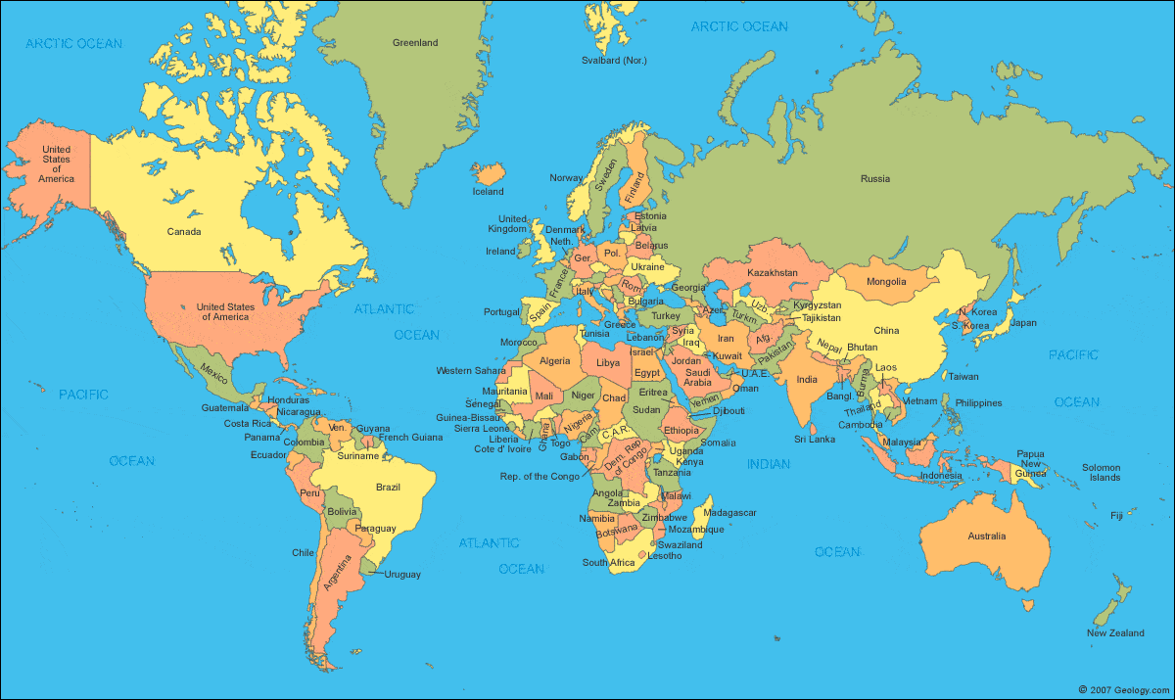
map

Slide 3
can

Slide 4
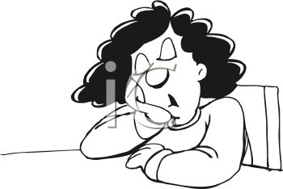
nap

Slide 5
tap

Slide 6
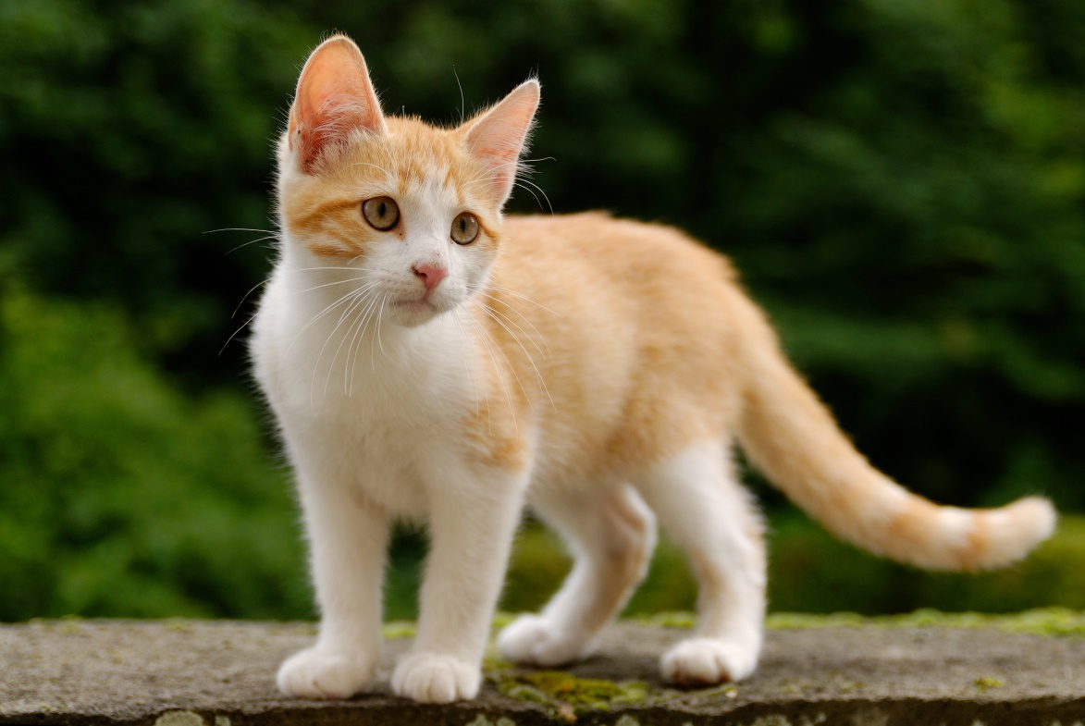
cat

Slide 7
hat

Slide 8
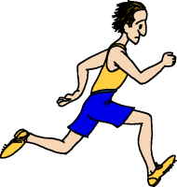
ran

Slide 9
bat

Slide 10
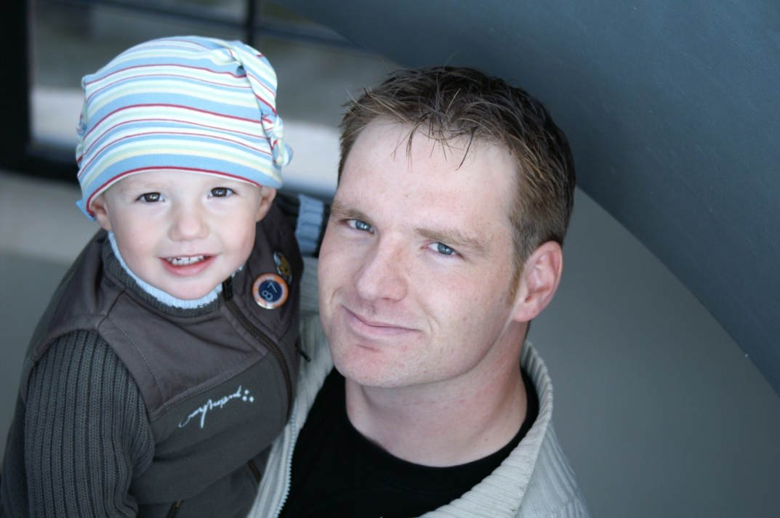
dad

Slide 11
mad

Slide 12
Challenge Words
not
does

