Slide 1
Unit 1, Week 5
Move It!
Spelling Words

Slide 2
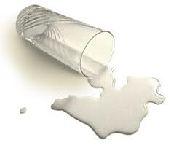
Spill

Slide 3
Spin

Slide 4
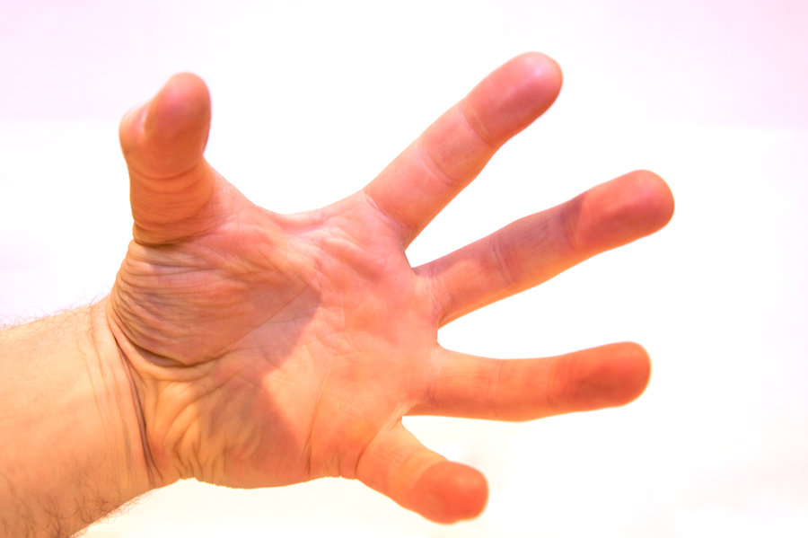
Grab

Slide 5
Grass

Slide 6
Drop

Slide 7
Drip

Slide 8
Frog

Slide 9
Swim

Slide 10
Trap

Slide 11
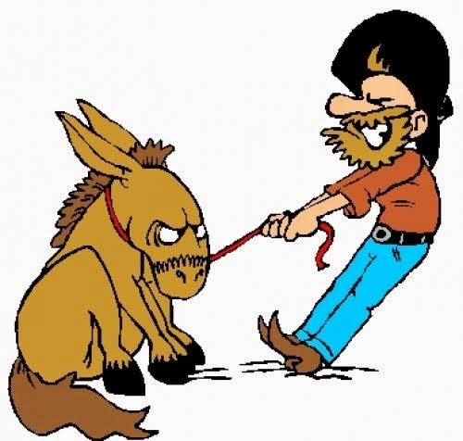
Drag

Slide 12
two move
Challenge Words

