Slide 1
Animal Teams
How do animals help each other?
Unit 4, Week 2

Slide 2
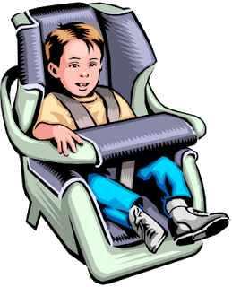
seat

Slide 3
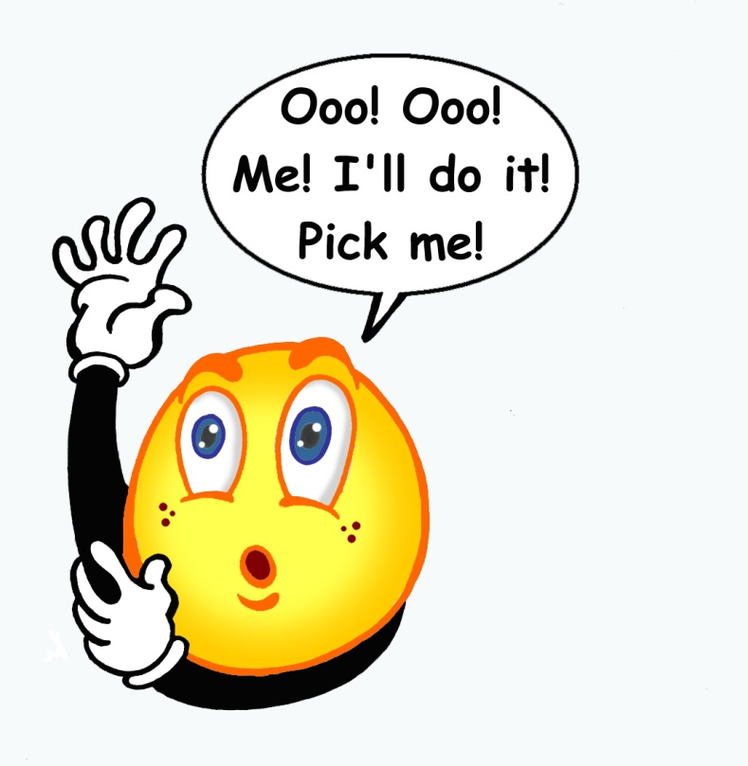
me

Slide 4
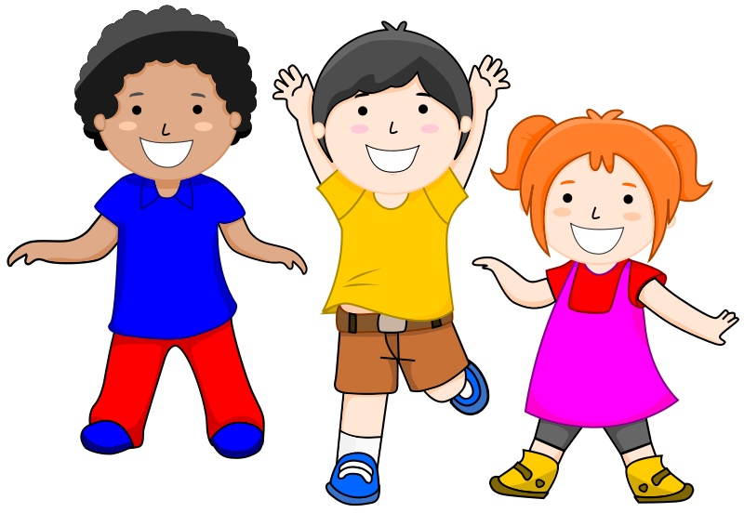
we

Slide 5
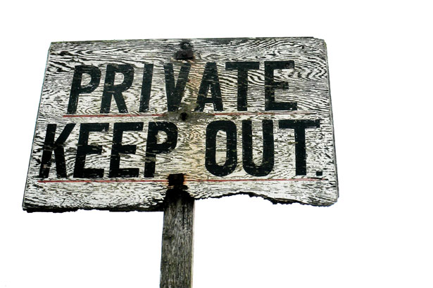
keep

Slide 6
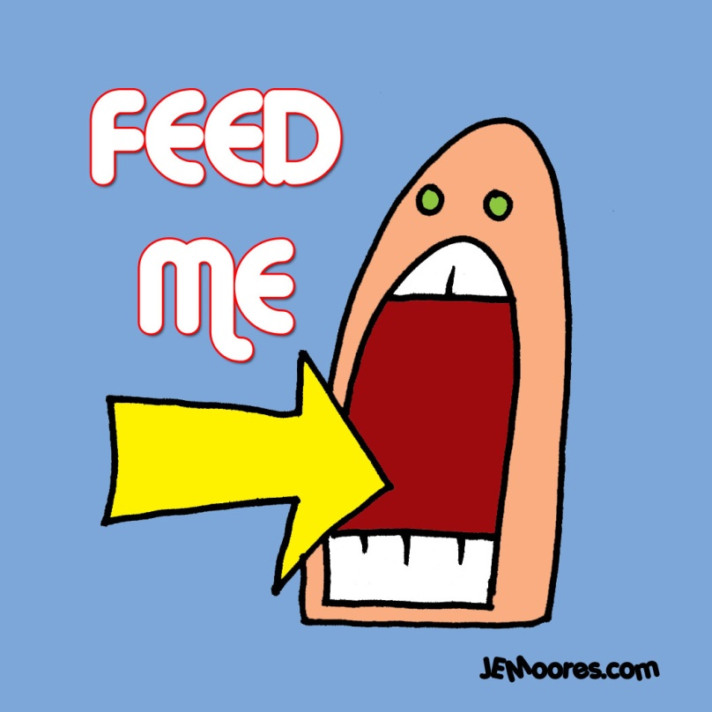
feed

Slide 7
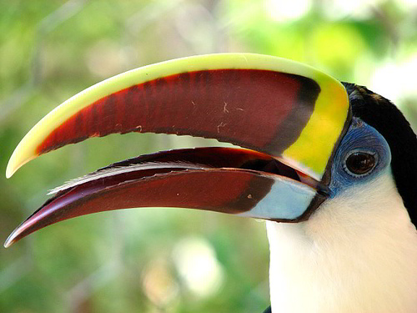
beak

Slide 8
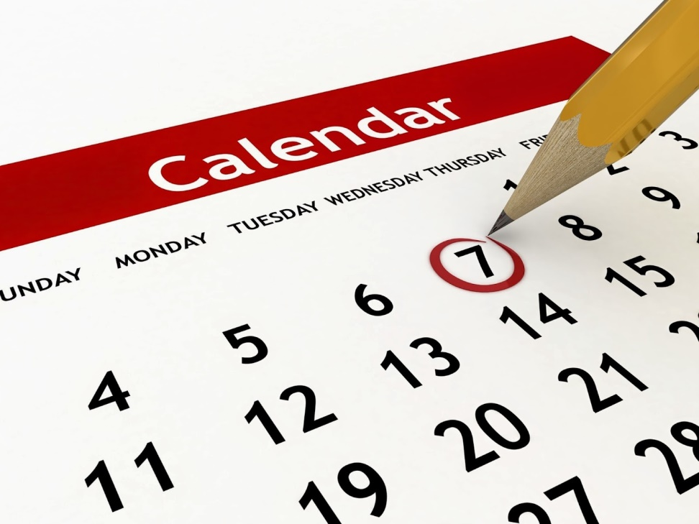
week

Slide 9
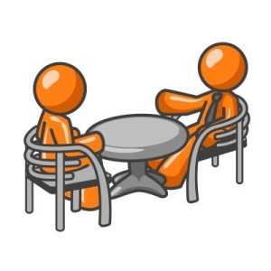
each

Slide 10
play

Slide 11
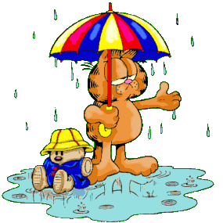
rain

Slide 12
High-Fequency Words
because
other

